Slide 1



Webinar #7
June 16, 2022
4:30 PM ET
Optimizing Use of Antipsychotics: Part Two
D2D and AMDA Team

Slide 2
Process for today
Participation encouraged! Please use the chat function.
  This session is being recorded and slides will be available soon

Slide 3
Optimizing Use of Antipsychotics: Part Two
Nicole J. Brandt, PharmD, MBA, BCGP, BCPP, FASCP
Professor, University of Maryland School of Pharmacy
Executive Director, Peter Lamy Center Drug Therapy and Aging
Senior Care Pharmacist, MedStar Center for Successful Aging
Email: nbrandt@rx.umaryland.edu
Lamy Website: https://www.pharmacy.umaryland.edu/centers/lamy/
Chad Worz, PharmD, BCGP
Chief Executive, ASCP
Email: cworz@ascp.com

Slide 4
A Decade Later: National Initiative to Reduce Antipsychotics: Research, Clinical, and Policy Discussion

Slide 5

Patient Story

Slide 6
Patient Story
This is a 76 yr old man who was hospitalized 2 months ago with urinary tract infection and developed delirium. Currently residing at skilled nursing facility (SNF) for rehab with goal of moving home with his family.
PMH: Chronic pain, hypertension, anxiety, depression, dyslipidemia, dementia NOS, BPH
SH: Born in Vietnam; Son (pharmacist) and daughter (teacher). He fought in the Vietnam War and primarily speaks Vietnamese. Denies alcohol or illicit substance use. Smoked but quit 5 years ago.

Slide 7
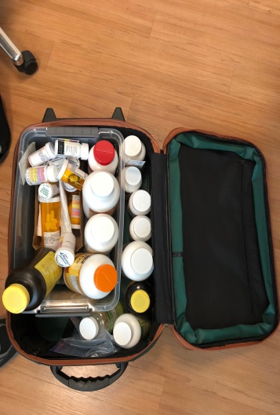
Medication History
Medication taking behaviors: Prior to his hospitalization was NOT taking medications. Does NOT like to take meds.
Medication List
Acetaminophen 500mg 1 tablet threes times daily for chronic pain
Gabapentin 300mg in the morning and evening for pain
Amlodipine 2.5mg 1 tablet daily for blood pressure
Losartan 100mg daily for blood pressure
Metoprolol succinate 100mg daily for blood pressure
Atorvastatin 40mg 1 tablet daily for cholesterol
Escitalopram 20mg daily for depression/anxiety
Lorazepam 0.5mg at bedtime for anxiety
Quetiapine 25mg in the morning and 50mg at bedtime for irritability
Tamsulosin 0.4mg 1 capsule daily for BPH
Centrum Silver tablets for health.
Tramadol 50mg every 8 hours for pain

Slide 8

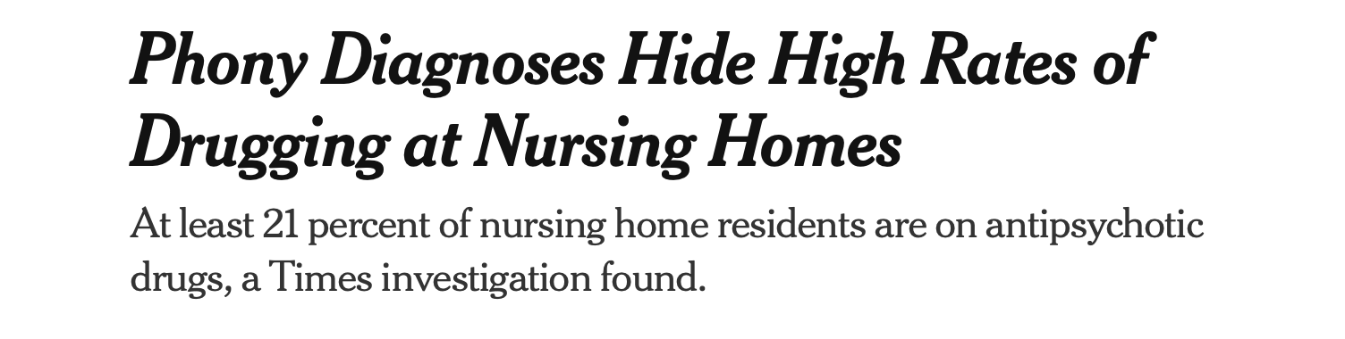
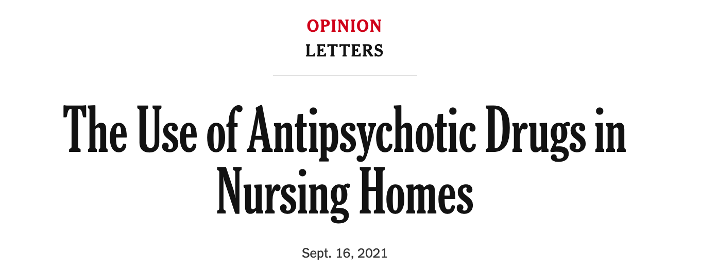
Real or Fake News??
Headlines on 9/10/14: Near Death and Overmedicated- NYTimes.com
BY PAULA SPAN
Why are patients with advanced dementia so often receiving ?medications of questionable benefit??
https://www.nytimes.com/2021/09/11/health/nursing-homes-schizophrenia-antipsychotics.html
https://www.nytimes.com/2021/09/16/opinion/letters/antipsychotic-drugs-nursing-homes.html

Slide 9
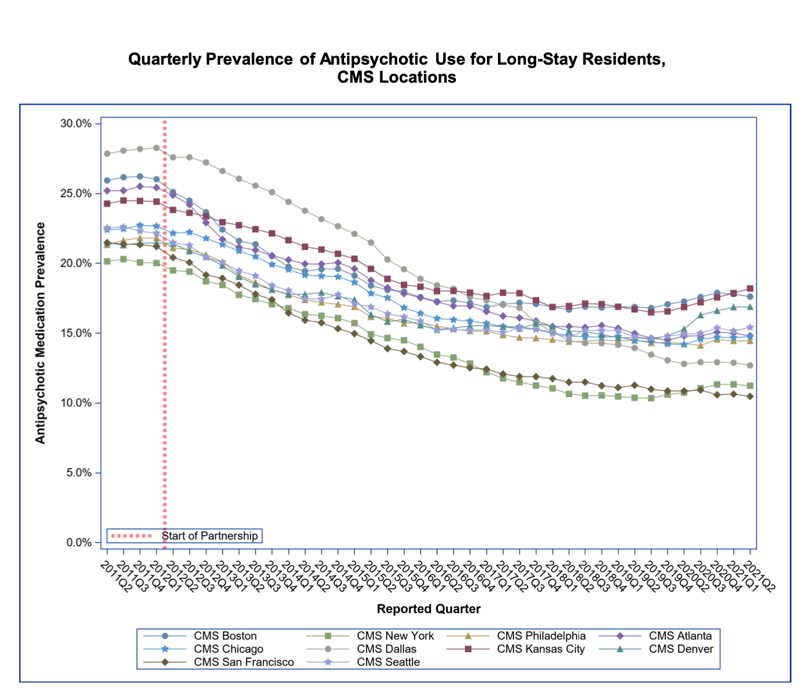
CMS National Initiative: A Public-Private Partnership
CMS and partners developed a national action plan to improve dementia care, behavioral health and to safeguard nursing home residents from unnecessary antipsychotic drug use
By increasing focus on person-centered (non-pharmacological) interventions for behavioral health in nursing homes, CMS reduced unnecessary antipsychotic medication use in nursing homes and eventually other care settings as well

Slide 10
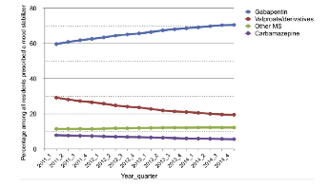
Unintended Consequences…
Overall Psychotropic Use
Focus on Mood Stabilizers
Maust, Kales et al. JAMA Internal Med 2018
Gerlach, Kales, Maust, et al. JAMDA 2020

Slide 11
Association of the Antipsychotic Reduction Policy on Long-Term Care Nursing Home Facilities:
Methods and Results

Slide 12
Research Team
Northeastern University
Becky Briesacher, PhD ​
Ben Koethe, MPH
University of Maryland, Baltimore​
Linda Wastila, PhD (PI)
Nicole Brandt, PharmD, MBA (Co-Inv)
Danya Qato, PhD, PharmD, MPH (Co-Inv)
Barbara Zarowitz, PharmD (Co-Inv)
Sarah D. Holmes, PhD, MSW
Abree Johnson, MS, MBA
Zhaoyong Feng, MS
Jeanne Yang, MCP
Fellows and Trainees
Aida Kuzucan, PharmD
Sean Fleming, MSW
Abisola Olopoenia, RN, MPH
Alexandra Wallem, PharmD, MS
Aaron Carabajal-Johnson, PharmD
Paavani Jain, MP, MPH
Consultants
Susan Levy, MD, CMD ​
Abhilash Desai, MD ​
Judith A. Lucas, EdD, RN, GCNS-BC
This research is funded by the National Institute on Aging: 1R01AG060939-01 (PI: L Wastila)
This presentation will discuss the off-label use of antipsychotics in older adults with dementia.

Slide 13
Study Aims
To predict the impact of a national antipsychotic reduction initiative (ARI) on antipsychotic and PPM use patterns
1) in nursing home residents, by population-level characteristics
Antipsychotic reductions experienced at the population-level are accompanied by changes in use of other PPM classes.
2) in nursing home residents, by facility-level characteristics.
Antipsychotic reductions resulted in fewer falls/ fractures, hospital/ED visits, and death.
Antipsychotic use reductions are greatest in facilities with high nursing staff: resident ratios.
Antipsychotic and PPM use is lowest in facilities with ADRD supports (e.g., dementia units).
3) and person-centered health outcomes in nursing home residents.

Slide 14
CMS Data - Medicare
LTCFocus data (compiled by Brown University)
Medicare administrative claims
(2010-2016)
MDS 2.0 (2010-2012)
MDS 3.0 (2012-2016)
Nursing Home Compare
1,068,542 facility-months of Medicare prescription and treatment claims
892,202 residents with > 100-day NH stays and
12,874 facilities

Slide 15
AIM 1: Population Level

Slide 16
Aim 1 – Population-level Findings
Antipsychotics, as well as a number of PPM categories, were decreasing prior to the ARI, and continued with similar slopes post-ARI
Little substitution of antipsychotics with other psychopharmacologic medications (PPM)
  Anticonvulsants/mood stabilizers showed most evidence of “filling in” for reduced antipsychotic use post-ARI, with infrequently-used muscle relaxants also increasing post-ARI
Emerging evidence some nursing facility populations inappropriately experiencing reduced antipsychotic use, including exempt (residents with schizophrenia, Huntington’s, and Tourette’s), bipolar disorder, and those suffering acute psychosis

Slide 17
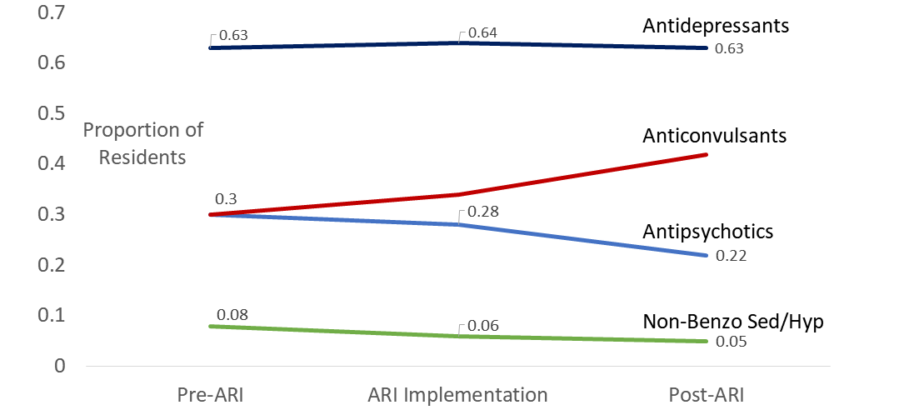
Adjusted Relationships of Change in Psychopharmacologic Use in Nursing Homes Post National Partnership Policy
Notes:
Statistically significant relationships were detected for the slope changes pre- and post-ARI for antipsychotics and anticonvulsants but not for the other psychopharmacologic agents. Anticonvulsant use moved in reciprocal to antipsychotics pre- and post-ARI

Slide 18
Population Level: Clinical Implications and Considerations
  Antipsychotic use decreasing prior to ARI
    Use declined in past for typical antipsychotics before atypicals available
  Anticonvulsants/mood stabilizers filling in
    Indications for Use: Better results vs Contributing to Polypharmacy
    FDA Safety
    ? Impact on morbidity and mortality
  QAPI Opportunities:
    Should not see an increase in other PPM when monitoring drug usage in QA&A
    Provide prescribers with data and hold behavioral health practitioners accountable for their medication recommendations

Slide 19
AIM 2: Facility Level

Slide 20
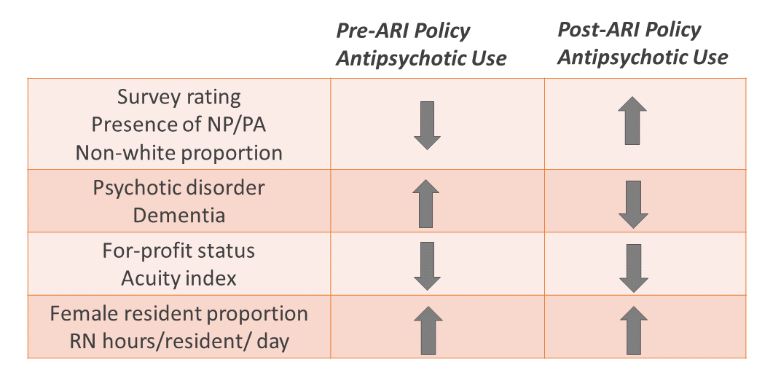
Summary Findings from the Multivariate Model

Slide 21
Facility-level Characteristics and Antipsychotic Use
Facilities with the fewest survey deficiencies (i.e., rating of 5) showed the greatest pre-ARI reduction and greatest post-ARI increase in AP use
AP use increased with increasing RN hours/resident/day pre- and post-ARI but was unrelated to LPN hours/resident/day and decreased with increasing CNA hours/resident/day pre-ARI only
AP use decreased with increasing age but average age was not associated with the change in AP use pre- or post-ARI
AP use increased post-ARI with the proportion of non-white residents
AP use increased with the proportion of residents who were dually eligible however, the rate of change in AP use pre- and post-ARI was unrelated to dual eligibility
AP use decreased with increasing acuity index pre- and post-ARI

Slide 22
Significant Changes in Characteristics Pre- and Post-ARI
Despite a 4.2 point decrease in antipsychotic use from 2010-2016:
  there was a significant increase in the prevalence of schizophrenia, bipolar disorder, psychosis, and dementia; and
  registered nurse, licensed practical nurse and CNA hours/resident/day all increased from pre-ARI to post-ARI.
Did the increase in nursing staff hours offset the need for antipsychotics in residents with higher prevalence of serious mental illnesses through nonpharmacologic interventions?

Slide 23
Facility Level: Clinical Implications and Considerations
There are modifiable NH characteristics associated with changes in antipsychotic use pre- and post-ARI
Previously identified factors (i.e., higher survey rating, presence of NP/PA on site, greater prevalence of females, and higher RN hours/resident/day) showed increasing trends of antipsychotic use post-ARI
Factors associated with higher antipsychotic use in the literature (e.g., for profit status, higher acuity index, and proportion of residents with psychosis or dementia) were associated with lower antipsychotic use in our study
Sustainable care models (e.g., staffing hours; provider types) that best meet the needs of this population remain to be defined.

Slide 24
QAPI Opportunities
Diagnosis
  Increase in prevalence of major mental health diagnosis
    Over diagnosis to improve facility quality measures-diagnostic inaccuracy
    Improved behavioral health diagnosis
Social Determinants of Health
  Evaluating prescribing of psychoactive medications among non-white and dually eligible
Staffing
    RN/LPN
    CNA – key staff in behavioral health non-pharmacologic management
    NP/PA/special care units
    Training/Education

Slide 25
More work to be done…..

Slide 26


Center for Medicare & Medicaid Services (CMS)

Slide 27
Psychoactive Appropriate Use for Safety & Effectiveness
Effective, evidence based, measurable solutions for long term care
Advocacy to members of Congress
Engagement with the Centers of Medicare and Medicaid Services (CMS)
Education and training of clinicians and caregivers

Slide 28
The History of Antipsychotic Management by CMS
Established the National Partnership to Improve Dementia Care in Nursing Homes in 2012
  Set goals (latest a 15% reduction in APs by2019)
  Provide resources
  Educational Webinars
Set for refinement/new goals

Slide 29
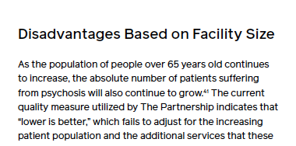
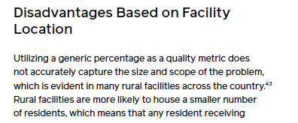
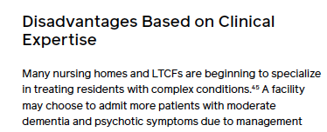
Current Inequities

Slide 30
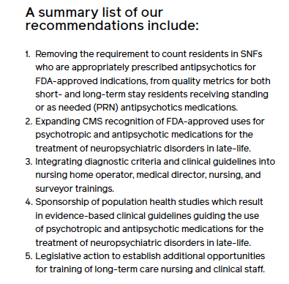
Shovel Ready Solution

Slide 31

Questions and Discussion
Please use the chat box or raise your hand

Slide 32
Deprescribing Spearhead Group
Opportunity to recognize high performing PALTC centers
  Draw their experience into our monthly Drive to Deprescribe discussions
Please contact our D2D Team through the form below to share your deprescribing success stories and strategies during future Drive to Deprescribe discussions:
  https://amda2015.wufoo.com/forms/contact-the-d2d-work-group/

Slide 33
Next D2D Progress Update and Webinar
July 21st (4:30-5:15pm EST) – Progress Update
August 18th (4:30-5:15pm EST) – D2D Webinar

