Slide 1
Progress Update #8
September 15, 2022
4:30 PM ET
Sharing Strategies, Successes and Secrets
D2D and AMDA Team

Slide 2
Process for today
Participation encouraged! Please use the chat function.
This session is being recorded and slides will be available soon

Slide 3
Drive to Deprescribe
KIM RATLIFF

Slide 4
Review each individual resident
Is there anything unnecessary?
Is there anything that could be less frequent?
Can we decrease any doses?

Slide 5
A different approach
Medication classification review

Slide 6
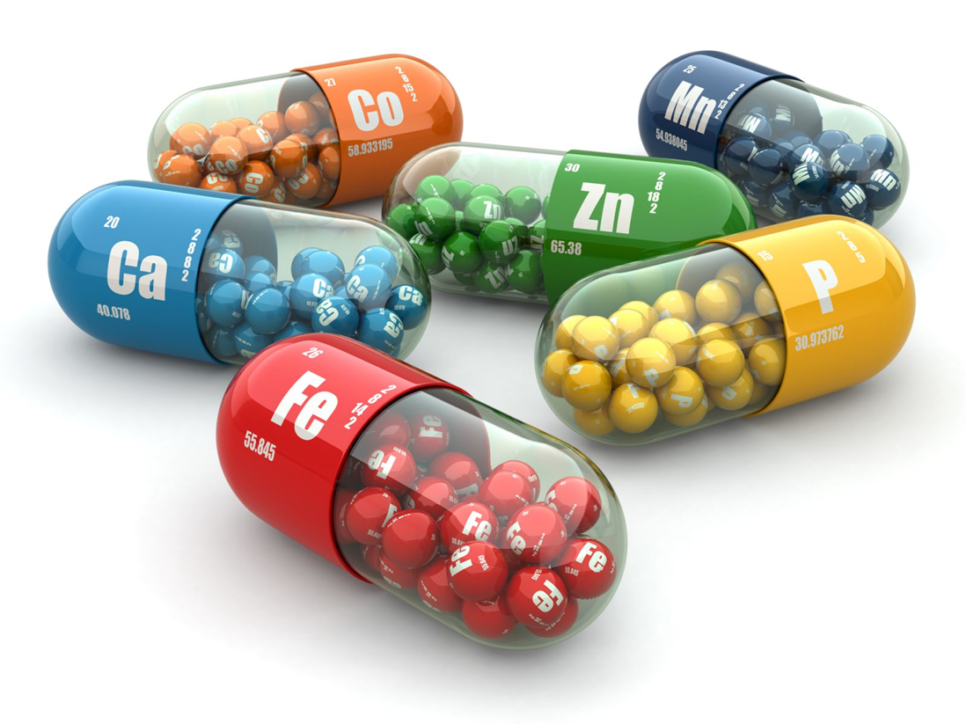
Vitamins and Minerals
Dietician suggestions
Physician approval

Slide 7
Proton Pump Inhibitors
Gather a list of residents on this class of medication and remove those with:
History of GI bleed
Actual GI upset
Once the list of PPI’s are reviewed by the doctors, discontinue the medication and replace with 3 days of Maalox.

Slide 8
Alternative Medications
What is the benefit?
Is it beneficial to the original purpose?

Slide 9
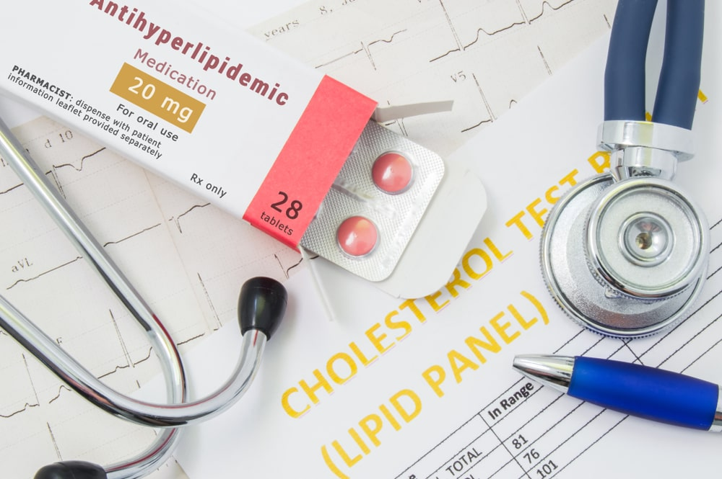
Antihyperlipidemic Medications
When skilled nursing residents average age is 85 and older,
What are the risks?
What are the benefits?

Slide 10
Allergies, Colds and Coughs
Often these medications are ordered for an acute event and never looked at again

Slide 11
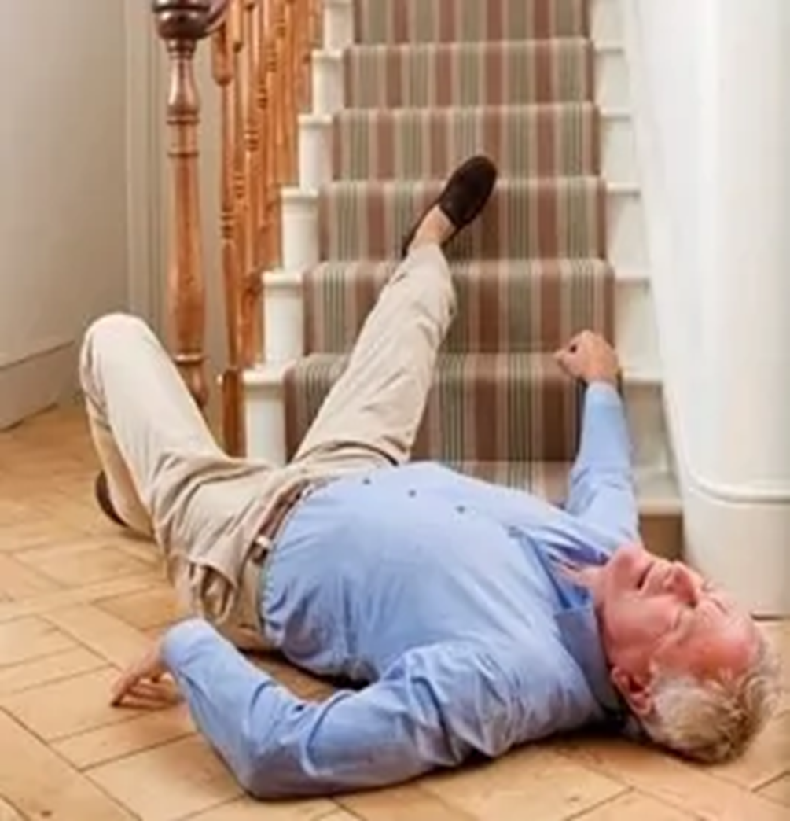
Anticoagulants including aspirin
When residents are prone to falling,
What are the risks?
What are the benefits?

Slide 12
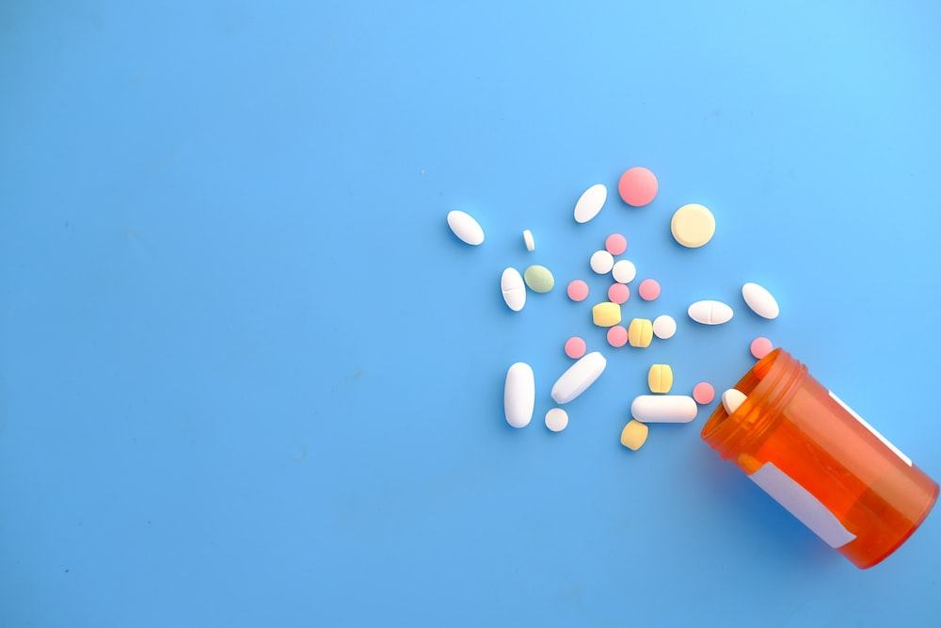
Psychotherapeutic Medications
What is the status of the resident's dementia?
What are the risks?
What are the benefits?

Slide 13
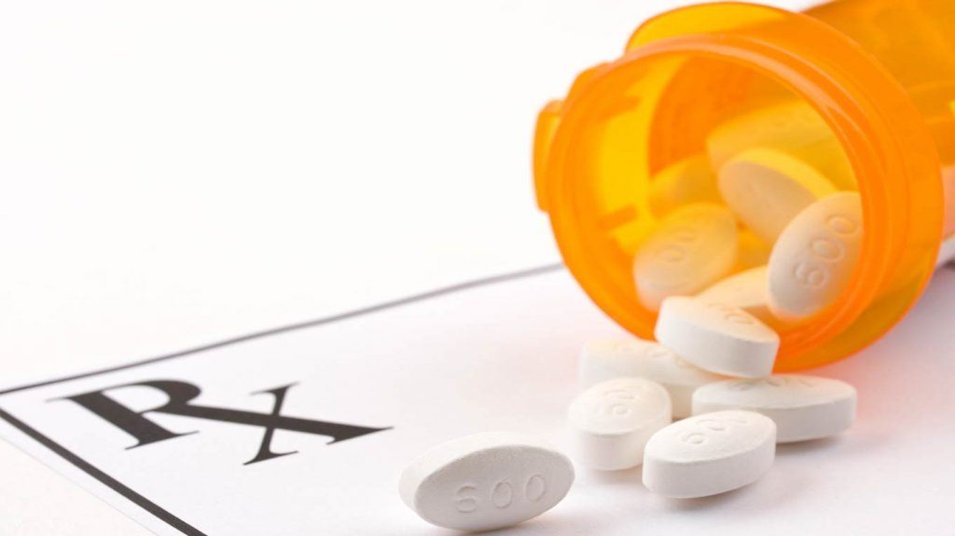
Psychotropic Medications
Review the list of residents that are on this class of medications monthly
Psychiatry will review the residents who are on multiple psychotropic medications

Slide 14
Urinary Medications
If the resident is incontinent, are they still needed?

Slide 15
Bowel Medications
When one thing doesn’t work, we add medications which may not be necessary!

Slide 16
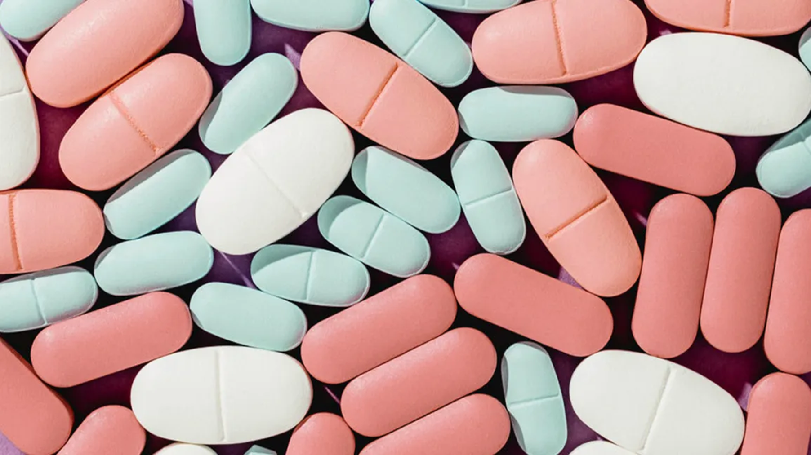
Hospice
Review the medication profile for residents on hospice every month

Slide 17
Thank you!
Please let me know if you have any questions!

Slide 18
Next D2D Webinar and Progress Update
Statins, Aspirin, and Antihypertensives
October 20th
4:30-5:15pm ET
Sharing Strategies, Successes and Secrets
November 17th
4:30-5:15pm ET

