Slide 1

JOINT PROVIDERSHIP
NEW APPLICATION
Updated Standards Reminder
Mitigating Disclosures
New Standards & Rules
Beginning January 1, 2022

Slide 2

Application Updates
Updated 1.23.24
About the Activity
New! Description Field
Expanded types
Educational Design
Updated MOC Formats
Relevant Gap Worksheet
ABIM MOC Guidance
Finances & Budget
New! No More Budget Worksheet
Series of Check Boxes Instead
Post-Activity Complete Package
AMDA handles all of the evaluation, credit claim, compliance, certificates, and reporting!
Upgrade required
We’ve gotten really good reviews ☺
You just provide a link and/or QR code to your attendees!
Commendation Criteria Section – Internal to AMDA
Disclosures
Enhanced Instructional Worksheet
Mitigation Options Provided
NO LONGER AVAILABLE

Slide 3
ACCME Standards for Integrity and Independence in Accredited Continuing Education
Accredited Education
Manage Commercial Support
Manage Ancillary Activities
Encourages discussing new/evolving topics
Must disclose this
Actively chosen by attendees
30-minute buffer
Label not for CME
Opt-In for contact info
Expanded opportunities
Valid Content
Mitigate Financial Relationships
ALL relationships within 24 months
Review relationships for relevance
Updated disclosure statement
Prevent Commercial Bias & Marketing in Accredited Education
Ineligible company changes
Free of marketing
Free of sales of products & services
ACCME Standards for Commercial Support

Slide 4
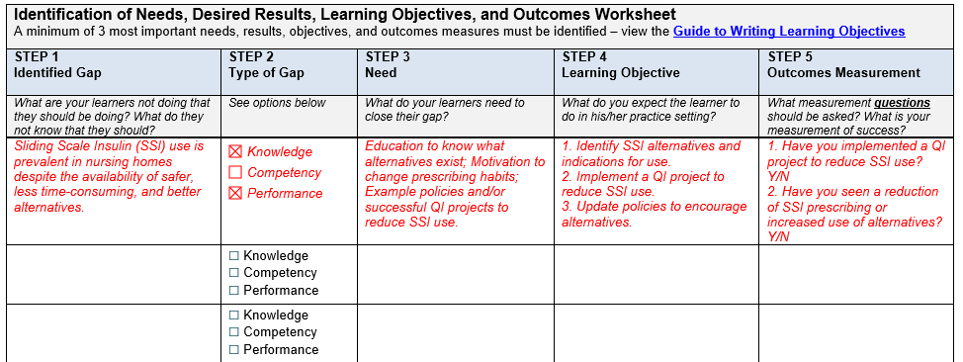
Updated Gap Worksheet

Slide 5
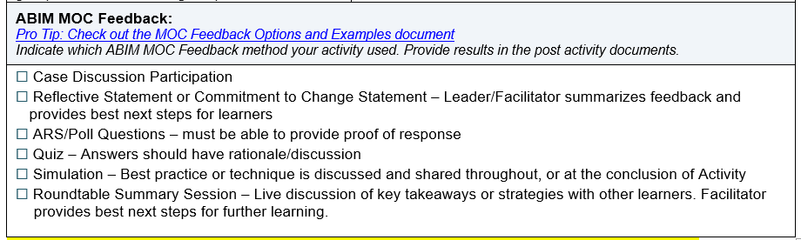
ABIM MOC Guidance

Slide 6
Mitigate Financial Relationships
Mitigate Financial Relationships
ALL relationships within 24 months
Review relationships for relevance
Updated disclosure statement

Slide 7
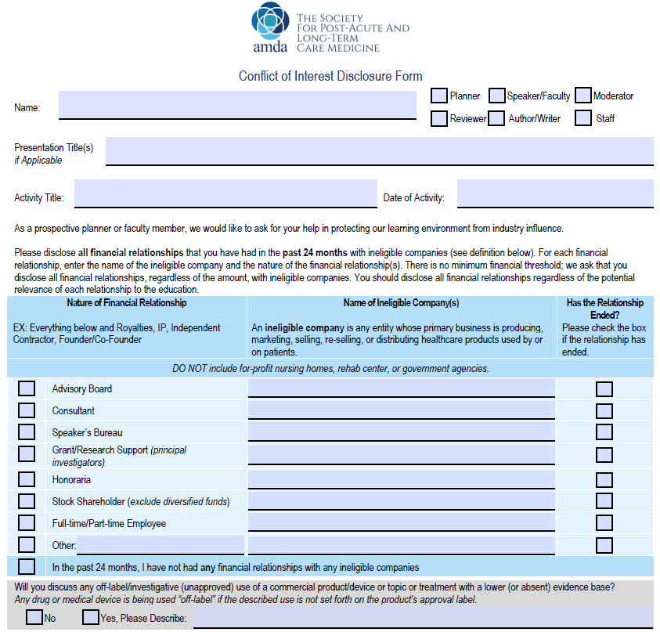

Are you using the right form?
Yep, we have a template for that!

Slide 8
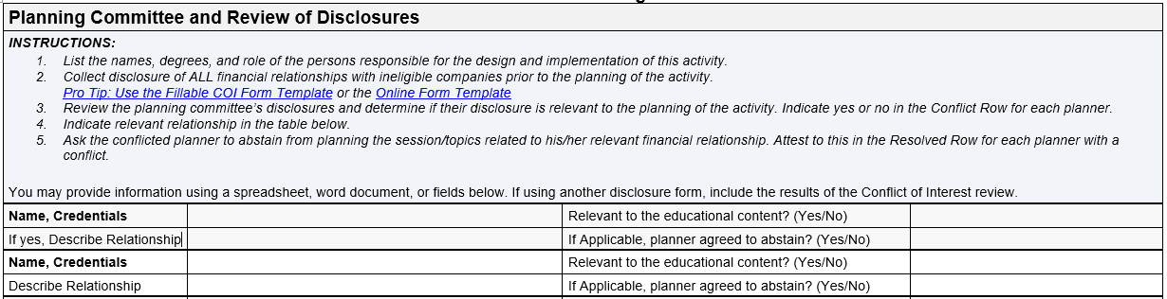
Planner Disclosures

Slide 9
Relevant Financial Relationships
Identify
Mitigate
Disclose

Slide 10
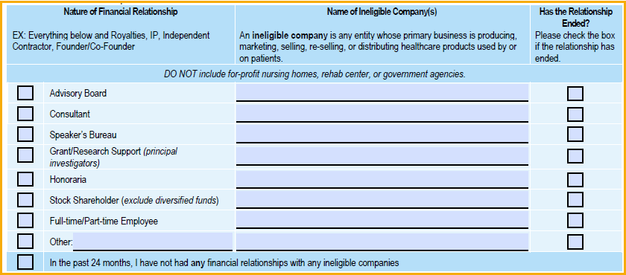


Poll Question
Steve Smith, NP
Name: Steve Smith, NP
Role: Planner
Planner for Presentation/Abstract Title: Annual Conference
Annual Conference Program includes: Sliding Scale Insulin: New Diabetes Management; Working Together as an IDT; Appreciation Goes a LONG Way; Aid in Dying
UnitedHealth Group
Identify

Slide 11
Mitigate Financial Relationships
Identify
No
Disclose

Slide 12
Relevant Financial Relationships
Identify
Mitigate
Disclose

Slide 13
Poll Question
Mickey Mouse, RN
Name: Mickey Mouse, RN
Role: Planner
Planner for Presentation/Abstract Title: Annual Conference
Annual Conference Program includes: Sliding Scale Insulin: New Diabetes Management; COVID-19 Vaccines; Working Together as an IDT; Appreciation Goes a LONG Way; Aid in Dying
Pfizer
Identify

Slide 14
Mitigate Financial Relationships
Identify
Yes
Disclose

Slide 15
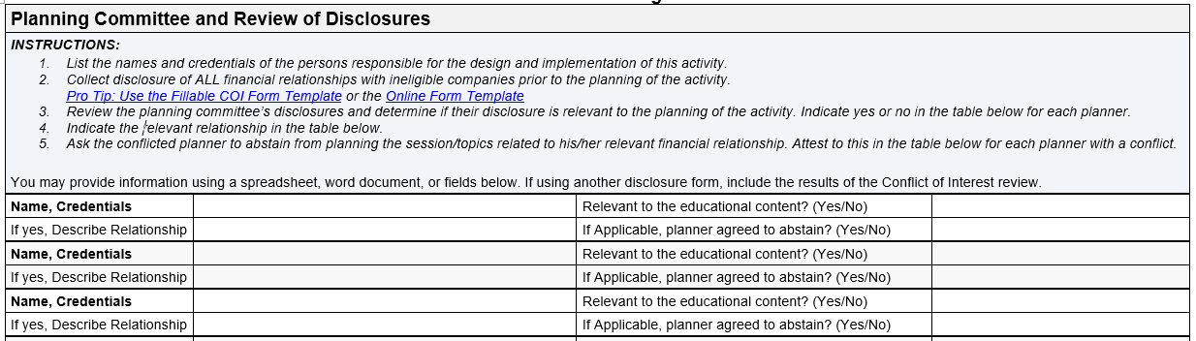
Planner Disclosures
Steve Smith, NP
No
Mickey Mouse, NP
Yes
Pfizer, Honoraria
Yes

Slide 16


How to disclose financial relationships
For Planners?
Name: Steve Smith, NP – UnitedHealth Group, Stockholder
Role: Planner
Name: Mickey Mouse, RN – Pfizer, Honoraria
Role: Planner
Disclosure:
The following planner(s) have relevant financial relationships:
Mickey Mouse, RN – Honoraria, Pfizer
All other planners have no relevant financial relationships.
All relevant financial relationships have been identified, mitigated and resolved.
Logos and/or promotional messages should not be included in the disclosure or visible at the same time as the disclosure.
Must be provided to learners before the education starts.
Providing of disclosure must be verifiable.
Must include this phrase: “All relevant financial relationships have been identified, mitigated and resolved.”
Disclose

Slide 17
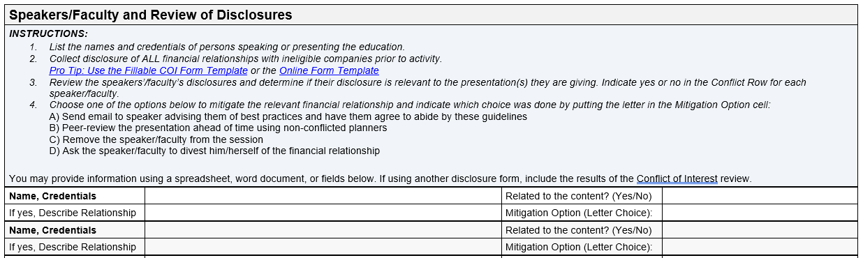
Speaker Disclosures

Slide 18
Relevant Financial Relationships
Identify
Mitigate
Disclose

Slide 19
Identifying Relevant Financial Relationships
Poll Question
Name: Sarah Sample, MD, CMD
Role: Faculty/Presenter
Presentation/Abstract Title: Sliding Scale Insulin: New Diabetes Management
Sanofi
NIH
Signature HealthCare
Identify

Slide 20
Mitigate Financial Relationships
Identify
Mitigate
Disclose

Slide 21
Poll Question
Speaker Disclosures
Sarah Sample, MD, CMD
Yes
Advisory Board, Sanofi
B
Yep, we have a template for that!

Slide 22
Disclose Financial Relationships
Identify
Mitigate
Disclose

Slide 23
How to disclose financial relationships
For Faculty/Speaker?
Name: Sarah Sample, MD, CMD – Advisory Board, Sanofi
Role: Faculty/Speaker
Disclosure:
The following speaker(s) have relevant financial relationships:
Sarah Sample, MD, CMD: Advisory Board, Sanofi.
All relevant financial relationships have been identified, mitigated and resolved.
Logos and/or promotional messages should not be included in the disclosure or visible at the same time as the disclosure.
Must be provided to learners before the education starts.
Providing of disclosure must be verifiable.
Must include this phrase: “All relevant financial relationships have been identified, mitigated and resolved.”
Disclose

Slide 24
How to disclose ALL financial relationships?
Name: Sarah Sample, MD, CMD (Speaker) – Advisory Board, Sanofi
Name: Steve Smith, NP (Planner) – UnitedHealth Group, Stockholder
Name: Mickey Mouse, RN (Planner) – Pfizer, Honoraria
Disclosure:
The following planners & speakers have relevant financial relationships:
Sarah Sample, MD, CMD (Speaker): Advisory Board, Sanofi.
Mickey Mouse, RN (Planner) – Pfizer, Honoraria
All other speakers and planners have no relevant financial relationships.
All relevant financial relationships have been identified, mitigated and resolved.
Logos and/or promotional messages should not be included in the disclosure or visible at the same time as the disclosure.
Must be provided to learners before the education starts.
Providing of disclosure must be verifiable.
Must include this phrase: “All relevant financial relationships have been identified, mitigated and resolved.”
Disclose

Slide 25
Relevant Financial Relationships:
What does AMDA need?
Identification of Relevant Financial Relationships for Speakers/Planners
(Worksheets)
Mitigation Process Documentation
(Worksheets)
Disclosure Provided to Learners
(Document)
Yep, we have a template for that!

Slide 26
I liked the budget worksheet!
Section 5: Finances and Funding Update

Slide 27
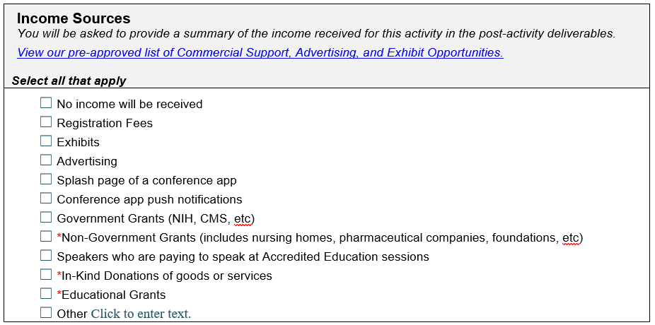

Income Sources
Commercial Support?
Ask if you need help!
Yep, we have a list for that!

Slide 28
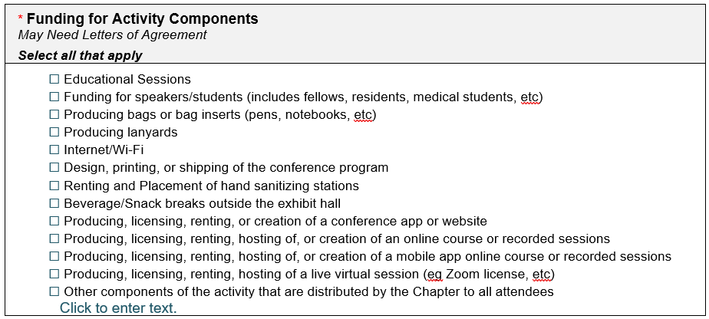
What’s being funded?
Commercial Support?
Ask if you need help!
Yep, we have a list for that!

Slide 29
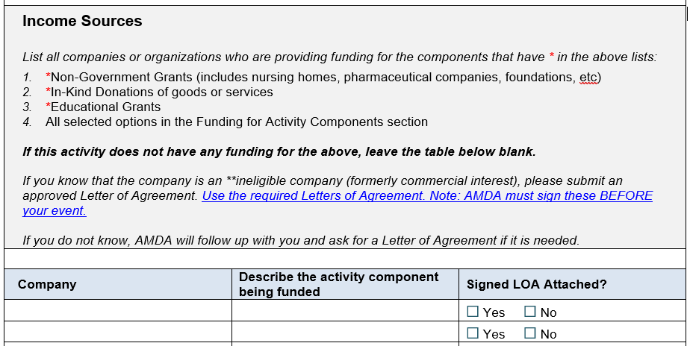

Let’s get specific
Ask if you need help!
Yep, we have a template for that!

Slide 30
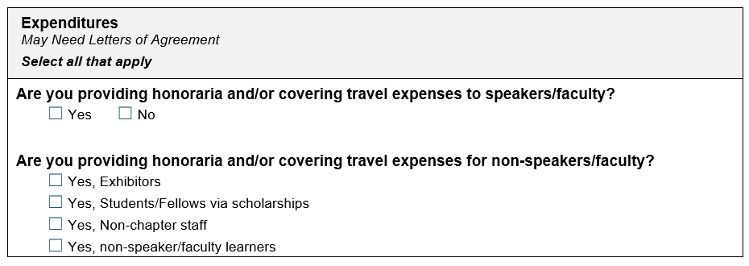
Who gets an honoraria/travel money?

Slide 31
Manage Commercial Support & Funding
Manage Commercial Support
Opt-In for contact info
Expanded opportunities

Slide 32
Must get consent to share names or contact information of learners
Compliant
Non-Compliant
  Adding checkbox on registration form
  Selling an ad spot in an exhibit hall promotion email
  Learners can give information to exhibitors/sponsors on their own
  Signs outside the exhibit hall that scanning a badge = opting-in
  Working with mail houses to rent lists to contact all learners
  Selling lists of learners to ineligible companies
  Pre-checking an “Opt-out” box
  Burying “Opt-in” language in a long list of terms
AMDA Needs: An example of how this is handled
Yep, we have a template for that!

Slide 33
Opt-in Recommended Language
By checking this box, I consent to have AMDA share my contact information with PALTC22 exhibitors & supporters.
AMDA relies on exhibitors and sponsors to help support the organization and the conference. We hope that you will opt-in to sharing your contact information with our supporters as they promote their presence at PALTC22.
Yep, we have a template for that!

Slide 34
Talking Money
PITFALLS
OPPORTUNITIES
No logos or other promotional material to be visible at the same time as disclosures.
AMDA needs to sign ALL Letters of Agreements.
Logos and ads cannot be visible at the same time as accredited education.
Placing logos on lanyards and bags if given out to all attendees by the provider.
Sharing contact information with exhibitors or supporters without an opt-in.
Allowing exhibitors or industry representatives to engage in discussion in the educational space.
Increased variety of eligible companies.
Any swag given out by exhibitors OR produced by exhibitors.
Use a company’s name as the Wi-Fi password.
Host paid for advertising or exhibit advertising on your activity’s homepage/schedule
Exhibit virtual breakout rooms chosen by attendees
Social walls
Competitions
Booths/paid for presentations
Yep, we have a list for that!

