Slide 1
From Surviving to thriving…
The Aftermath of COVID….
How do we move forward?
Will things ever be normal again?
Where has the joy gone?
¹Project ECHO. (2022). https://hsc.unm.edu/echo/what-we-do/about-the-echo-model.html

Slide 2
Today….
Dr. Beth A. Lown
Chief Medical Officer, The Schwartz Center for Compassionate Healthcare
Associate Professor of Medicine, Harvard Medical School
Beth Lown has been interested in empathy, compassion, collaboration and relational and communication skills since beginning medical school four decades ago. This interest has deepened over her many years of clinical practice, and as a health professional educator and researcher. She has been an active participant in many national organizations dedicated to improving these attributes and skills.
She is the chief medical officer of the Schwartz Center for Compassionate Healthcare, a nonprofit dedicated to strengthening the relationships among patients, families and clinicians and advancing compassionate health care. In this role she develops and implements programs, curricula and research. She speaks locally, nationally and internationally about empathy, compassion and communication, and teaches these attributes and skills to health professionals across the continuum of learning.
https://www.theschwartzcenter.org/speakers/beth-a-lown-md/

Slide 3
Sustaining Compassion and Calling
in the Midst of Crisis
Beth Lown, MD FACH
Chief Medical Officer, The Schwartz Center for Compassionate Healthcare
Associate Professor of Medicine, Harvard Medical School

Slide 4
About 8% of people who live in US long-term-care facilities have
died of COVID-19
nearly 1 in 12
For nursing homes alone, the figure is nearly 1 in 10

Slide 5
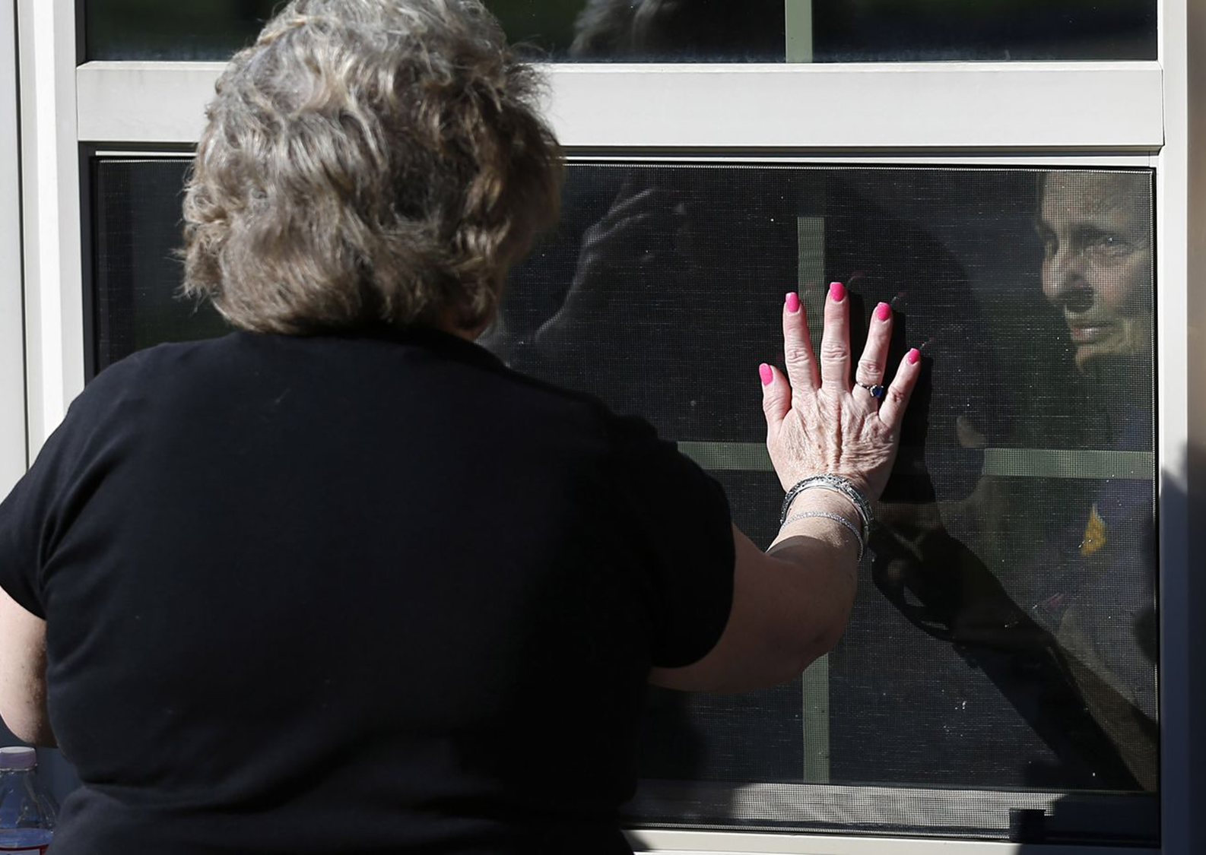
Notes:
Type into the chat

Slide 6
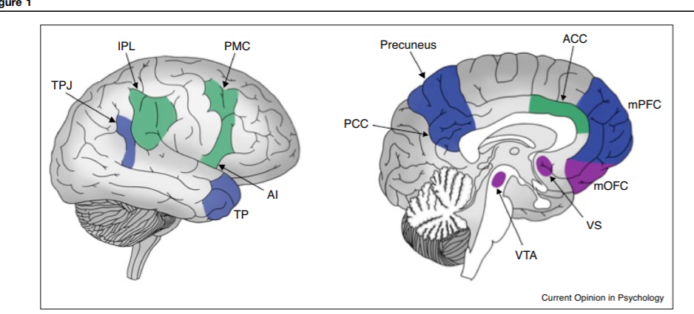
Emotional empathy
Cognitive empathy
Compassion
Weisz E, Zaki J. Curr Opin Psychol. 2018;24:67-71.

Slide 7
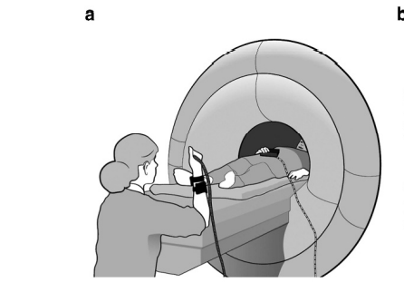
Prosocial Motivation,
Compassionate Behaviors
Overwhelm
Detachment
Avoidance
Burnout
Empathic Distress
Moral
Distress
Empathic Concern
Treatment Satisfaction,
Sense of Reward
Jensen K, et al. Molecular Psychiatry (2014) 19, 392–398.
Jensen et al. Translational Psychiatry (2020) 10:17.

Slide 8
Some Compassion Mediators Are Modifiable
Trait Empathy, Perspective-Taking Skills, Emotion Regulation, Implicit Bias
Organizational,
Systemic Constraints
Organizational Culture
Team/Unit Climate
Supervisor/Manager Support

Slide 9
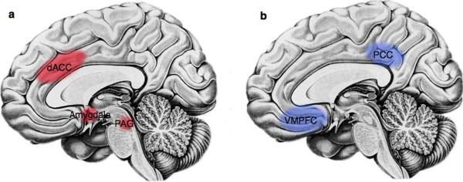
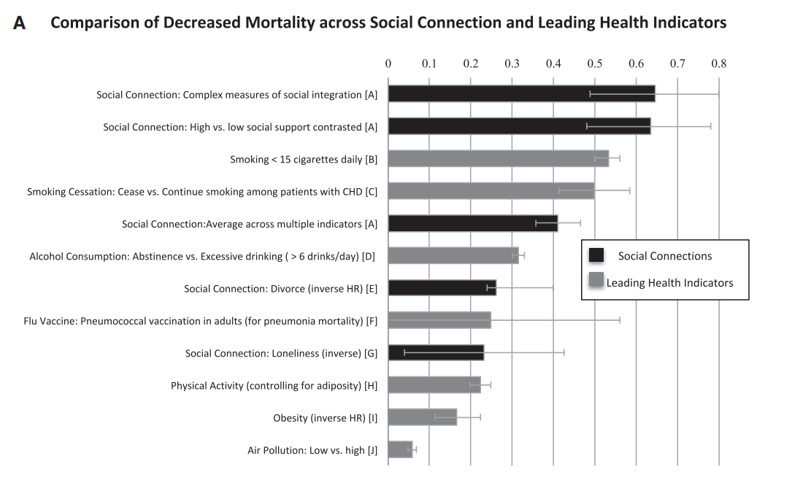
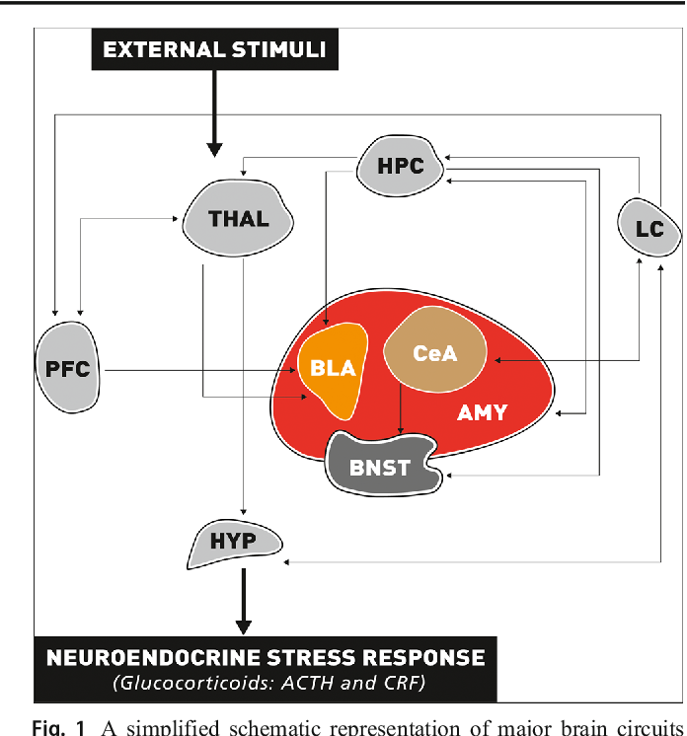
Let’s Focus on the Impact of Social Support on Traumatic Stress and Mortality
Notes:
Key drivers of burnout: Job demands, job resources, social support

Slide 10
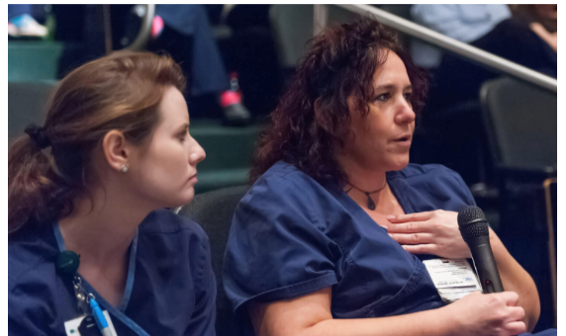
Evidence on the Impact of Fostering Cultures of Compassion and Social Support Schwartz Rounds® ^{1, 2} Stress First Aid ³ Supervisor/Manager Impact ⁴
1. Lown BA, Manning CF. Acad Med. 2010;85(6):1073-81.
2. Dawson et al. BMC Health Services Research. 2021; 21, 392.
https://doi.org/10.1186/s12913-021-06413-42021; 21:392.
3. Hooper JJ, et al. BMJ Open. 2021;11(5):e044134.
4. Barsade S, O’Neill OA. Admin Sci Quarterly. 2014; 59(4):551-598
Notes:
SRds are regularly scheduled, structured, facilitated conversations that bring caregivers together to discuss the most challenging and compelling aspects of what it’s like to take care of patients and their families. We teach organizational teams how to implement and facilitate these conversations, so participants are able to offer and to receive support and to feel heard. SRds are currently implemented in about 600 of our member organizations across the U.S., Canada, AU and NZ and through our partners in the UK in England, Ireland and soon in Scotland.
Evidence-Base: Schwartz Rounds® significantly impact: Significant correlations between frequency of attendance and outcomes
Enhanced teamwork, responsiveness, support, Decreased feelings of stress, isolation, Significant reductions in psychological distress scores (GHQ-12)
13% decrease in scores among participants vs. 3% decrease in non-participants; Odds of being identified as an individual needing clinical intervention 72% lower for participants c/w non.
SFA: Studies with frontline workers show improved psychological outcomes, perceived knowledge of coping strategies, connection with social support, reduced self-stigma c/w control groups.¹
Barsade: Wharton Professor of Management. Cultures in which employees show care, concern and compassion for each other in the face of pain, challenges, suffering. Also shown as a sense of interdependence, thinking about the team’s collective good, stepping up to help each other, feeling like a family. Study of a large not-for-profit LTC in the Northeast. Included 185 employees, 108 residents, 42 family members of patients; 13 units in 3 different geographical sites. Participants were MD, RN, CNAs, food service, social workers.

Slide 11
Welcome
Thank you for joining today’s session. A few notes:
Please turn on your camera if you are able.
Please remain muted when you’re not speaking.
Please use the “raise hand” function when you feel moved to speak – we’ll call on you to unmute.
We also invite you to participate via chat.
If y0u need help with Zoom, just send a message to the hosts and we’ll get right back to you!

Slide 12
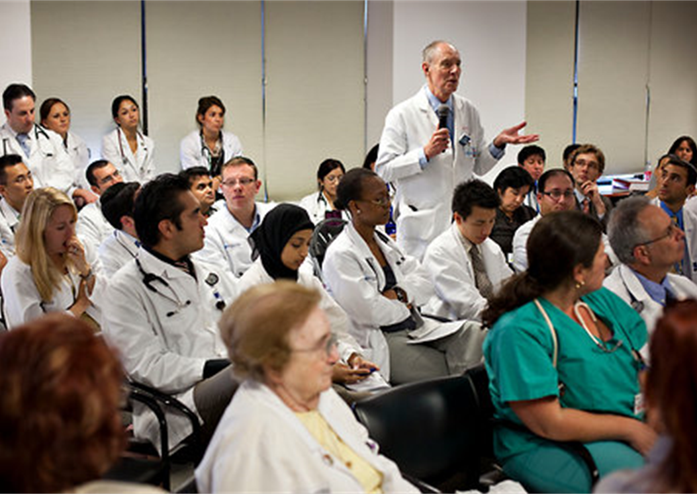
Community Guidelines
Honor this as a “brave space.”
Listen without judgement.
Speak from the heart.
Make space and take space.
Respect confidentiality.

Slide 13
Panelists
Leslie Eber, MD, Certified Medical Director
Orchard Park Health Care Center
Greenwood Village, CO
Serves on AMDA’s Board of Directors
Taylor McMahon, RN
The Willows
Pittsburgh, PA
Branden Fillbrook, Certified Nursing Assistant, Certified Preceptor
Trilogy Health in Michigan
Serves on NAHCA Board of Directors

Slide 14
Remember: Pause-Acknowledge-Support
Pause
Acknowledge grief and suffering
Offer compassion to yourself and others
Cultures of compassion are built on social support
balown@theschwartzcenter.org
www.theschwartzcenter.org

Slide 15
Coming Up….The next “M”: Mobility
June 23rd, 4p.m. ET
Erin Woodford, MSN, RN
Vice President of Population Health, Genesis
Ms. Woodford led Schuylkill Center to ANCC accreditation (Pathway to Excellence) as their Director of Nursing, making the center only 1 of 7 to achieve this accreditation in the United States. She was also the 2019 NADONA Nurse Administrator of the Year for the Northeast Region of the United States.
Erin will discuss the role that shared governance can play in staff retention and provide practical strategies to implement immediately.

