Slide 1
Welcome to our roundtable series. We’re glad you’re here.
Roundtable Discussion #3
June 23rd, 2022

Slide 2
Our Work Together
JoAnne Reifsnyder PhD, MSN, MBA, RN, FAAN
Professor, Health Services Leadership and Management
University of Maryland School of Nursing
Former Chief Nursing Officer, Genesis HealthCare

Slide 3
AFHS 4 “M’s” Applied to the Careforce
What Matters (e.g., facility culture, respect, a voice),
Medication (health promotion & workplace safety),
Mentation (wellbeing of staff with a focus on stress management and compassionate self-care), and
Mobility (opportunities for personal growth and career advancement with ongoing education),
Notes:
these focused, collaborative discussions will lead to the development of action plans to include concrete, practical steps that PALTC facilities can start taking immediately to build trust with current staff and recruit and retain new staff to grow and strengthen the PALTC workforce.

Slide 4
Roundtables to date…and coming up
April 28 Kick-off: The 4Ms Expanded for Staff
May 26 Sustaining Compassion & Calling in the Midst of Crisis: Schwartz Center Rounds
June 23 Career Mobility and Shared Governance
July 28 Health Promotion and Safety
August 25 Trauma-informed Care for our Careforce
Sept 22 Developing Leaders for the Future

Slide 5
To Level Set….
We are a community focused on co-design
“All teach, all learn”¹
Small tests of change
Collation and dissemination of insights
¹Project ECHO. (2022). https://hsc.unm.edu/echo/what-we-do/about-the-echo-model.html

Slide 6
More of a Good Thing: Career Mobility and Shared Governance Erin Woodford, MSN, RN Vice President of Population Health Genesis HealthCare

Slide 7
The Why.
Research has shown specific organizational factors influence staff retention.
compensation (monetary and non-monetary rewards)
job characteristics (skill variety and job autonomy)
training and development opportunities
supervisor support (recognition by and feedback from supervisors to employees)
career opportunities (internal and external career options an employee may have)
work–life balance (ability to meet both work and family commitments)
organizational commitment (employee's emotional attachment to, identification with, and involvement in the organization)
(Coetzee & Stoltz, 2015)

Slide 8
What is Shared Governance and WHY would it help?
Tim Porter O’Grady’s Shared Governance
Shared governance is about putting decision-making power in the hands of those who are most closely affected by those decisions, such as clinical issues to nurses.
The model encourages the use of evidence-based information and data to inform practice. Tim Porter-O’Grady believes a facility begins its journey to shared governance by structuring a sturdy framework based on accountability, equity, partnership, and ownership.

Slide 9
One example…….
Center Medical Team
Center Department Leadership

Slide 10
Be authentic and transparent
Live it, speak it, express it, incorporate the principles in your daily interactions.
“Walk the walk and talk the talk”- this is how we begin a culture shift…
Evaluate what you have….and begin.

Slide 11
Begin with ONE PIECE

Slide 12
Now let’s relate the concepts:
Shared Governance helps address: accountability, equity, partnership, and ownership
Retention is affected by:
job characteristics (skill variety and job autonomy)
training and development opportunities
recognition by and feedback from supervisors
internal and external career opportunities
work–life balance
organizational commitment (employee's emotional attachment to, identification with, and involvement in the organization)

Slide 13
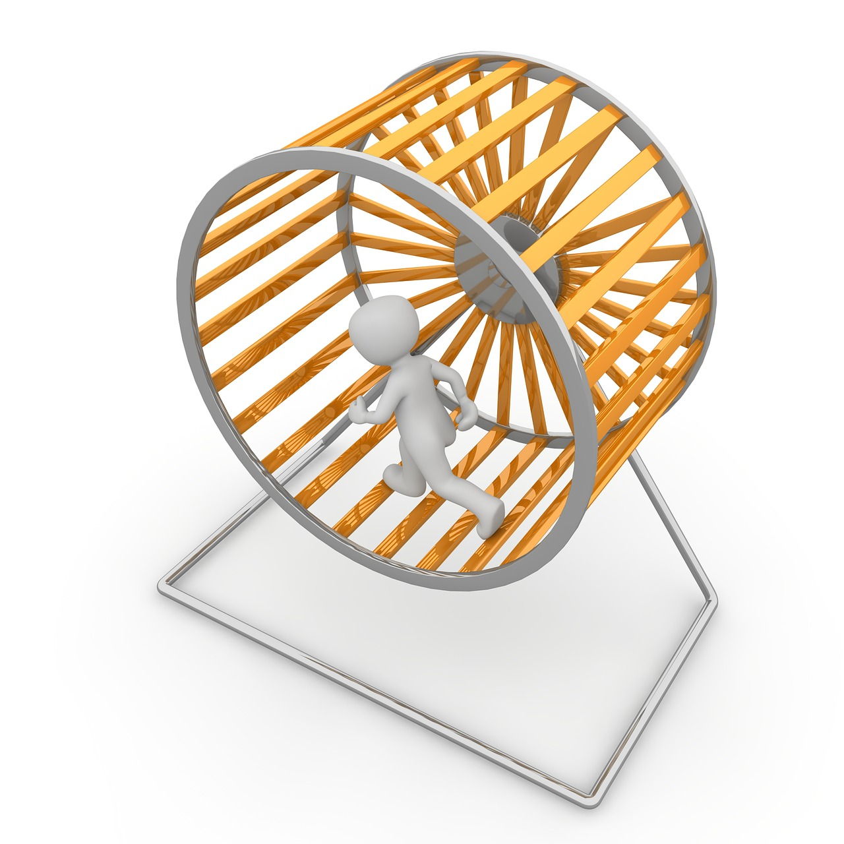
THEN CAME 2020….2021…2022….
skilled nursing industry losing staffing at record rates
healthcare access issues due to staffing shortages
staff burnout, fatigue, employees facing moral dilemmas
WE ALL LIVED THIS….we can go on and on

Slide 14
One Tool: Career Mobility
Upward, downward or lateral movement of employees across positions
Organizational/Center based programs that support career mobility can be a cost-effective strategy to increase morale, retention and attract future employees to our workforce
Programs that support ALL/ ANY movement desired by an employee are ideal.

Slide 15
Moving on….to the How
Assess what you have now…..and lean into it!!! Signs and occasional reminders of programs are not enough
Intentional, sustained conversation and communication, highlighting the programs are crucial
We need to walk the walk and talk the talk! CULTURE!!!!
Build new programs that are designed for each type of employee:
Those looking for career advancement
Those looking for lateral moves (temporary or permanent)
Destigmatize stepping down from a higher position to one of less responsibility

Slide 16
HINT: Ask what they want…. then start with a Mentor Program
We are here because of a mentor……
Building a true mentor program that incorporates training should be included in all career mobility programs
recognition of mentors (physical)
provides an avenue for relationship building and insight into employees, aspirations, aptitude and appetite for growth
Mentorship can/should be separate from training and orientation!!!

Slide 17
Mobility….
Lateral moves - temporary or permanent, make available to all staff based on predetermined criteria
Downward moves
Career Shadowing/Career Ladders: tuition reimbursement and career ladders tied to educational requirements
CNA ,CNA Level 1, CNA Level 2
Valuable certifications
LPN to RN to BSN
Don’t forget non-nursing career progression
Educational Opportunities: Industry conferences

Slide 18
Real Life Examples:
Lateral career ladders designed to highlight expertise or provide other departmental experience while giving employees other opportunities outside their “9-5”.
Identify areas of our business process/clinical process that can be led by the center experts
LPN who has who has demonstrated through experience robust understanding of risk management and event completion….( THEY CAN TEACH OTHERS)
Spearheading unit/center projects
Cross training…..
Receptionist who always stays over (UNPAID) to visit with residents…..provide opportunity to work in the activity department
The kitchen staff—chef, dietary aides—engage in resident social planning activities
BUT ….again, we need to SAY IT OUT LOUD…walk the walk and talk the talk
Intentional programs that are available and communicated to staff regularly and are sustained.

Slide 19
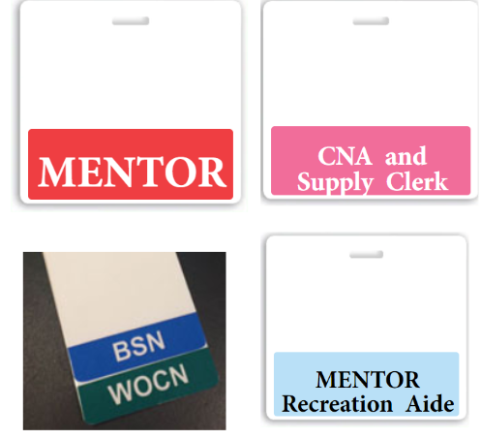
Career Mobility…..Making it Visible & Tangible
Elevate employees through recognition. Celebrate all achievements, large and small!

Slide 20
Career Mobility and Staffing….Flexible Scheduling
“When I decided to further my education, my very first concern was if I would be able to work my current full-time schedule and handle the school workload all at once. Luckily, the center exceeded my expectations! They helped me switch days or have other staff cover my shifts so I could attend my classes. They worked with me each semester to help me accomplish both my work schedule and schooling. I will always be very appreciative of that.”

Slide 22
Remember:
Don’t overcomplicate it!!!
Structure is necessary, but don’t get caught in the weeds

Slide 23
Role of our Physicians and Practitioners….
Position of influence, opinion and input is highly valued among all staff
Need to be a resource for all staff, engaged in center meetings, center celebrations, communication meetings, etc.
Career discussion, connections to resources outside the facility
Knowing staff, staff knowing them and being “present” as a center leader
personal connections, show active interest in overall staff well-being
Host education sessions (not just related to clinical)
Stress reduction
Smoking cessation
Rock climbing and ice skating (true story)

Slide 24
Overcome Pitfalls…

Slide 25
Questions? Comments?

