Slide 1
Welcome to our roundtable series. We’re glad you’re here.
Roundtable Discussion #4
July 28th, 2022

Slide 2
Our Work Together
JoAnne Reifsnyder PhD, MSN, MBA, RN, FAAN
Professor, Health Services Leadership and Management
University of Maryland School of Nursing
Former Chief Nursing Officer, Genesis HealthCare

Slide 3
AFHS 4 “M’s” Applied to the Careforce
What Matters (facility culture, respect, a voice),
Medication (health promotion & workplace safety),
Mentation (wellbeing of staff with a focus on stress management and compassionate self-care), and
Mobility (opportunities for personal growth and career advancement with ongoing education)
Notes:
these focused, collaborative discussions will lead to the development of action plans to include concrete, practical steps that PALTC facilities can start taking immediately to build trust with current staff and recruit and retain new staff to grow and strengthen the PALTC workforce.

Slide 4
Roundtables to date…and coming up
April 28 Kick-off: The 4Ms Expanded for Staff
May 26 Sustaining Compassion & Calling in the Midst of Crisis: Schwartz Center Rounds
June 23 Career Mobility and Shared Governance
July 28 Health Promotion and Safety
August 25 Trauma-informed Care for our Careforce
Sept 22 Developing Leaders for the Future

Slide 5
To Level Set….
We are a community focused on co-design
“All teach, all learn”¹
Small tests of change
Collation and dissemination of insights
¹Project ECHO. (2022). https://hsc.unm.edu/echo/what-we-do/about-the-echo-model.html

Slide 6
Today’s Speaker: Kelly Doran, PhD, RN
Led five worksite wellness studies within LTC facilities
Has offered these wellness programs during paid work time and provided interventions that were maintained following the study
For 10 years, Dr. Doran has studied interventions to increase the health promotion behaviors of staff working in LTC to improve health outcomes and reduce health disparities
Findings from her completed worksite projects have demonstrated improvements in staff health behaviors such as diet modifications; improved health outcomes such as blood pressure; improved organizational outcomes such as increased worker productivity; and spillover benefits to residents from staff serving as healthy role models and engaging residents in healthy behaviors

Slide 7
Worksite wellness in long-term care settings Kelly Doran, PhD, RN kdoran@umaryland.edu Barbara Resnick, PhD, CRNP & Shijun Zhu, PhD Karen Chen, PhD & Lira Yoon, PhD
This work was funded by the American Heart Association (grant #s 14CRP20480034 & 19TPA34830011); Sigma The Tau International; Accelerated Translational Incubator Pilot UMB
Notes:
What we said we’d cover
Even before the COVID-19 pandemic long-term care staff typically experienced higher levels of stress and lower engagement in health promotion behaviors compared to the general population. These outcomes impact the health of staff but they also indirectly impact facilities and residents. Worksite health promotion programs with long-term care staff can improve staff and facility outcomes and our preliminary work suggests they may impact resident outcomes. During this presentation, we will present data and lessons learned from our three worksite health promotion studies with long-term staff aimed at increasing heart health behaviors (exercise, diet, sleep, stress, etc.). We will discuss the evidence base supporting worksite health promotion programs. Further, we will provide intervention strategies, methods to spark and maintain staff participation, and program outcomes that we have used within long-term care settings. Finally, we will end with discussing our lessons learned and next steps for future programs in these settings.
By the end of this session, attendees will be able to:
Apply at least three motivational strategies that can be used to engage employees in worksite health promotion programs.
Apply at least two outcomes to measure the effectiveness of worksite health promotion programs within long-term care.
Apply at least four evidence-based worksite health promotion interventions within long-term care.
How will ICAA delegates implement your session content?
The session will be delivered virtually. Upon completion of the session attendees will be presented with the necessary information to work with their facility to implement a worksite health promotion program.

Slide 8
Agenda
Why and what is worksite wellness
EBPs for worksite wellness
Profile of LTC staff
Motivation, facilitators, barriers and solutions
Small suggestions you can start next week

Slide 9
Notes:
If you asked me what beautiful setting would be it would be something like this- I am assuming you came to this talk to hear about how to create a beautiful work environment, how can reduce staff turnover, improve staff health, improve resident health, reduce work stress, we are going to spend the next 45 min talking about using worksite wellness programs to do just that

Slide 10
Why and what elements
Comprehensive program elements | %
Linkage to wellness programs | 65
Supportive social and physical environment | 56
Health education | 48
Integration into worksite culture | 39
Health screenings | 38
All 5 elements | 17
Linnan, Laura A et al. “Results of the Workplace Health in America Survey.” American journal of health promotion : AJHP vol. 33,5 (2019): 652-665. doi:10.1177/0890117119842047; Punnett, L., Cavallari, J. M., Henning, R. A., Nobrega, S., Dugan, A. G., & Cherniack, M. G. (2020). Defining ‘integration’for Total Worker Health®: A new proposal. Annals of work exposures and health, 64(3), 223-235.
Notes:
In addition to the what I just said about helping staff, are there org outcomes- rois ranging up to .38-5 + $
dollars, producing a return on investment equal to a range of $1.88—$3.92 saved gotzel 2011
Earlier during roi we discuss the importance of right balance of dose and intensity to result in impacts, rol found critical components comprehensive however you can see less than 1/5 include all elements in whp
Each of the 5 specific elements of a comprehensive health promotion program were present in less than 50% of worksites: supportive social and physical environments (47.8% of all worksites reported this), linkages to related programs (46.0%), health education programs (33.7%), integration of the program into the organization’s structure (28.4%), and health screenings with appropriate follow-up and education (26.6%; Table 3). Overall, 11.8% of worksites offered all 5 key elements of a comprehensive WHP program. Larger worksites (250+ employees) were both more likely to report having any 1 of the 5 elements, as well as more likely to report having all 5 key elements, as compared to smaller worksites. Worksites in the hospital industry (35.7%) were more likely to have a comprehensive program than any other industry group
In the adjusted model, after controlling for all other variables, worksites with a person assigned responsibility for the health promotion program had 8.14 times the odds of having a comprehensive program (P < .001), worksites with an annual budget had 6.99 times the odds (P < .001), and sites with more than 5 years of health program experience had 3.08 times the odds of having a comprehensive program (P < .001).
a recent national survey by the Centers for Disease Control and Prevention indicates that <1 in 5 worksites implement comprehensive programs and policies comprehensive” health promotion programs were defined as those that incorporated all of the 5 key elements outlined in Healthy People 2010: (1) health education programs, (2) supportive social and physical work environment, (3) integration of the program into the organization’s structure, (4) linkage to related programs such as employee assistance programs (EAPs), and (5) health screening with appropriate follow-up and education.11

Slide 11
Total worker health
Workplace psychosocial conditions
Supervisor support – variety health outcomes and injury rates
Aggression (pts, staff, management)- chronic injury, obesity, low PA
Demands/low decision- pain, obesity, CVD risk, sleep
Home/community environment
Flexible shift- less depression and anxiety
Work/family conflict- sleep, pain
SDOH- stress, engagement
Workplace physical/chemical environment
Safety- needlesticks, back pain
Policies- food, PA
Personal health behaviors
Work ability & health outcomes- PA, diet, health engagement, mood, sleep, tobacco
Punnett, L., Cavallari, J. M., Henning, R. A., Nobrega, S., Dugan, A. G., & Cherniack, M. G. (2020). Defining ‘integration’for Total Worker Health®: A new proposal. Annals of work exposures and health, 64(3), 223-235.; Sorensen, G., McLellan, D. L., Sabbath, E. L., Dennerlein, J. T., Nagler, E. M., Hurtado, D. A., ... & Wagner, G. R. (2016). Integrating worksite health protection and health promotion: A conceptual model for intervention and research. Preventive medicine, 91, 188-196; Flannery, K., & Resnick, B. (2014). Nursing assistants’ response to participation in the pilot worksite heart health improvement project (WHHIP): a qualitative study. Journal of community health nursing, 31(1), 49-60.
.
Notes:
As we think about comprehensiveness orograms and what should be included it was critical to discuss twh mode
We know these 4 areas- pyscosocial work conditions, home/community, phycial/chemical environment and our personal health all impact us, how we show up to work and work outcomes
For exam we pulled some examples from each section to show the importance and if that section is missed how there might be a gap in programing
Eg high demands and low decision lattaitude- correlated with pain, obesity, sleep issues, miltuple CVD risk factors
Poor health behaviors0 sedentary, unhealth diets, low sleep, mood stress, tobacco shown to be coorelated with work ability
SDOH – racicm- stress, food insecurity, stability, etc stress engagement in healthcare and health behaviors
Change safety practices can reduce needslticks and back pain
Punnett, L., Cavallari, J. M., Henning, R. A., Nobrega, S., Dugan, A. G., & Cherniack, M. G. (2020). Defining ‘integration’for Total Worker Health®: A new proposal. Annals of work exposures and health, 64(3), 223-235.
TWH-Policies, programs, and practices that integrate protection from work-related safety and health hazards with promotion of injury and illness prevention efforts to advance worker well-being
Theme 2: The psychosocial work environment shapes safety and health behaviors and health outcomes Supervisor Support: Supervisor support was associated with a range of health outcomes (Caspi et al., 2013; Hurtado et al., 2015b; Reme et al., 2014; Sembajwe et al., 2013; Sorensen et al., 2011b). We found lower injury rates in units where workers reported better supervisor support and more favorable organizational policies and practices (Tveito et al., 2014). Work-family Conflict and Job Flexibility: Nurses working on units with more shift flexibility had relatively less depression and anxiety (Hurtado et al., 2015a). Higher levels of work-family conflict were also significantly associated with sleep deficiency in the short term and nearly two years later (HB Jacobsen et al., 2014), and with multiple types of musculoskeletal pain (Kim et al., 2013). Harassment at Work: Being sworn at, screamed at, and receiving hostile or offensive gestures from patients, coworkers, or supervisors were associated with increased risk of chronic injury (Sabbath et al., 2014). Harassed workers were also more likely to be obese and have low levels of physical activity (Nelson et al., 2014; Sorensen et al., 2011b).
Decision Latitude and Job Demands: We found that higher job demands were associated with musculoskeletal pain (Sembajwe et al., 2013), that low decision latitude was associated with obesity (Nelson et al., 2014), and that job strain was associated with sleep deficiency and cardiometabolic risk (H.B. Jacobsen et al., 2014). Individual and Organization-level Exposures: We found both contextual and compositional group-level exposures contribute to individual workers’ outcomes. For example, shift flexibility at the unit level translated to lower depression and anxiety at the individual level (Hurtado et al., 2016), and high levels of ambient harassment (regardless of individual harassment) were associated with greater injury risk (Sabbath et al., 2014).
Theme 3: Health behaviors are partially rooted in conditions of work, suggesting that conditions of work need to be addressed if health-related behaviors are to improve Physical activity: Workers with low decision latitude and low job flexibility were less likely to meet guidelines for adequate physical activity (Nelson et al., 2014). Sleep: We found especially strong evidence that sleep and sleep inadequacy were predicted by adverse conditions of work (Buxton et al., 2012; HB Jacobsen et al., 2014; H.B. Jacobsen et al., 2014; Nelson et al., 2014; Sorensen et al., 2011b). For example, sleep deficiency was associated with nearly all psychosocial exposures examined in Theme 2. Simultaneously, broader policies and practices within the work environment also predicted improved sleep, including people-oriented culture, ergonomic practices, and safety practices (Sorensen et al., 2011b). Collectively, these findings underscore the need for a comprehensive approach to safety and health interventions, consistent with our integrated model.

Slide 12
EBPs for some common program offerings
Integration/culture of health
TWH, champions, stakeholders
PA
Work time, PA work stations, incentives/ competitions, tracking devices, equipment
HRA
Screening with individual feedback, health coaching, referrals, follow up screening
WT/DM
Onsite classes, health coaching, subsides/ rewards for participating
Tobacco/clean air
Workplace policies, health coaching, linkage to NRT/other supports
Food
Financial incentives, prompts, architecture, menu changes, potlucks, take out
Mood/stress/depression
Mindfulness, TWH, mental health swipe out
Calitz, Chris, et al. "Cardiovascular Health Research in the Workplace: A Workshop Report." (2021): e019016.; Flannery, K., & Resnick, B. (2014). Nursing assistants’ response to participation in the pilot worksite heart health improvement project (WHHIP): a qualitative study. Journal of community health nursing, 31(1), 49-60. Doran, K., Resnick, B., Alghzawi, H., & Zhu, S. (2018). The worksite heart health improvement project’s impact on behavioral risk factors for cardiovascular disease in long-term care: A randomized control trial. International journal of nursing studies, 86, 107-114.
Notes:
The top 6 boxes are some EBPs for the common programs or diseases
Culture- huge,- motivation, sustsinability and how can you do that twh, embedding it into program by including workers front line and admin- champions and stakeholders, tec
Pa- ebp paid work time (might be asking how is that possible (hand on) pa stations, incentives/comptetions, using resident equipment,
Food0 promots for health food, placing healthy food at eye level or making point of decision locations, menu changes, offering food at discounted prcies, potlucks
HRA- screenings with individual and tailored feedback and coaching, follow up screenings at least 1 year
Wt/dm- onsite, rewards, tailored coaching, starting work time then as e/f increases moving to off work timw
Tobaccoo- clean air 12% smokded by ~40% consistcnly exposed to 2nd hand smoke 25/35% increased CVD risk (important know your population and needs, NRT and councleing choaching
Add mood- only ~20% of companies offering wellness programs include mood/stress/despression but this is a huge gap (COVID, impact on health outcomes and engagement) – one of the things we promote often in our projects is the mental health swipe out- just like you leave for the day and clock out lets use this wellness time to leave work stress when you sipe out

Slide 13
Baseline Health Status
Sleep 6.5 hrs
Steps 5,902
BMI
30.5
Aerobic steps 0
32% sleep quality as bad or very bad
37% passive smoke
73% OW or obese
12% tobacco
High salt diet
High fat diet
Profile of LTC staff
BP 114/77
TC 170
Stress
When
~ 2/3 eve, night
Who
Residents > 1/2
Self ~ 1/5
What
Rigid schedules, rushed, disrespect, pt safety, depleted, personal stress
Where
Everywhere with no escape (breakroom, outside, gym)
Doran, K., & Resnick, B. (2017). Cardiovascular Risk Factors of Long-Term Care Workers. Workplace health & safety, 65(10), 467-477.; Unpublished Data from ATIP project, conducting analysis now
* From 20 commonly eaten high fat and/or high salty foods
Notes:
Important to know your population- great that they don’t have HTN or High Chol,
Better picture of what we need to focus on – sleep miss the boat if you don’t include esp with shift hc workers, pa ~6k steps low active group but if you ask them they hch would say they do plenty of pa at work- have to tackele that before you start there will be no perceioeved valiue in your pa program
Flannery, K., Burket, T. L., & Resnick, B. (2014). Exercise habits of licensed nurses and nursing assistants: are they meeting national guidelines?. Geriatric Nursing, 35(2), S17-S20.
In 2004 Tudor-Locke and Bassett [11] introduced the concept of a graduated step index for healthy adults: 1) < 5,000 steps/day ('sedentary'); 2) 5,000-7,499 steps/day ('low active'); 3) 7,500-9,999 steps/day ('somewhat active'); 4) ≥10,000-12,499 steps/day ('active'); and 5) ≥12,500 steps/day ('highly active’).
The misconception that NAs and licensed nurses engage in sufficient levels of exercise as a result of their job can add additional challenges for recruiting and retaining these individuals in health promotion interventions. If individuals incorrectly believe they are meeting exercise recommendations, because they misunderstand the recommendations, they will not seek out additional opportunities to engage in exercise. Therefore, individuals need to be aware of exercise guidelines and they must understand exercise guidelines (especially the difference between PA and exercise) before health promotion interventions can be successful in this population.
Five (7.6%) participants reported engaging in PA but at levels that did not meet PA guidelines (range 45e140 min/week). 95% think they engage in sufficient pa

Slide 14
Motivation for joining
Improve health
Positive reinforcement
Group interaction
Health benefits
Flannery, K., & Resnick, B. (2014). Nursing assistants’ response to participation in the pilot worksite heart health improvement project (WHHIP): a qualitative study. Journal of community health nursing, 31(1), 49-60.
Notes:
desire to improve their health- for their kids, to live longer, be health role model family,
, positive reinforcement from pedometers about their daily physical activity counts (e.g., steps, aerobic steps), group interaction, and
health benefits experienced (e.g., stress reduction, increased energy or reduced blood pressure)
Wanted group connection and support

Slide 15
Program facilitators
Simple changes
Behavior awareness
Prizes/ competitions
Fun
Teamwork/support
Share with family and friends
Low pressure
Constant edu and tip infusion
Flannery, K., & Resnick, B. (2014). Nursing assistants’ response to participation in the pilot worksite heart health improvement project (WHHIP): a qualitative study. Journal of community health nursing, 31(1), 49-60.
Notes:
simple health changes and healthy behavior- really preached life long marathon – start small build 1 small little goal, eg 200 extra steps a week, awareness – going back to basics – food groups, how many caolories meal vs snack coverage system- sign out board – hand off the pager, rotate coverage during report,
Extra hadnouts to share with family and friends
Best thing about the interventionist – rolled with resitsnce- did not pressure or make people feel bad- they know they ghosted you, understand stress and time demands of the job
“I can take 10 minutes out and do my walk and do a little exercise” and “Before the program, I was not eating healthy. . . . Now, . . . I think, . . . ‘This is 300 calories.’ . . . I never did that before; . . . before this program I just ate away.

Slide 16
Program participation & barriers
33%
All
11%
Hospital
16-55%
WHHIP
Stress
Job stress
Time / care demands/ staffing
Lack of support
Exhausted
Lack of culture change
Robroek, S. J., Van Lenthe, F. J., Van Empelen, P., & Burdorf, A. (2009). Determinants of participation in worksite health promotion programmes: a systematic review. International Journal of Behavioral Nutrition and Physical Activity, 6(1), 1-12.; Han, M. (2019). Participation and Effectiveness of Worksite Health Promotion Program (Doctoral dissertation). Lemon, S. C., Zapka, J., Li, W., Estabrook, B., Rosal, M., Magner, R., ... & Hale, J. (2010). Step ahead: a worksite obesity prevention trial among hospital employees. American journal of preventive medicine, 38(1), 27-38.; Flannery, K., & Resnick, B. (2014). Nursing assistants’ response to participation in the pilot worksite heart health improvement project (WHHIP): a qualitative study. Journal of community health nursing, 31(1), 49-60.
Notes:
Time
Lack of support staff and managers
Culture change- crtically all staff are allowed
Tired- sleep and stress interventions to combat this
60% working a second job,
In addition to what is offered in order to have a successful program we know that participation.
Reviwers have round whp programs to have on average about 33% participation, whp with hc while not reported often can be ~11%
We have found in our projects 16-55% participation, snap shot of the 1st 3 months of a project that looked at what was offered and who came, we know we under reported since we did not account for who was working/shift offered but you can see the interest py program and each participants
We did anaysls and found we we looked at health demos job factors the only things that predicted participation were stress- personal and job, and that less stressedstaff participanted up to 2x more
Predictors of participation – can increase participation by up to 2x
Myeunghee Han, RN

Slide 17
Barriers Solutions
Staff coverage | Rotating staff “buddies” Staff sign out board Cover pager system
Engagement | Screening and report cards Competitions (self goals) and raffles
Too much time away from residents | Handouts (condensed to 1 page) Simultaneous interventions Drop in/flexible model - staff could come when free Sustainability planning / text/ phone coaching / videos
Staff could not leave the unit for PA breaks | Set PA times so staff could plan their day Peer champions / team lead for the day / stakeholders After work and weekend activities
Different staff wanted to do different forms of exercise | First person to come to session got to pick type PA Post an exercise schedule with a consistent time slot for dance Pair participants based on PA preference
Notes:
These are some solutions we found for the common barriers to worksite wellness
Best solutions are tailored and staff driver
Reamember we said ebp hra and using s/e theory we would do screenings and then link with participation and goal progress- bp this and came to x / sessions this was goal in this area discuss progress
Time- pack everything into 15 min then did drop in office hours- come ask questions work 1:1 connect with staff
How to pick pa- schedules, however came first got to pick, group folks based on pa and shift preferences

Slide 18
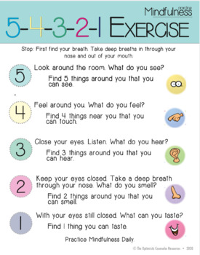
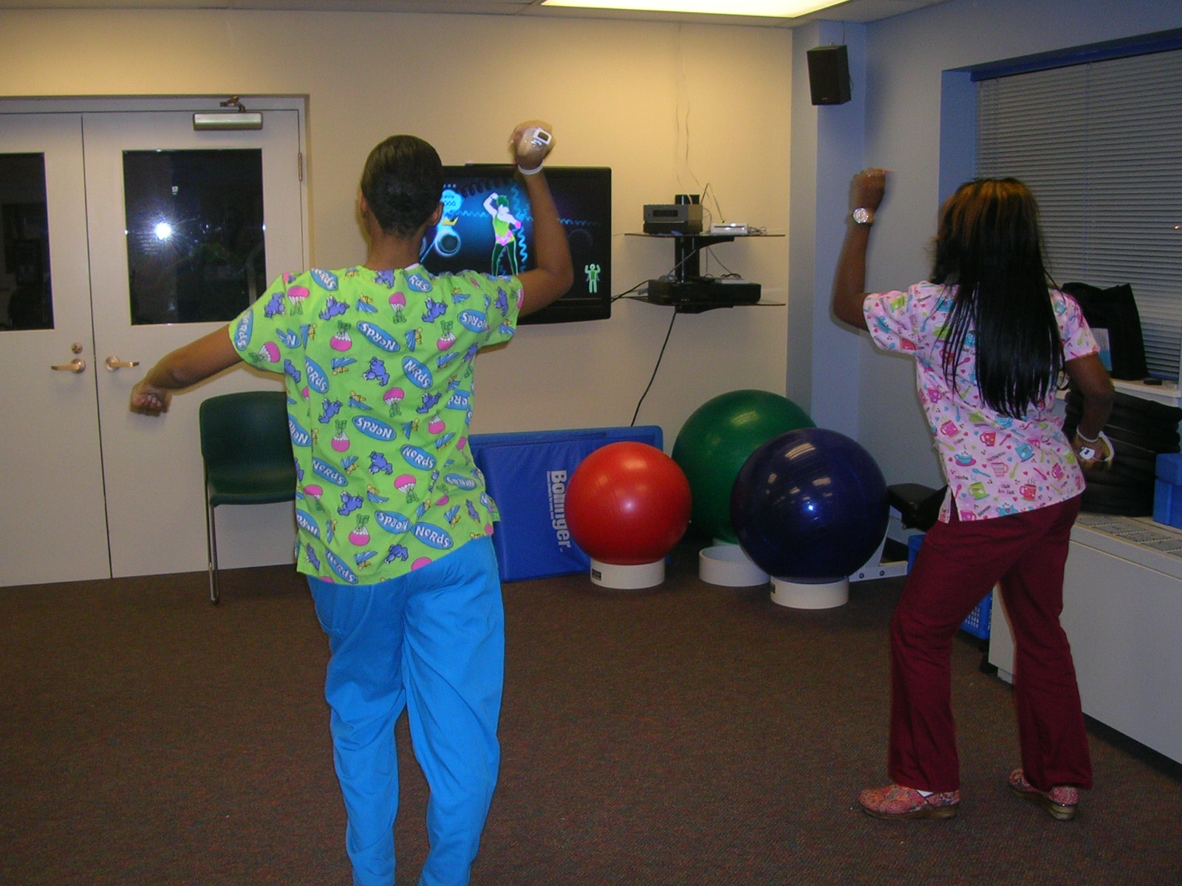
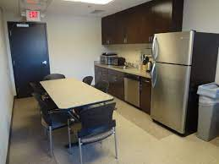
What changes can you make now?
Notes:
Treat wellness goals like professional developmet goals

Slide 19
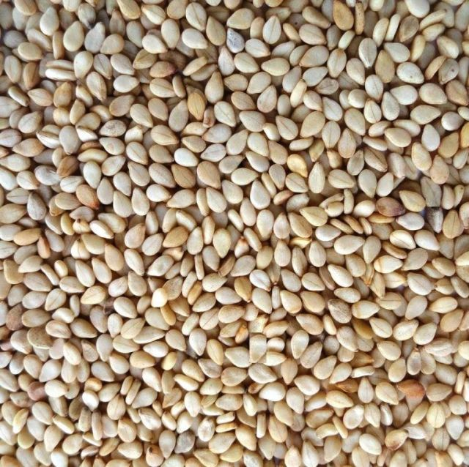
Final thoughts

Slide 20
Thank you
Notes:
Remember to rate the session for planning next year

