Slide 1
Welcome to our roundtable series. We’re glad you’re here.
Roundtable Discussion #5
August 25th, 2022

Slide 2
Our Work Together
JoAnne Reifsnyder PhD, MSN, MBA, RN, FAAN
Professor, Health Services Leadership and Management
University of Maryland School of Nursing
Former Chief Nursing Officer, Genesis HealthCare

Slide 3
AFHS 4 “M’s” Applied to the Careforce
What Matters (facility culture, respect, a voice),
Medication (health promotion & workplace safety),
Mentation (wellbeing of staff with a focus on stress management and compassionate self-care), and
Mobility (opportunities for personal growth and career advancement with ongoing education)
Notes:
these focused, collaborative discussions will lead to the development of action plans to include concrete, practical steps that PALTC facilities can start taking immediately to build trust with current staff and recruit and retain new staff to grow and strengthen the PALTC workforce.

Slide 4
Roundtables to date…and coming up
April 28 Kick-off: The 4Ms Expanded for Staff
May 26 Sustaining Compassion & Calling in the Midst of Crisis: Schwartz Center Rounds
June 23 Career Mobility and Shared Governance
July 28 Health Promotion and Safety
August 25 Trauma-informed Care for our Careforce
Sept 22 Developing Leaders for the Future

Slide 5
To Level Set….
We are a community focused on co-design
“All teach, all learn”¹
Small tests of change
Collation and dissemination of insights
¹Project ECHO. (2022). https://hsc.unm.edu/echo/what-we-do/about-the-echo-model.html

Slide 6
Today’s Speakers:
Nancy Kusmaul, PhD, LMSW
Paige Hector, LMSW

Slide 7
Trauma-Informed Care for Staff in Post-Acute and Long-Term Care Settings
Nancy Kusmaul, PhD, MSW
Associate Professor | Department of Social Work University of Maryland Baltimore County
nkusmaul@umbc.edu | 410-455-1144
Fellow, Gerontological Society of America
Health and Aging Policy Fellow | American Political Science Association Congressional Fellow
Paige Hector, LMSW
Author | Speaker | Educator
Paige Ahead Healthcare Education & Consulting, LLC
www.paigeahead.com
paige@paigeahead.com
520-955-3387

Slide 8
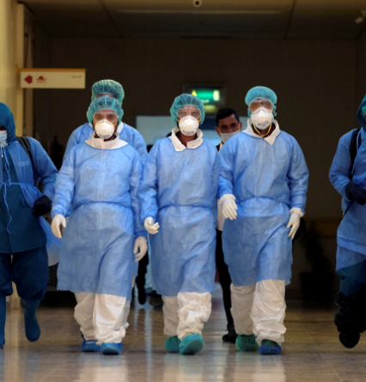
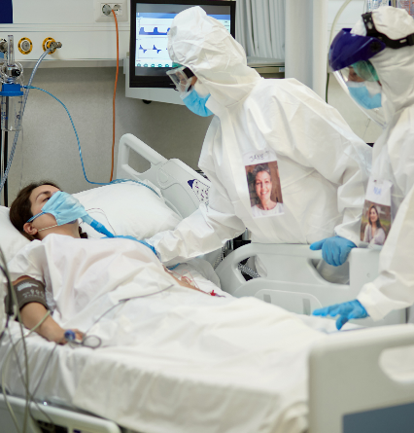
PTSD following pandemics is a significant public health concern (COVID-19, SARS, H1N1, Ebola, Zika included in this study)
26.9%
19.3%
23.8%
Healthcare Workers
General public
Infected Cases
Yuan K, Gong YM, Liu L, et al. Prevalence of posttraumatic stress disorder after infectious disease pandemics in the twenty-first century, including COVID-19: a meta-analysis and systematic review. Mol Psychiatry. 2021; https://doi.org/10.1038/s41380-021-01036-x.
Notes:
PTS symptoms are common, normal, and often an adaptive response to experiencing a traumatic or stressful event.
PTSD symptoms are more severe, persistent, can interfere with daily functioning, and can last for more than a month.
Put into perspective:
Look around at your peers in this room, 1 in 5 of you may experience PTSD.
(88 studies were included in this analysis)

Slide 9
Trauma Definition
Individual trauma results from an event, series of events, or set of circumstances that is experienced by an individual as physically or emotionally harmful or life threatening and that has lasting adverse effects on the individual’s functioning and mental, physical, social, emotional, or spiritual well-being.
(SAMHSA, 2014)
(emphasis added)
CMS uses this definition of trauma
Notes:
Applies to residents AND staff.
Substance Abuse and Mental Health Services Administration (SAMHSA)

Slide 10
Emotional and Psychological Trauma
“Result of extraordinarily stressful events that shatter your sense of security, making you feel helpless in a dangerous world. Often involve a threat to life or safety, but any situation that leaves you feeling overwhelmed and isolated can result in trauma, even if it doesn’t involve physical harm. The more frightened and helpless you feel, the more likely you are to be traumatized.”
(emphasis added)
Emotional and Psychological Trauma
https://www.helpguide.org/articles/ptsd-trauma/coping-with-emotional-and-psychological-trauma.htm

Slide 11
Trauma is an INJURY, not a weakness, illness or character flaw
Notes:
Shift from “What’s wrong with you?” to “What happened to you?”

Slide 12
Triggers and Re-traumatization
A trigger is anything (a smell, a sound, an emotional state, a situation, etc.) that reminds a person of a trauma.
Re-traumatization is “…any interaction, procedure or even something in the physical environment that either replicates someone’s trauma literally or symbolically, which then triggers the emotions and cognitions associated with the original experience.”
Trauma-Informed Organizational Change Manual,
http://socialwork.buffalo.edu/social-research/institutes-centers/institute-on-trauma-and-trauma-informed-care/Trauma-Informed-Organizational-Change-Manual0.html
Notes:
The traumatic experience (with all the emotions, visuals, sounds, words, etc.) gets trapped in the amygdala.
When something in the environment mimics any aspect of the event or trauma experience, the amygdala takes over (shuts down the PFC) and the person experiences the trauma the same as the moment of the actual trauma.
When the present moment experience is loaded with unresolved past pain, we get “triggered” or “activated” (Yvette Erasmus)

Slide 13
Notes:
When operating from your prefrontal cortex, you can handle challenges and are in charge of yourself.
When a person is stressed or traumatized, this part goes ‘off-line’ and the person now functions from the amygdala (fight-flight-freeze).
So, what happens when staff try to “reason” or use cognitive-based interventions with a person who is functioning from their amygdala (e.g., yelling, withdrawing, using substances)?

Slide 14
Stress (and trauma) responses can also be connected to…
A location
A tone of voice
A social situation
Social rejection
Mere hint of disapproval
Worries about health or finances
Emotional reactions like feeling trapped, anticipating rejection, having doubts
Winston S, Seif M. Overcoming Unwanted Intrusive Thoughts. Oakland, CA: New Harbinger Publications, Inc.; 2017.

Slide 15
I really need you to focus on your work.
Do you think you are burned out? Depressed?
Why didn’t you do that differently?
Stay positive. Do it for the residents.
Don’t worry…this will get better.
The pandemic is basically over. What’s going on with you?
Have you tried going to a therapist?
Notes:
Things we say to one another, usually out of good intention.
COVID fatigue, relentless stress, frustration, fear
Grief, suffering (emotional, physical, spiritual)
People are more edgy, angry, quicker to lose their temper

Slide 16
Our Biology Picks One of These
Fight
Flight
Freeze
Notes:
FIGHT (anger, defensiveness, blame and violence)
FLIGHT (anxiety, avoidance, drug or alcohol use)
FREEZE (disconnection, difficulty/inability to identify one’s needs or feelings, dissociation or flat affect)

Slide 17
ENGAGEMENT AND CONNECTION
CALM IN CONNECTION
CURIOUS / OPEN
SETTLED
COMPASSIONATE
GROUNDED
MINDFUL / IN THE PRESENT
ABOVE (Response)
The Line (Of Choice)
BELOW (Reaction)
IMMOBILIZATION
MOBILIZATION
FREEZE
FIGHT
FLIGHT
HELPLESSNESS
FRUSTRATION
WORRY
DEPRESSION
IRRITATION
ANXIETY
SHAME
ANGER
FEAR
SHUT DOWN
RAGE
PANIC
Adapted by Francois Beausoleil from the work of Dr. Stephen Porges and Arianne Missimer
Notes:
When we are below the line, we are not choosing our response to a situation.
When we are above the line, we are choosing our response (engaged and connected).

Slide 18
But we’re already doing so much. Why aren’t these things enough?
Extra paid days off
Treasure hunts
Cards that say, “I’ll be back in 15 minutes” to give staff permission to take care of themselves
Blessing of the hands
Employee of the Day
Giving staff who do nice things a card and basket of goodies
Food, treats, snacks

Slide 19
Compassion and Empathy are Critically Important for Healthcare Staff
“HCPs who are able to maintain empathy for patients and consistently practice with compassion have less burnout, more resilience, and superior well-being, indicating that compassion may in fact be protective.”
StephenTrzeciak, Brian W.Roberts, Anthony J.Mazzarelli, Compassionomics
“A stronger culture of compassion could create physiological effects that reduce employees’ absenteeism.”
Barsade, Oneil, What’s Love Got to Do With It? Administrative Science Quarterly
“Findings suggest that compassion may be an under-recognized, but essential element in meeting the promise of person-centered care within long-term care environments.”
Smith-MacDonald, Venturato, Hunter, P. et al. Perspectives and experiences of compassion in long-term care facilities within Canada
“Another survey of 1,400 U.S. adults found that nearly two-thirds had an experience as a patient in which HCP compassion was lacking, and 93% believed that a lack of compassion lowered the quality of care.”
Trzeciak, Roberts, Mazzarelli, Compassionomics
Notes:
Is there empathy and compassion in your facility culture?
[Facility culture “is the way we do things around here”.]

Slide 20
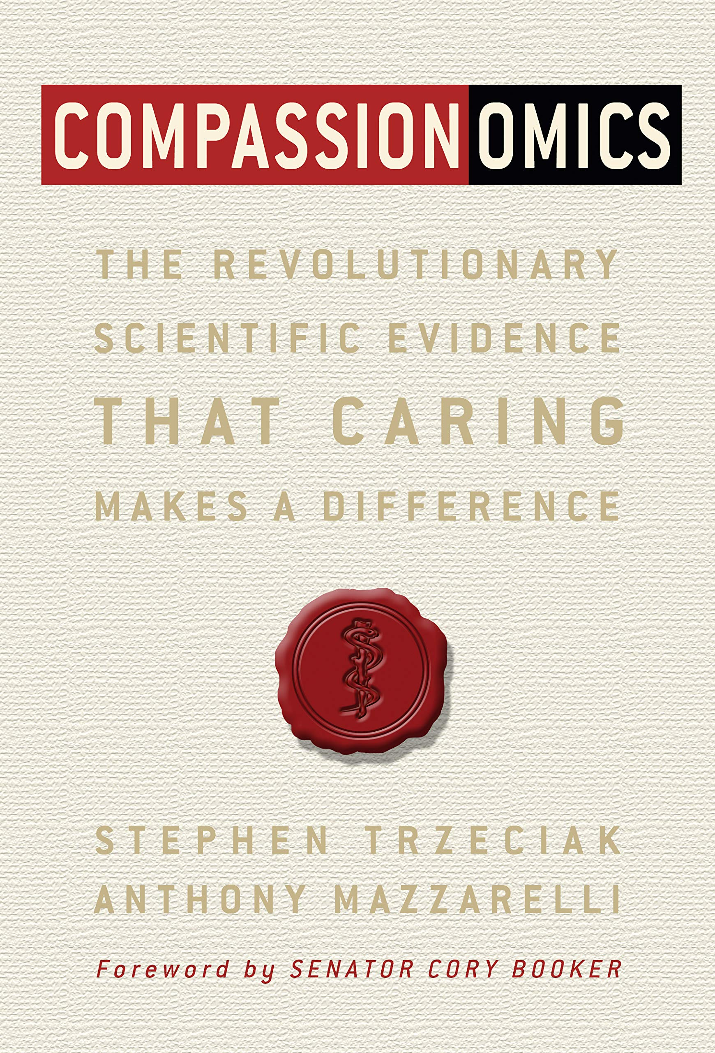
Dr. Stephen Trzeciak
How 40 Seconds of Compassion
Could Save a Life
“There is science in the art of medicine, and it is strong.”
https://www.youtube.com/watch?v=elW69hyPUuI
Notes:
Compassion is connected with resilience.

Slide 21
What is Trauma-Informed Care (TIC)?

Slide 22
Trauma-informed care is the adoption of principles and practices that promote a culture of safety, empowerment, and healing.
According to the Substance Abuse and Mental Health Services Administration (SAMHSA)
https://www.integration.samhsa.gov/clinical-practice/trauma

Slide 23
Six Principles of Trauma-Informed Care
Cultural, Historical and Gender Issues
Peer support
Trust and transparency
Safety
Collaboration and mutuality
Empowerment, voice and choice
SAMHSA’s Concept of Trauma and Guidance for a Trauma-Informed Approach, https://store.samhsa.gov/sites/default/files/d7/priv/sma14-4884.pdf
Notes:
Cultural, Historical, and Gender Issues (Diversity, Equity, and Inclusion)
Sandra Bloom says, “a physically safe environment, although necessary, was not sufficient. So there had to be other kinds of safety, which I have termed psychological safety, social safety, and moral safety.” Sanctuary Model

Slide 24
Social and Moral Safety
Social safety refers to the ability to be a part of a group, to listen and to be heard, to be able to play a role in conflict resolution, to use one’s intelligence and creativity to serve a group process without engaging in behavior or activities that destroy the integrity of the self or the group.
Moral safety reflects an environment that actively defines and redefines a moral universe of integrity, responsibility, honesty, tolerance, compassion, peace, nonviolence, justice, and an abiding concern for human rights.
The Sanctuary Model: Through the Lens of Moral Safety by Sandra Bloom, https://sandrabloom.com/wp-content/uploads/2017-BLOOM-THE-SANCTUARY-MODEL-THROUGH-THE-LENS-OF-MORAL-SAFETY.pdf

Slide 25
Mourning grieving I let myself feel grief in response to the loss of something that matters to me
Kathleen Macferran and Jared Finkelstein,
Certified Nonviolent Communication Trainers
Notes:
Human beings NEED to mourn (grieve).
How can we increase the capacity of our facility culture to support staff to mourn?

Slide 26
What are we mourning?
Deaths, illness, loss of friendships and connections
Loss of ‘normalcy’ or at least processes as we understood them
Loss of predictability, sense of safety, purpose, trust, respect, faith
Unmet hopes, dreams, and expectations
Questioning our desire to stay in healthcare, wondering what we would do differently

Slide 27
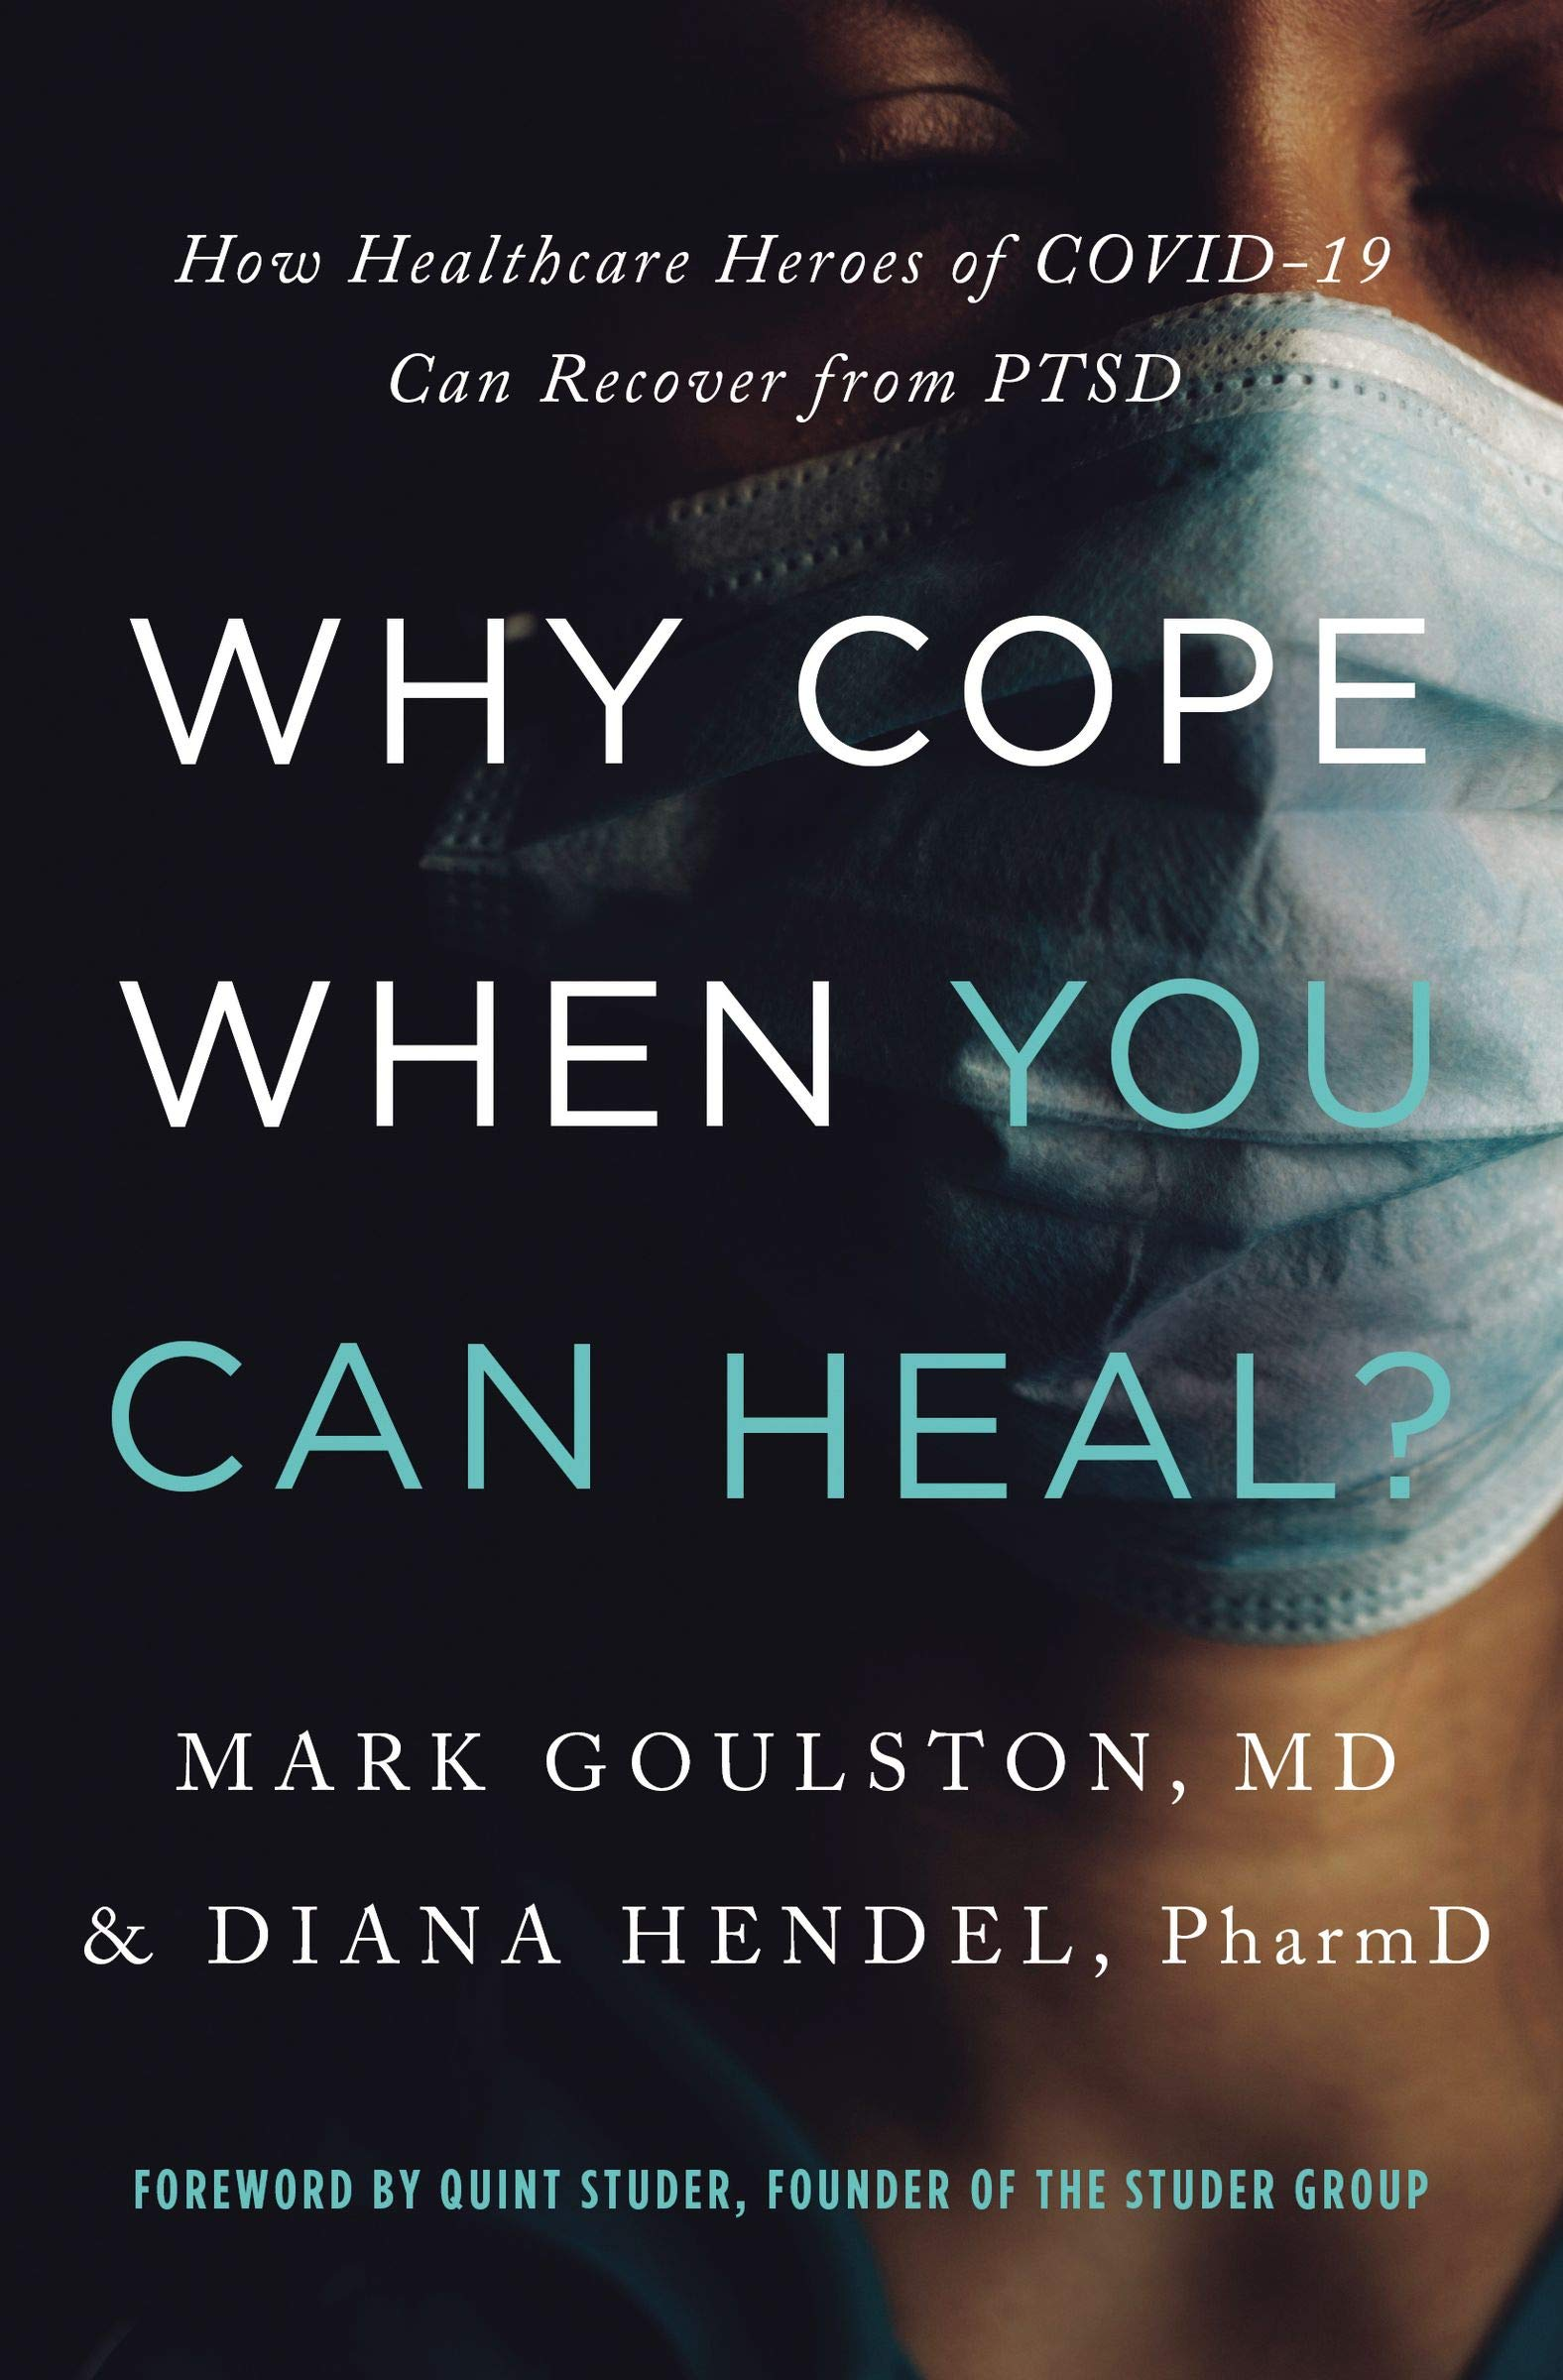
Just-Get-Over-It-Culture
Dominates in healthcare
No time to process emotions (which may contribute to PTSD)
“This means [staff] don’t have the time or ability to pause, reflect, and process the crisis that continues grinding away at them.”
Notes:
I (Paige) am choosing to spend my life energy to stand up to the social order.

Slide 28
“[Team members] shared with us the devastation they feel when someone passes away. Regardless of position, those of us who work in communities feel deep pain when a resident dies.”
The extreme dysfunction and damaging effects of our institutional approach quickly became evident.
Notes:
“Do you know how it feels,” asked one team member, “to have known and loved a resident for years and then be off for a couple of days and come back and find that the person has died? No one called me. I just have to go back to work and pretend that everything is okay.”

Slide 29
Why is grieving and mourning difficult?
Staff may not feel safe to express their grief, to mourn
Staff may feel pressured, overtly or implicitly, to ‘deal with it’
There may not be a formal structure in place to support staff in their grief and/or to participate in a mourning practice
Constant detachment (after death) and reattachment to new residents
Pressure to “maintain census” so a new resident comes into the same room as the resident who died and staff has not grieved or mourned

Slide 30
Tendency to minimize or trivialize mourning
General discomfort for expressions of grief (mourning) leads us to use language to stop our own or others’ mourning:
Changing the subject, “You’ll never believe what happened yesterday…”
Trying to see the bright side, “The gift in this is…”
Offering reframes, “Look at it this way...”
Offering advice, “I think you should…”
Dismissing, “Snap out of it”
Minimizing, “It’s not that bad”
Reassuring, “You’re going to be fine”
Diagnosing, “You’re depressed” or “You have PTSD”
The Trouble with Mourning by Sarah Peyton
https://thefearlessheart.org/the-trouble-with-mourning/

Slide 31
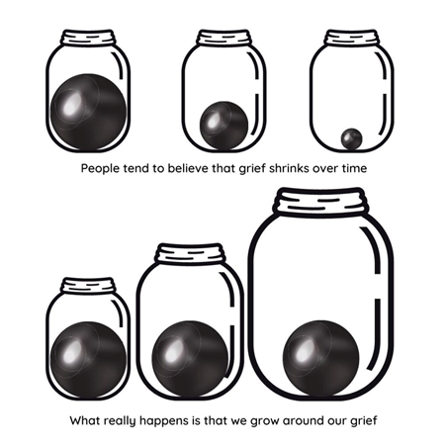
Notes:
The container in which we hold our grief expands.

Slide 32
“How can we stay in relationship with inevitable and natural experiences of loss, in the most life-affirming and healing ways?”
What Does it Mean To Grieve Well? By Dr. Yvette Erasmus, https://www.yvetteerasmus.com/blog/what-does-it-mean-to-grieve-well

Slide 33
Suggestions to Support Grieving Well
Name the loss
Identify and acknowledge exactly what you once “had” that is no longer present in some way? (sense of normalcy, loss of connection, a dream or a hope, a person, an ability)
Surrender to the yearning
When we experience a loss, our physical system will yearn for this, long for it, try to reach it
The ache is painful, physical, and real. It is also temporary.
Process in community
Tell your story (humans need to be seen, heard, and witnessed). Talk, cry, express, and feel with others.
We need community and empathic listening (not people trying to lessen our grief)
Reorient
We resituate ourselves in the world – update our beliefs, our sense of who we are, and we develop new routines
May still feel a void. And we start to reach for life and possibility
What Does it Mean To Grieve Well? By Dr. Yvette Erasmus, https://www.yvetteerasmus.com/blog/what-does-it-mean-to-grieve-well

Slide 34
We do not have to be therapists to be therapeutic.
Notes:
These are communication skills!

Slide 35
Peer support an essential part of mourning and trauma-informed care
Provide time and space for staff to grieve, reminisce, and gather after a loss, distressing news, or death
Notes:
Peer support is:
Safe, constructive, sharing, and active listening of feelings in a way that meets staff’s needs
Objective and non-blaming identification of what’s going well and what is not
Reinforce shared purpose and personal agency
Focus on incorporation of learning into systems
Supporting staff so they do not feel alone
Peer support is NOT:
Blaming, judging, and criticizing of staff, residents, and families--present and not
Venting and complaining about aspects out of one’s control
A time to try to “fix” feelings or outcomes

Slide 36
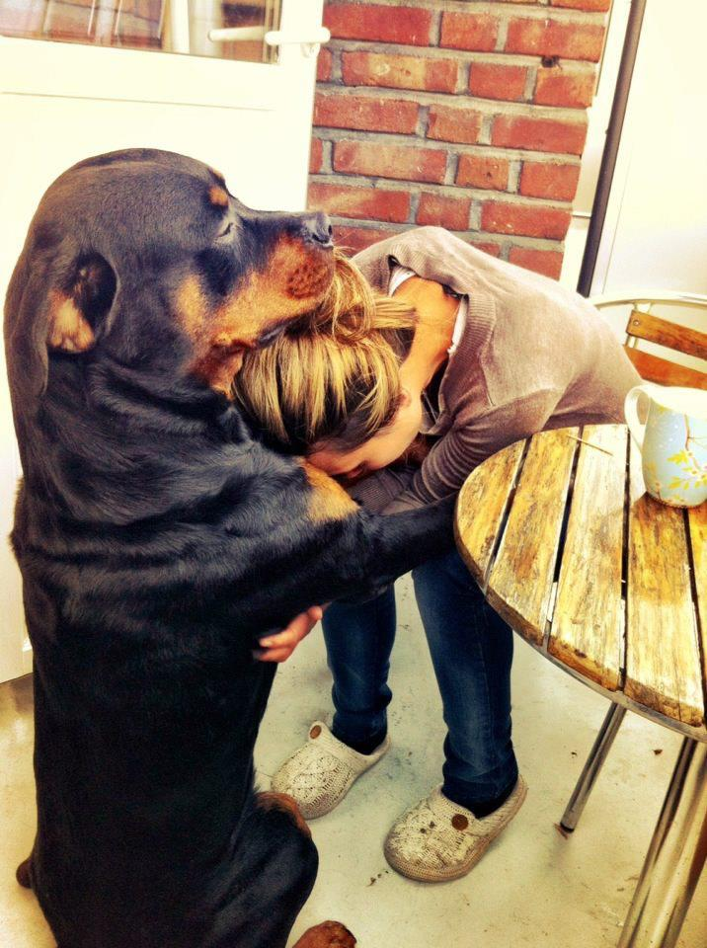
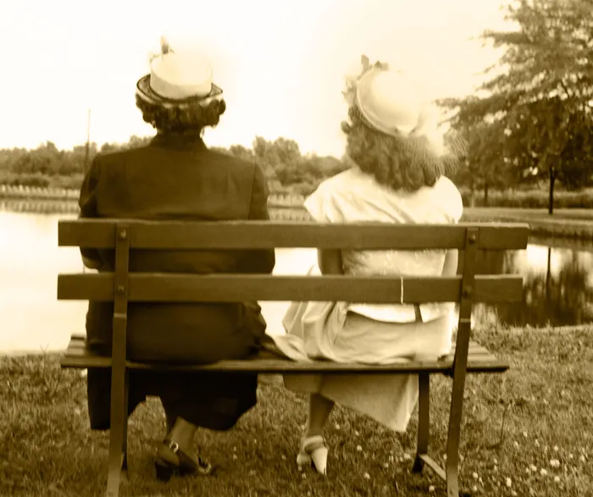
Humans are more settled by being understood than anything else. ~ Sarah Peyton
Notes:
Words create understanding and connection. Something physically shifts.
An exhale, a softening of the face or shoulders, tears, goosebumps. Translates into, “I’m understood.”
“…when an individual realizes that everything going on within has received full empathic understanding, they will experience a sense of relief.”
When you experience being heard and understood, you are more in choice with how you respond to another person.

Slide 37
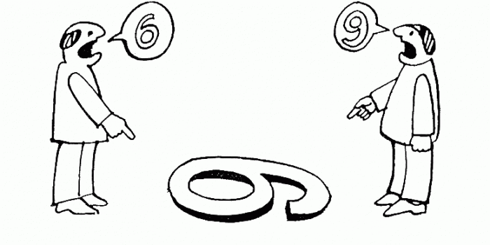
Assess staff perceptions of the organization
Notes:
Introduce the Trauma-Informed Climate Scale (TICS-10)

Slide 38
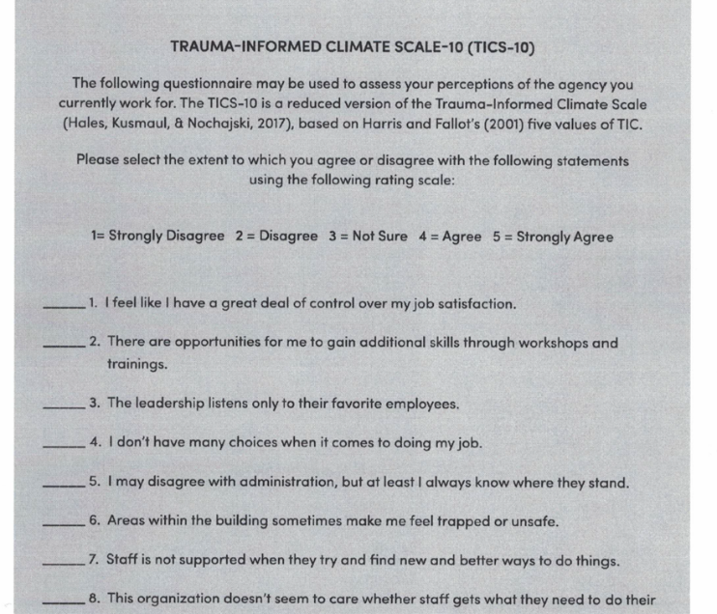
Trauma-Informed Climate Scale - 10
Trauma-Informed Organization Change Manual, http://socialwork.buffalo.edu/social-research/institutes-centers/institute-on-trauma-and-trauma-informed-care/Trauma-Informed-Organizational-Change-Manual0.html
Notes:
Risk of this tool being a “flavor of the month.”
You will likely decrease staff trust if you ask them to complete this questionnaire and then do nothing with the results.

Slide 39
“The TICS-10 ultimately measures the extent to which employee rights, freedoms, and contributions are valued within the agency, and research has demonstrated how the prioritization of these values can contribute to the overall success of the agency.”
(Hales, Green, Bissonette et al., 2018)

Slide 40
Results of the TICS-10
What would you do if a majority of staff do not believe that the organization cares whether staff gets what they need to do their job well?
What would you do if a significant segment of staff say they don’t know where they stand if they disagree with administration?
What happens if a few people report they are uncomfortable with a co-worker?

Slide 41
Providing time and space for peer support & debriefing

Slide 42
Wanting and Needing to Debrief is Natural
Alleviate some of the burden, the grief, the sadness
Turning to others for support and validation is healthy
The problem is that we’re not doing it properly
What can we do differently?
Francoise Mathieu of Compassion Fatigue Solutions & Professional Development, http://www.compassionfatigue.org/pages/LowImpactDisclosure.pdf

Slide 43
Low Impact Debriefing
Self-awareness of the story
How do you debrief when you’ve seen or heard hard things? Is it in formal supervision or informal time with colleagues? How much detail do you provide? What is most helpful to you in dealing with difficult stories?
Fair warning
Let the other person know some of the story is traumatic, give the listener a chance to brace themselves. “I would like to talk with you about a difficult situation and the story involves traumatic content.”
Francoise Mathieu of Compassion Fatigue Solutions & Professional Development, http://www.compassionfatigue.org/pages/LowImpactDisclosure.pdf
Low Impact Debriefing by TEND, https://www.tendacademy.ca/low-impact-debriefing-how-to-stop-sliming-each-other/

Slide 44
Low Impact Debriefing
Consent by recipient
Ask for consent, “I heard something really hard today, could I talk to you about it?”
The listener has a chance to decline or to qualify what they are able/ready to hear
Responsibility to say “no” if unable or not ready
Limited disclosure
Decide how much to share
Start with least traumatic information and gradually progress
You may not need to share the most graphic details
Francoise Mathieu of Compassion Fatigue Solutions & Professional Development, http://www.compassionfatigue.org/pages/LowImpactDisclosure.pdf
Low Impact Debriefing by TEND, https://www.tendacademy.ca/low-impact-debriefing-how-to-stop-sliming-each-other/

Slide 45
Next Steps
By next Monday, I will…
I will share this information with…
Notes:
Write one thing in the chat box.
Or, call out!

Slide 46
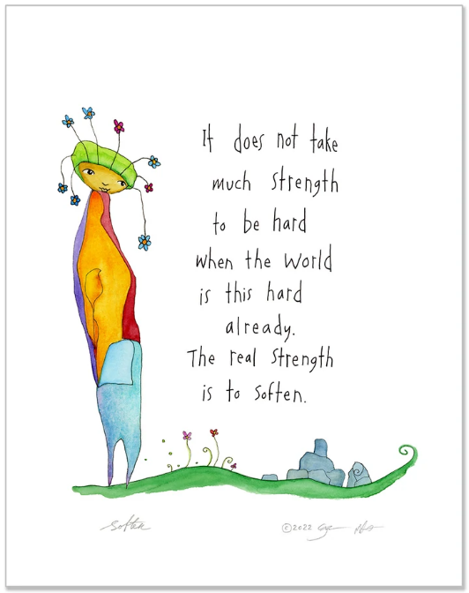
Thank you for sharing part of your day with us.
Nancy & Paige
https://www.storypeople.com/

Slide 47
Coming Up….Developing Leaders for the Future
September 22nd, 4pm ET

