Slide 1


Welcome to our roundtable series.
We’re glad you’re here.
Roundtable Discussion #6
September 22nd, 2022

Slide 2

Our Work Together
JoAnne Reifsnyder PhD, MSN, MBA, RN, FAAN
Professor, Health Services Leadership and Management
University of Maryland School of Nursing
Former Chief Nursing Officer, Genesis HealthCare

Slide 3

AFHS 4 “M’s” Applied to the Careforce
What Matters (facility culture, respect, a voice),
Medication (health promotion & workplace safety),
Mentation (wellbeing of staff with a focus on stress management and compassionate self-care), and
Mobility (opportunities for personal growth and career advancement with ongoing education)
Notes:
these focused, collaborative discussions will lead to the development of action plans to include concrete, practical steps that PALTC facilities can start taking immediately to build trust with current staff and recruit and retain new staff to grow and strengthen the PALTC workforce.

Slide 4
To Level Set….
We are a community focused on co-design
“All teach, all learn”¹
Small tests of change
Collation and dissemination of insights
¹Project ECHO. (2022). https://hsc.unm.edu/echo/what-we-do/about-the-echo-model.html

Slide 5
Roundtable Topics & Speakers
April 28 Kick-off: The 4Ms Expanded for Staff (Emily Nicoli, MS, RN, CRNP, Chief Nursing Officer, UnitedHealthcare Retiree Solutions)
May 26 Sustaining Compassion & Calling in the Midst of Crisis: Schwartz Center Rounds (Beth Lown, MD, CMO, Schwartz Center for Compassionate Healthcare)
June 23 Career Mobility and Shared Governance (Erin Woodford, MSN, RN, VP of Population Health, Genesis Healthcare)
July 28 Health Promotion and Stress Management (Kelly Doran, PhD, RN, Associate Professor, University of Maryland School of Nursing)
August 25 Trauma-informed Care for our Careforce (Nancy Kusmaul, PhD, MSW, Assoc. Prof. at UMBC and Paige Hector, LMSW, MSW )
Sept 22 The Role of Leadership in Staff Growth & Retention (Nancy Istenes, DO, CMD, FACP and CMO of Saber Healthcare Group, and Shauna Assadzandi, MD, AMDA Futures Participant)

Slide 6
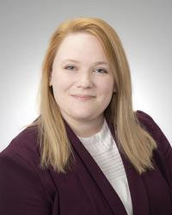
Today’s Speakers:
Dr. Shauna Assadzandi is a graduate of Mercyhurst University and the West Virginia University School of Medicine, where she also completed her Family Medicine residency. Dr. Assadzandi then pursued a Geriatric Medicine Fellowship at UPMC Presbyterian-Shadyside and is now a clinical assistant professor of medicine for UPMC’s Division of Geriatric Medicine. She also provides patient care at Asbury Heights, a continuing care retirement community. Dr. Assadzandi’s research focuses on frailty evaluation and treatment in PALTC. Her educational pursuits are focused on increasing resident and medical student presence in PALTC settings.
Shauna Assadzandi, MD

Slide 7
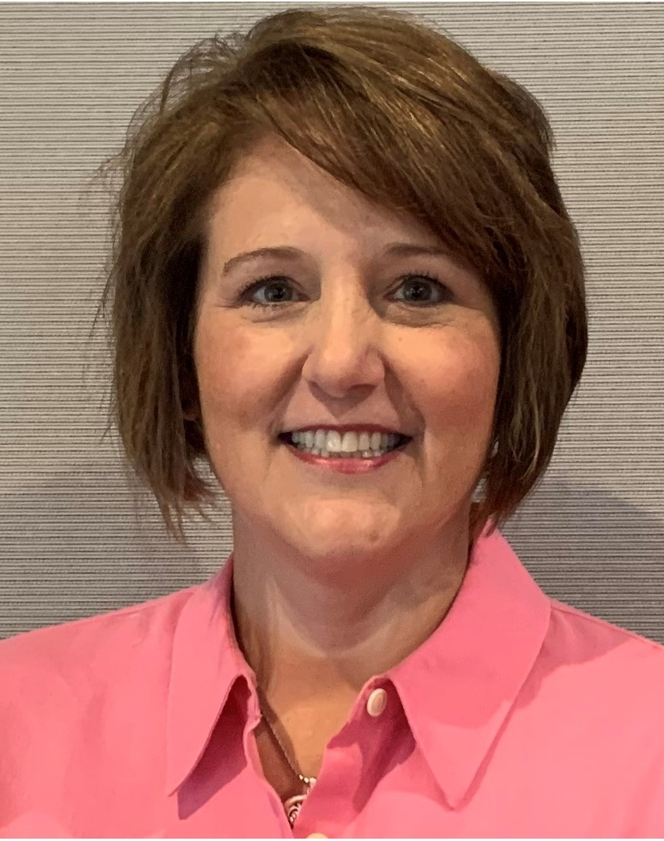
Today’s Speakers:
Dr. Nancy A. Istenes is the Chief Medical Officer for Saber Healthcare Group. She is a graduate of the Philadelphia College of Osteopathic Medicine and completed her residency training in Internal Medicine in Pittsburgh, Pennsylvania and a Geriatric Medicine Fellowship at The Cleveland Clinic. She is board certified in Internal Medicine and Geriatric Medicine. She practiced at Summa Health System in Akron, Ohio for 15 years and specialized in developing innovative models of care delivery for complex medical patients. She has always had a passion for nursing home residents and has spent a large part of her career working in a skilled nursing facility and long-term care setting. She is a Certified Medical Director and serves as the chair of the Workforce Development Committee for The Society for Post-Acute and Long-Term Care Medicine and is on the board of directors for the Ohio Medical Directors Association. When she is not working you will find her relaxing with her husband at their home in Hudson, Ohio or traveling and she almost always has a pair of knitting needles in her bag.
Nancy Istenes, DO, CMD, FACP

Slide 8
Today’s Discussion
What specific actions can medical leaders take to grow and strengthen the PALTC Careforce?
What actions are being taken by nursing, medical, operations, social services, rehab and other leaders ~
  What matters most?
  What has worked?
  What are you thinking about trying?
What could AMDA do to support/accelerate PALTC leaders’ actions to grow and strengthen the Careforce?

Slide 9
https://paltc.org/goodthing
Next steps… and Thank You!

