Slide 1
Diabetes Management in Post-Acute and Long-Term Care Setting
Teaching Slides based on the
PALTmed 2024 Clinical Practice Guideline

Slide 2
Introduction to Diabetes in the Post-Acute and Long-Term Care Setting
The prevalence of patients with diabetes in post-acute and long-term (PALTC) facilities in the United States is estimated to be between 25% to 34%.
For older adults, diabetes is an independent predictor of placement in a PALTC facility.
Patients with diabetes in PALTC facilities are a vulnerable group who often take multiple medications; experience frequent infections; and have high rates of cardiovascular complications, dehydration, hospitalizations, hyperosmolar states, functional decline and cognitive impairment.

Slide 3
Scope of the Problem
Multiple comorbidities, functional impairments, and psychosocial issues may increase the complexity of diabetes management in the post-acute and long-term care (PALTC) setting.
In patients with dementia, hyperglycemia and hypoglycemia may impair cognition, while chronic hyperglycemia may contribute to further functional decline. Hyperglycemia may also decrease pain thresholds, impair vision, impede wound healing, and increase risk for falls.
Increased attention is now focused on cardiovascular-kidney-metabolic health, as described by a 2023 Presidential Advisory from the American Heart Association. It is essential that healthcare providers who are caring for patients with diabetes understand the role that diabetes management plays in a patient’s overall health and well-being.

Slide 4
The CPG provides a new way to conceptualize the diagnosis, assessment, and management of diabetes among older adults across the long-term care continuum:
Less rigid
More focused on person-centered approaches and quality of life
Addresses long-term impact of diabetes in older adults and those closer to end of life
Considers management of diabetes across all long-term care settings, including guidance for those in assisted living communities
Available for download at: https://paltmed.org/products/diabetes-management-cpg

Slide 5
Use of Diabetes Clinical Practice Guidelines
PALTmed’s Clinical Practice Guideline (CPG) presents an updated, evidence-based approach to diabetes management among older adults across PALTC settings.
Major changes around managing medications, setting individual patient goals, and other key components of quality care require clinicians to re-evaluate how they treat patients with diabetes as well as how to most effectively collaborate with the interdisciplinary team to achieve optimal outcomes.
In conjunction with the integration of the Age-Friendly Health Systems “4 Ms” framework into our plans of care (What Matters, Medication, Mentation, and Mobility), diabetes management should also incorporate shared decision making and goal setting that includes the older adult and his or her proxy.
https://www.johnahartford.org/grants-strategy/current-strategies/age-friendly/age-friendly-health-systems-initiative

Slide 6
Using the 4Ms Framework of Age-Friendly Health Systems to Address Patient-Specific Issues That Can Affect Diabetes Management in the PALTC Setting
MENTATION Ability to use diabetes technology Anxiety Depression or dementia Coping skills and self-care | MEDICATIONS Affordability or insurance coverage End-organ disease or complications affecting medication choice History of adverse medication effects Social and family support Risk of hypoglycemia, hypoglycemia unawareness
MOBILITY Foot complications Functional ability Frailty and sarcopenia Leg weakness Neuropathy Vision status | WHAT MATTERS MOST Advanced care planning Macrovascular and microvascular complications Quality of life Remaining life expectancy Risks, burdens and benefits of treatment Treatment preferences (diet, injections, blood glucose monitoring)

Slide 7
Recognition Assessment Treatment Monitoring

Slide 8
Recognition of Diabetes
Possible symptoms and signs of hyperglycemia in frail older adults
Blurred vision
Fruity breath odor
Lethargy
New or increasing confusion
Polydipsia, polyphagia
Polyuria or worsening incontinence
Weight loss
Physical data
Vital signs and current blood glucose levels
Any symptoms of a current acute illness, including infection or an unstable chronic condition
Significant changes in function, cognition, or level of consciousness

Slide 9
Table 4 from CPG

Slide 10
Criteria for Diagnosis of Pre-Diabetes or Diabetes
Pre-diabetes laboratory values: A1C 5.7%–6.4% (39–-47 mmol/mol) or FPG 100 mg/dL (5.6 mmol/L) to 125 mg/dL (6.9 mmol/L) (IFG) | Criteria for diagnosis of diabetes: 1) A1C >6.5% or higher (>48 mmol/mol or higher), 2) FPG >126 mg/dL or higher (>7 mmol/L or higher), needs to be fasting for 8hrs 3) In a patient with classic symptoms of hyperglycemia or hyperglycemic crisis, a random plasma glucose level of >200 mg/dL or higher (>11.1 mmol/L or higher) Oral glucose tolerance test is not optimal in LTC patients
FPG: fasting plasma glucose; IFG,: impaired fasting glucose; IGT,: impaired glucose tolerance Source: Adapted from ADA, 2024

Slide 11
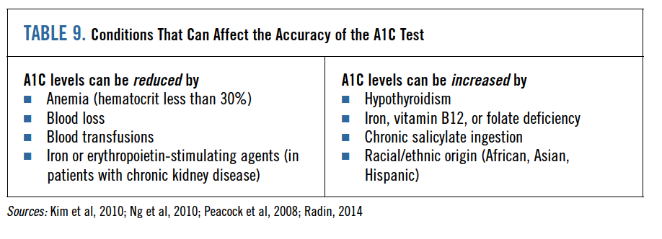
Table 9 from CPG

Slide 13
Recognition Assessment Treatment Monitoring

Slide 14
Medical History
Age and sex
Blood glucose trends over past week
Onset and duration of any blood glucose changes
Changes in food and fluid intake and urine output over past week
All current medications, including any recent changes
All current diagnoses
Doses and times of most recent glucose-lowering medication given
Recent or current changes in dietary intake
Any current skin breakdown
Baseline A1c

Slide 15
Assess Patient’s Risk for Hypoglycemia
Intensive glycemic control with regimens including insulin and sulfonylureas in older adults with comorbidities has been identified as overtreatment and found to be very common in clinical practice.
Older adults with diabetes in PALTC have a disproportionately high number of clinical complications and comorbidities that can increase hypoglycemia risk.
The risk of severe hypoglycemia is the most important factor determining glycemic goals and treatment choices in older patients with diabetes

Slide 16
Possible symptoms and signs of hypoglycemia
Altered behavior and cognition
Altered level of consciousness (drowsiness, lethargy,)
Confusion or disorientation
Falls
Generalized weakness
Hunger
Irritability
Poor concentration and coordination

Slide 17
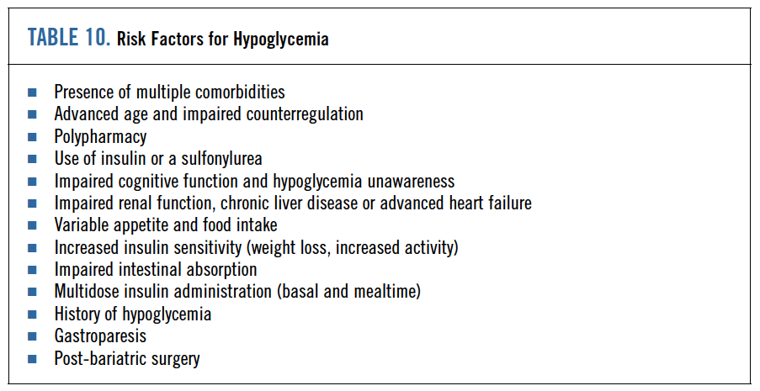
Table 10 from CPG

Slide 18
Three categories of hypoglycemia
Level 1: Glucose less than< 70 mg/dL (3.0 mmol) and greater than>54 mg/dL (3.0 mmol/L)
Level 2: Glucose less than <54 mg/dL (3.0 mmol/dL)
Level 3: A severe event characterized by altered mental and/or physical status and requiring assistance for treatment of hypoglycemia

Slide 19
Recognition Assessment Treatment Monitoring

Slide 20
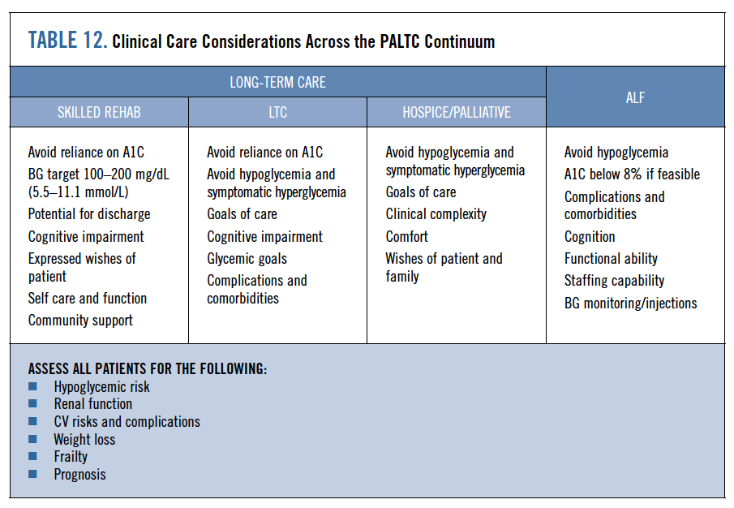
Table 12 from CPG

Slide 21
Overview of Available Oral Antidiabetic Agents

Slide 22
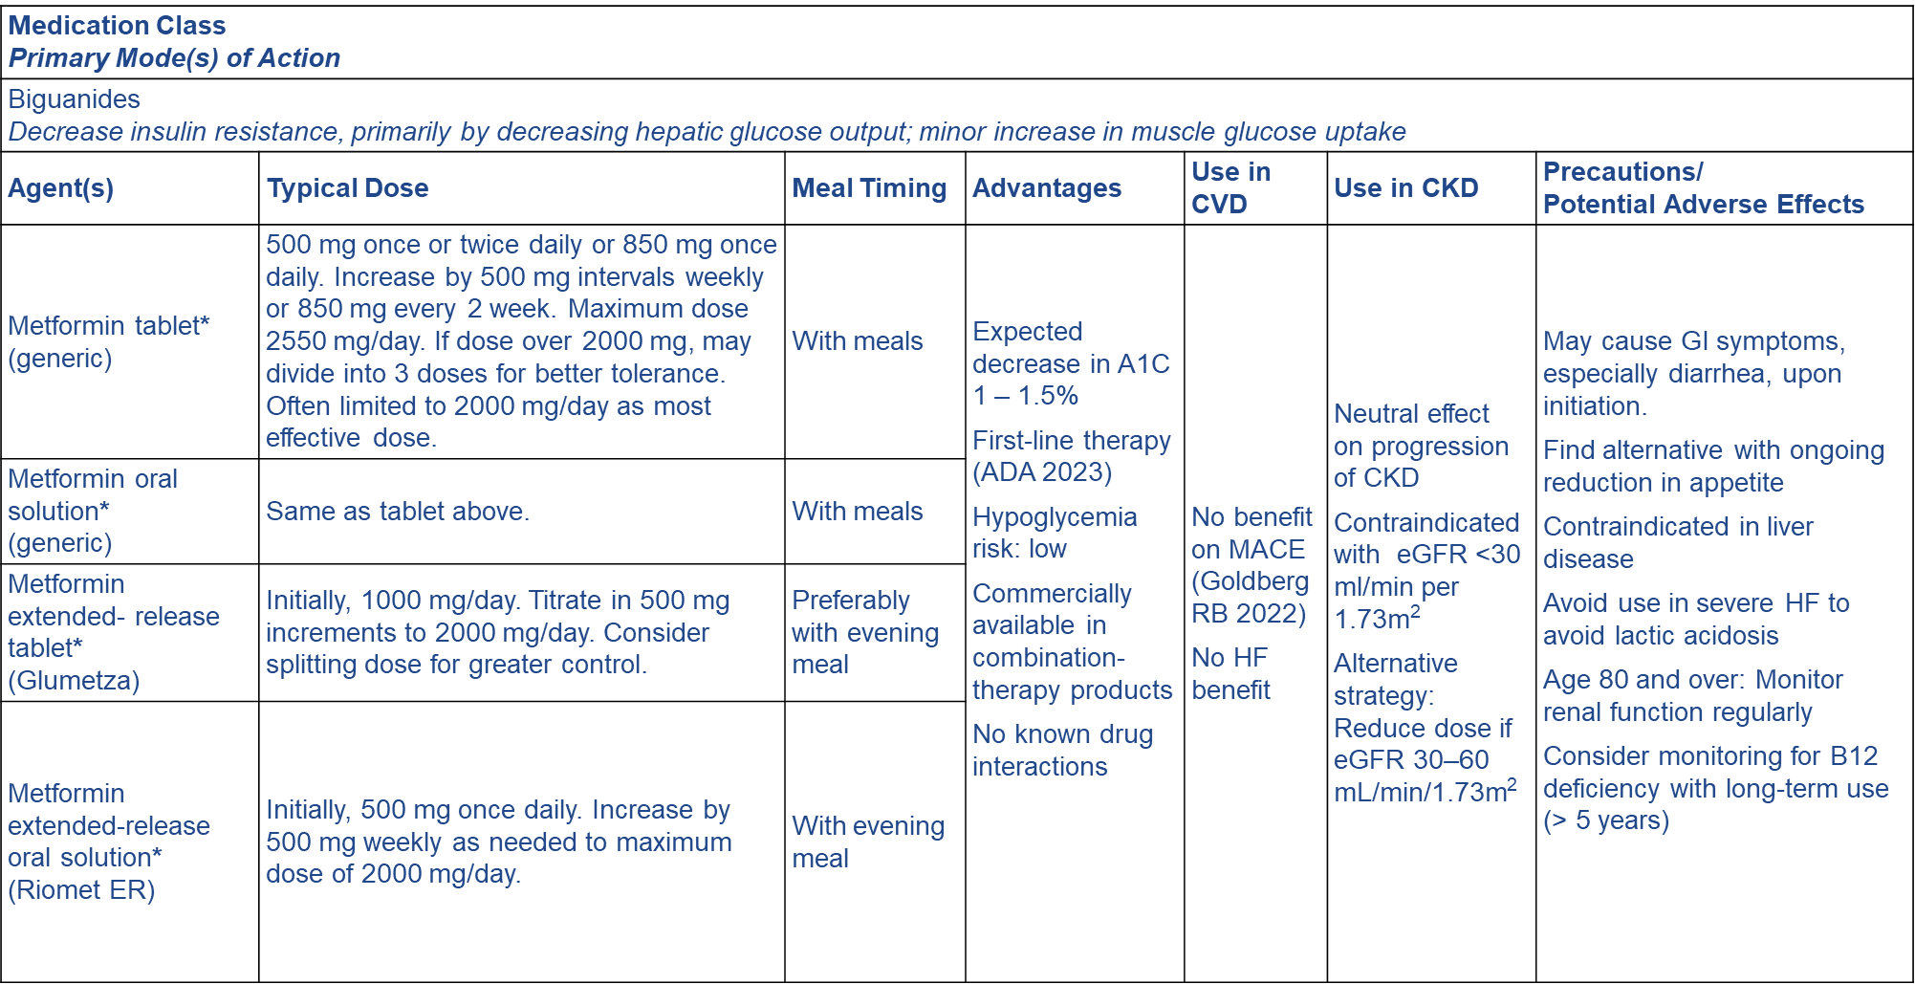

Slide 23
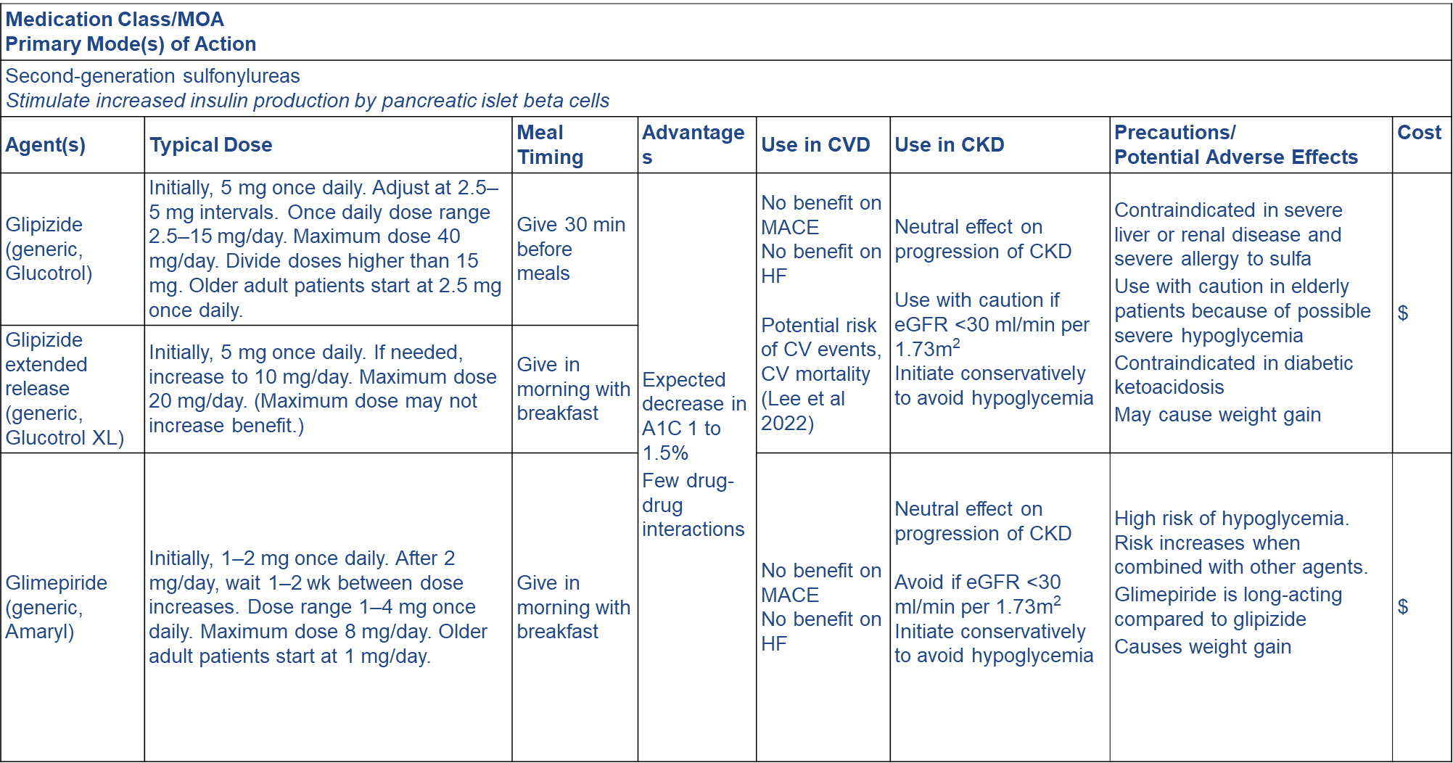

Slide 24
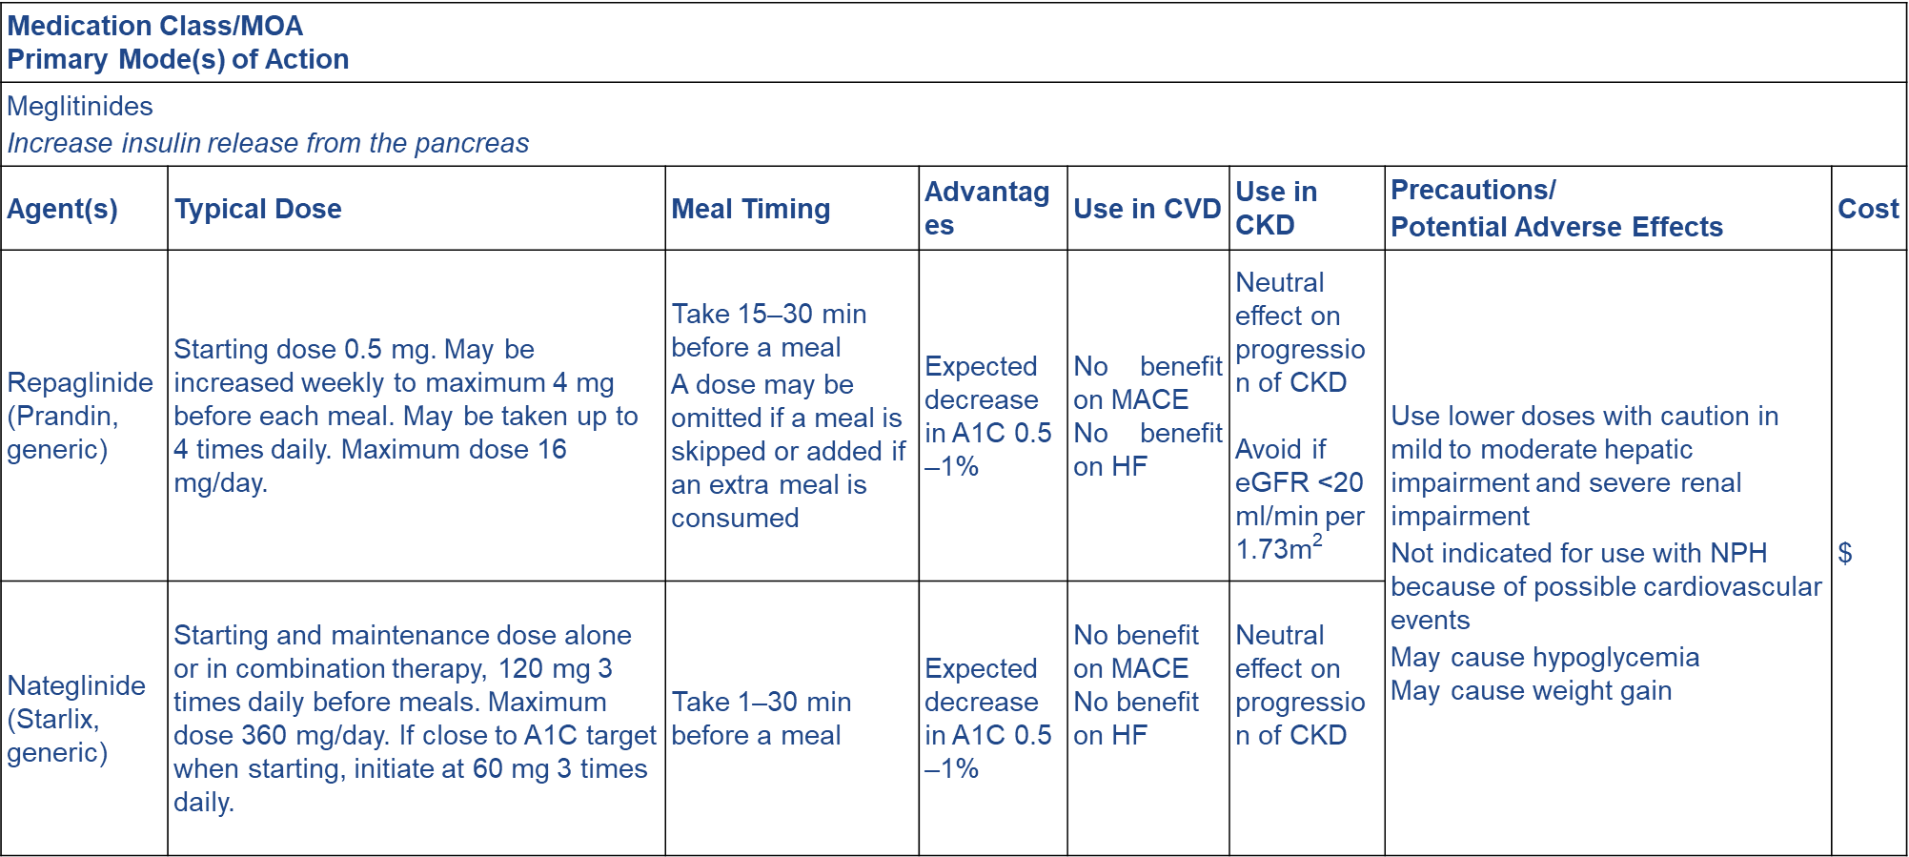

Slide 25
Insulin Therapy
Because type 2 diabetes is characterized by resistance to insulin, and later in the course of the disease by the progressive failure of the pancreas to produce insulin, many patients with diabetes in the PA/LTC setting may eventually require insulin therapy to manage their disease.
The addition of basal insulin is usually an effective intervention when oral agents alone do not achieve target blood glucose levels

Slide 26
Types of Insulin
Rapid Acting: Insulin Lispro (Humalog, Lyumjev, Admelog), Insulin Aspart (Novolog, Flasp), Insulin Glulisine (Apidra)
Short Acting: Insulin Human regular (Humulin R, Novolin R)
Intermediate Acting: NPH Insulin (Humulin N, Novolin N)
Long Acting: Insulin Glargine (Lantus, Basalgar, Semglee), Insulin Detemir
Ultra-long acting: Insulin Degludec (Tresiba), Insulin glargine (Toujeo)
Ultra-rapid acting: Afrezza

Slide 27
Premixed Fixed-Dose Combination Insulins
Standard combinations: Regular Human Insulin (Humulin 70/30, Novolin 70/30)
Analog combinations: Lispro (Humalog 50/50, Humalog 75/25); Aspart (Novolog 70/30)
Inhaled Insulin
Inhalation powder

Slide 28
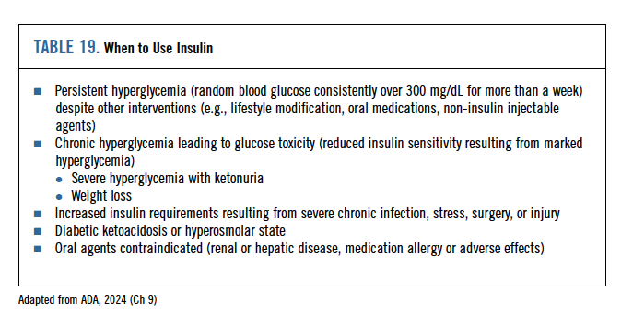
Table 19 from CPG

Slide 29
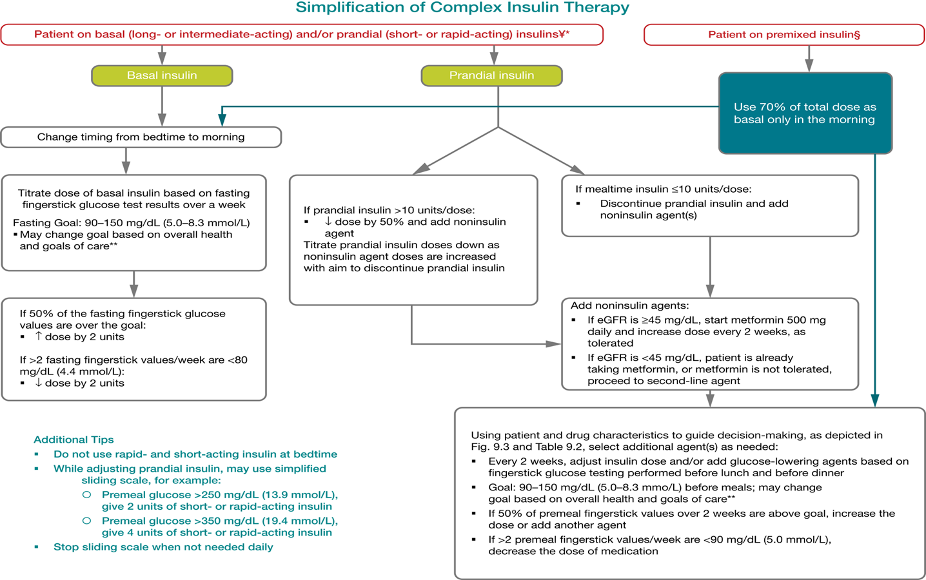

Slide 30
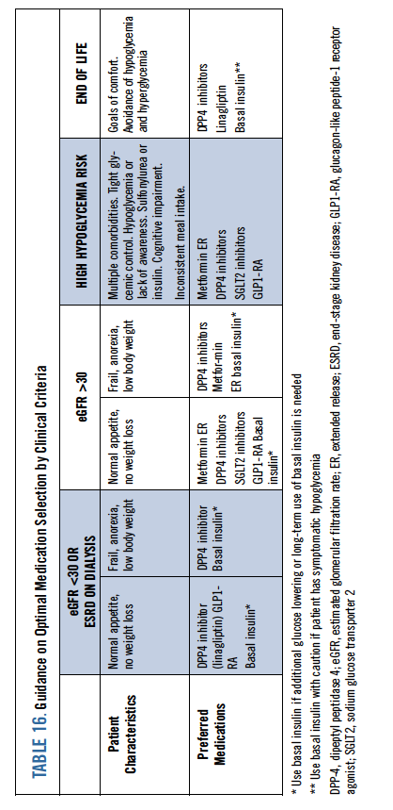
Table 16 from CPG

Slide 31
Treatment of Hypoglycemia
The “Rule of 15” says to administer 15 grams of carbohydrates and recheck the patient’s blood glucose level sugar in 15 minutes. If the glucose level is still less than 70 mg/dl, administer another 15 grams of carbohydrates and recheck after 15 minutes. Repeat this process until the patient’s blood glucose level increases. Examples of 15 grams of carbohydrates are
Three 5-gram glucose tablets
Four 4-gram glucose tablets
1 tube of glucose gel
4 ounces of fruit juice

Slide 32
Appropriate Use of Glucagon
Prescribe glucagon to all patients who are at increased risk for experiencing blood glucose levels below 54 mg/dL. Glucagon should also be used when a patient is obtunded or is unable or unwilling to consume oral glucose.
New glucagon formulas are now available to replace the older glucagon emergency kits that require manual reconstitution at the time of use and can be difficult for caregivers to use.
One of the new formulas (Baqsimi) is delivered nasally in powdered form; another (Gvoke) is a pre-mixed, solubilized liquid glucagon in an autoinjector or prefilled syringe that is administered subcutaneously.

Slide 33
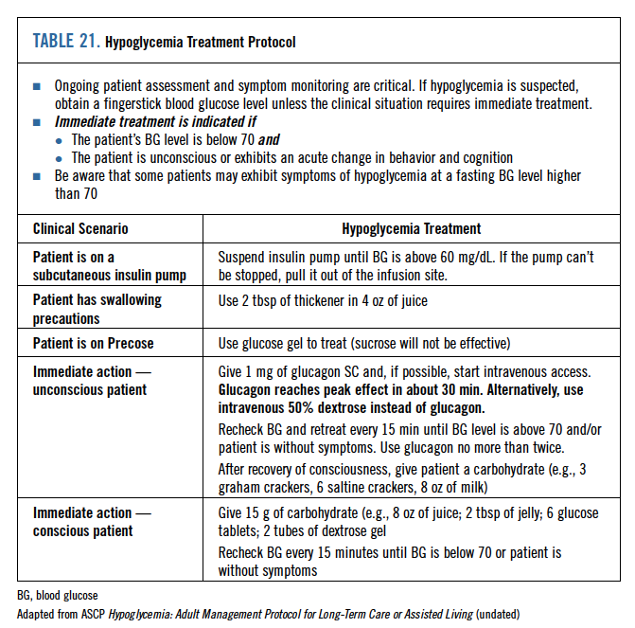
Table 21 from CPG

Slide 34
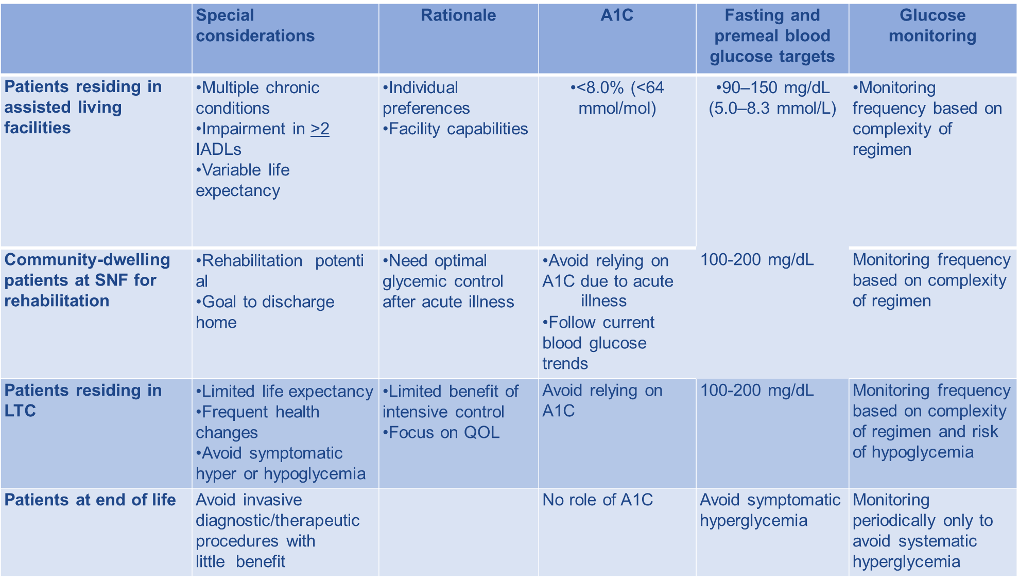
Glycemic and HbA1C Goals in PALTC

Slide 35
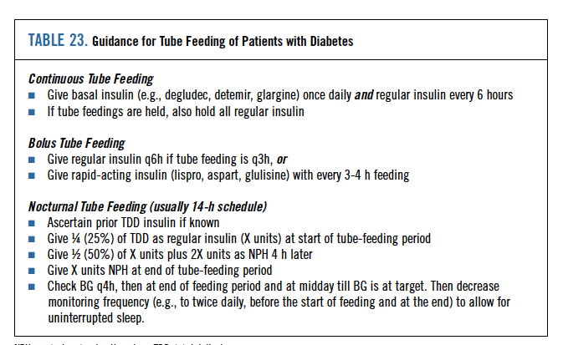
Table 23 from CPG

Slide 36
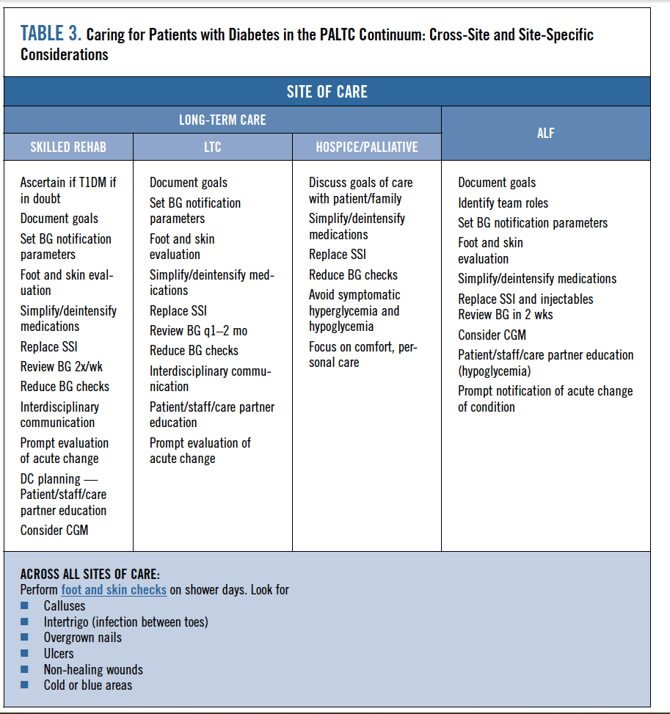
Components of a Systematic Facility Approach to Diabetes Management

Slide 37
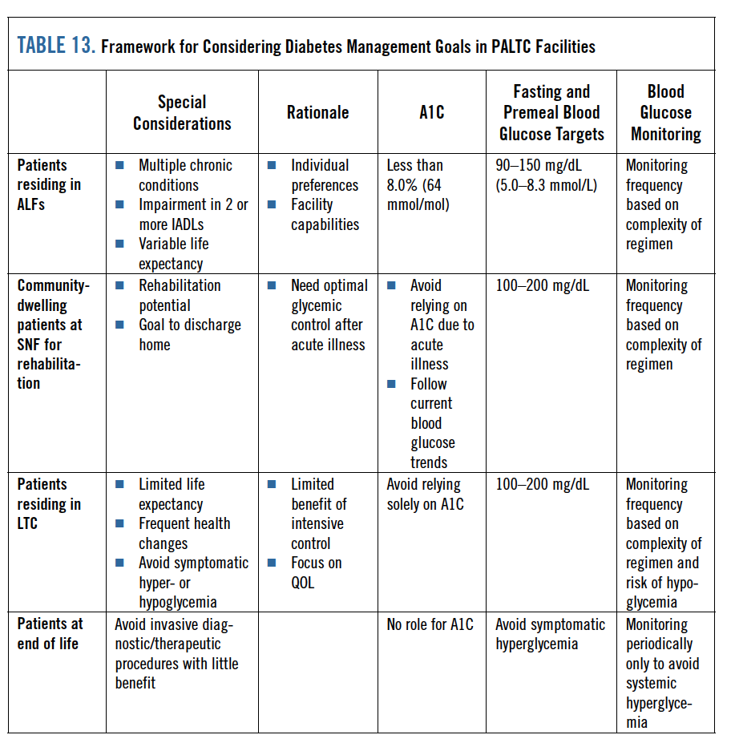
Table 13 from CPG

Slide 38
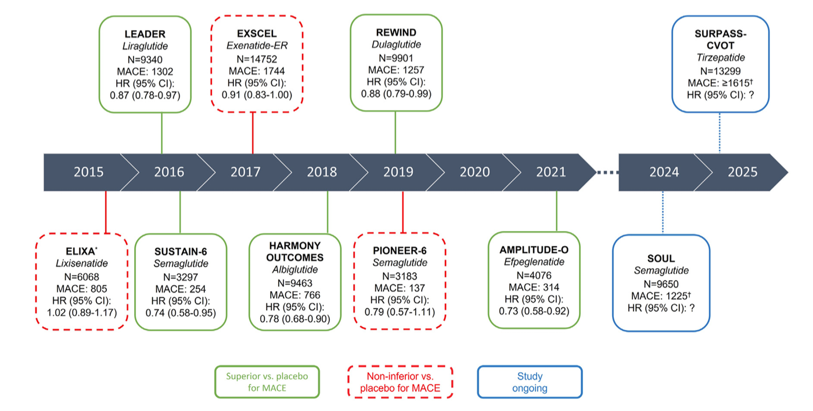
Cardiovascular Benefit – GLP-1s and MACE
Source: Nicholls SJ et al. Am Heart Journal 2024;267.

Slide 39
The Association of Diabetes with Comorbidities
There is strong evidence showing that type 2 diabetes increases cardiovascular morbidity and death.
The risk of acute coronary heart disease, ischemic stroke, and mortality are all increased two to four times in patients with diabetes.
Patients with diabetes tend to have higher rates of falls, dementia, kidney disease, and visual impairment.

Slide 40
Treatment Guidance for Patients with Cardiorenal Comorbidities
In patients with eGFR < 30 ml/min/1.73m2, glucagon-like peptide-1 receptor agonists such as subcutaneous liraglutide, semaglutide, or dulaglutide are preferred, as they demonstrated advantageous atherosclerotic cardiovascular and kidney outcomes
In patients with heart failure (systolic and/or diastolic), and/or with CKD with eGFR between 25 and 60 ml/min, a sodium-glucose co-transporter 2 inhibitor such as empagliflozin, canagliflozin or dapagliflozin is the preferred choice that have demonstrated cardiorenal benefit.
SGLT2 inhibitors should not be initiated if eGFR <30 to 45 mL /min. In this case, the use of an alternative or additional agent (commonly a GLP-1 RA) is indicated to achieve glycemic goals.

Slide 41
Caveats and cautions when prescribing diabetes medications in PALTC
Medication | AVOID IF:
Metformin | GFR<30, decompensated HF, hepatic disease, risk of dehydration, unexplained diarrhea Consider ER…
GLP1-RA | Weight loss, anorexia, gastroparesis, chronic constipation, unexplained GI symptoms. Preferred if ASCVD or HF
SGLT2i | AVOID if on dialysis, unable to drink fluids independently, dehydration, incontinence, frequent UTI or genital yeast infection, weight loss, fractures. Stop 5 d prior to elective procedure. Preferred if CKD or HF.
DPP-4 inhibitor | Unexplained GI symptoms, severe anorexia (Should NOT be used with concurrent GLP1-RA)
Basal insulin | Injectable treatments not possible in care setting (e.g., some ALF facilities), if BG monitoring inconsistent, lack of caregiver support, hypoglycemia risk (Stop sulfonylureas, stop SSI)
Prandial insulin | Injectable treatments not possible in care setting, if BG monitoring inconsistent, lack of caregiver support, hypoglycemia risk, erratic meal consumption, tube feeding (Stop sulfonylureas, stop SSI)
Sulfonylureas | Hypoglycemia risk, dementia, concurrent insulin use
Thiazolidinediones | Heart failure, other edema, osteoporosis, bladder cancer

Slide 42
Recognition Assessment Treatment Monitoring

Slide 43
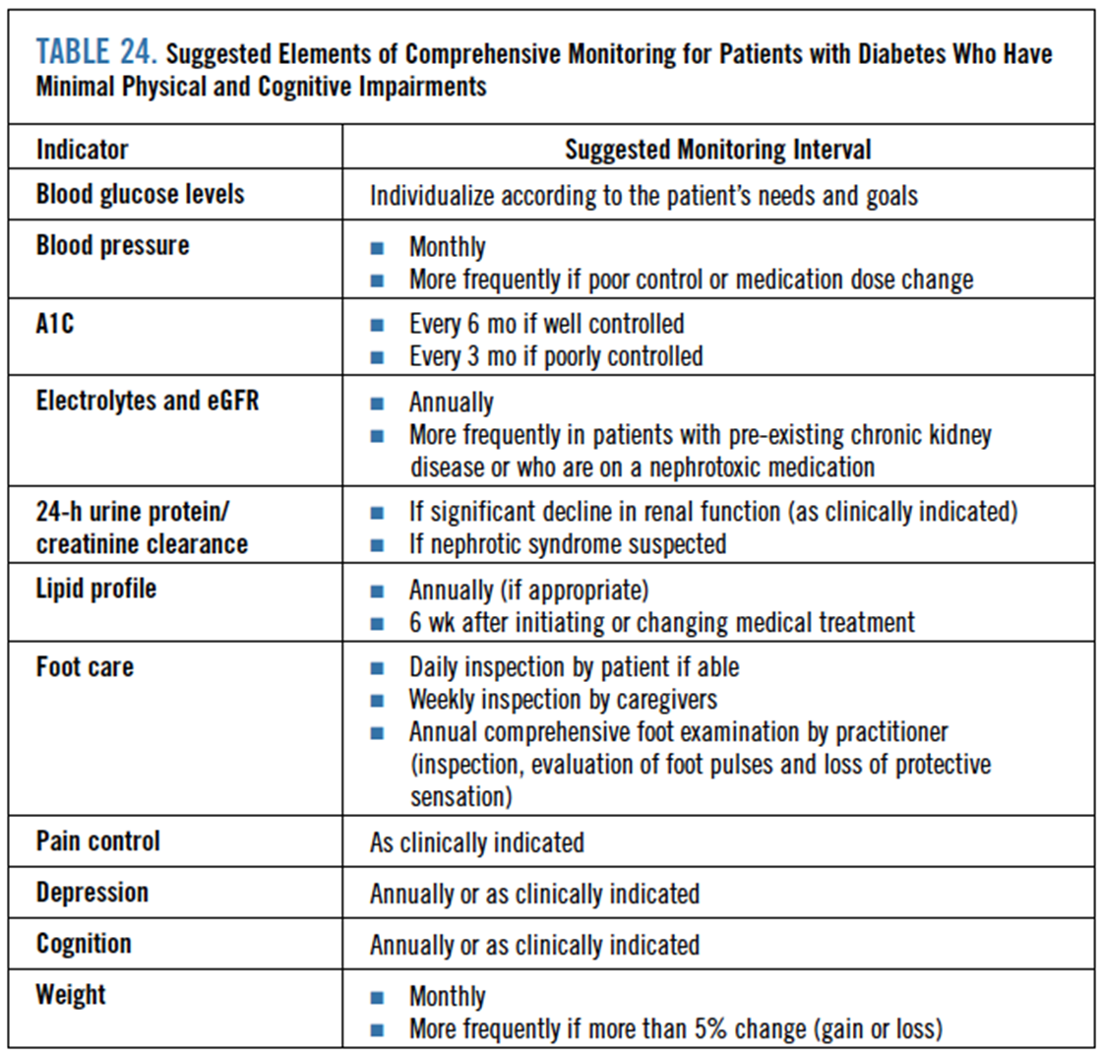
Table 24 from CPG

Slide 44
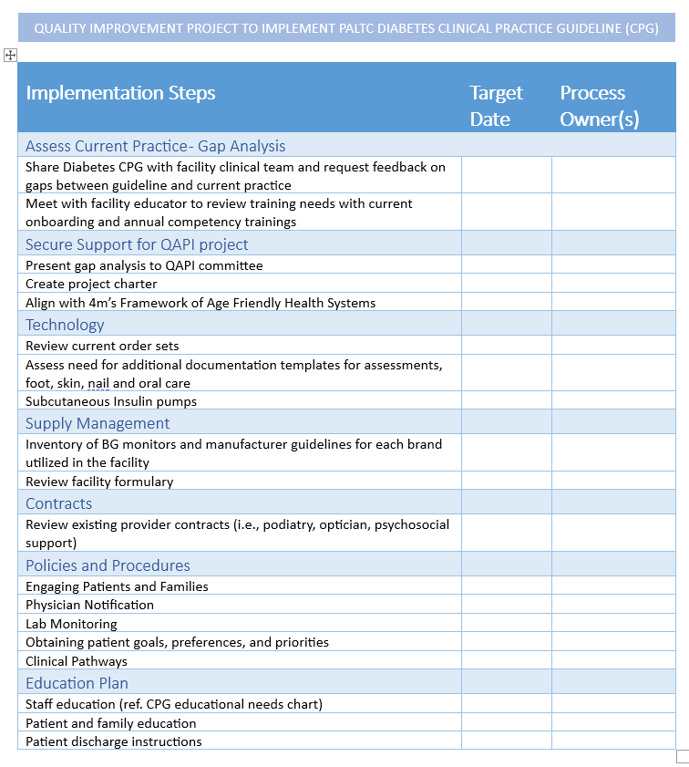
Facility Implementation Steps for Diabetes CPG

Slide 45
Take Home Messages
Holistic assessment of patients with diabetes using the Age-Friendly Health Systems 4Ms Framework is useful for planning care
Avoid strict adherence to low A1C goals
Avoid using sliding-scale insulin
Concurrent management of cardio-metabolic and renal complications influences outcome
Consider using oral agents in the classes DPP-4 inhibitors; SGLT2 inhibitors; and oral or injectable GLP1-RAs, each of which can improve diabetes management without increasing risk for hypoglycemia or other negative outcomes
Prepare and educate staff and clinicians in the use of diabetes technology as it is becoming more common in PALTC settings

Slide 46
Bibliography
Pandya N, Hames E, Sandhu S. Challenges and Strategies for Managing Diabetes in the Elderly in Long-Term Care Settings. Diabetes Spectr. 2020 Aug;33(3):236-245. doi: 10.2337/ds20-0018. PMID: 32848345; PMCID: PMC7428662.
Munshi, Medha N et al. “Management of Diabetes in Long-term Care and Skilled Nursing Facilities: A Position Statement of the American Diabetes Association.” Diabetes care vol. 39,2 (2016): 308-18.
Sircar, Mousumi et al. “Review of Hypoglycemia in the Older Adult: Clinical Implications and Management.” Canadian journal of diabetes vol. 40,1 (2016): 66-72.
Hume, Anne L et al. “Antihyperglycemic Drug Use in Long-Stay Nursing Home Residents with Diabetes Mellitus.” The journal of nursing home research sciences vol. 8 (2022): 10-19.
Fitzpatrick, D et al. “Structuring Diabetes Mellitus Care in Long-Term Nursing Home Residents.” Irish medical journal vol. 111,3 711. 14 Mar. 2018
Hurley, L et al. “Investigating the management of diabetes in nursing homes using a mixed methods approach.” Diabetes research and clinical practice vol. 127 (2017): 156-162.
Lega, Iliana C et al. “Glycemic Control and Use of High-risk Antihyperglycemic Agents Among Nursing Home Residents With Diabetes in Ontario, Canada.” JAMA internal medicine vol. 181,7 (2021): 992-994. doi:10.1001/jamainternmed.2021.0022
Pandya, N., Hames, E., & Sandhu, S. (2020). Challenges and strategies for managing diabetes in the elderly in long-term care settings. Diabetes Spectrum, 33(3), 236-245.
Sloane, P. D., & Pandya, N. (2021). Individualizing diabetes care in older persons with multimorbidity. Journal of the American Medical Directors Association, 22(9), 1884-1888.
Pandya, N., Jung, M., Norfolk, A., Goldblatt, C., Trenery, A., & Sieradzan, R. (2023). Medication Prescribing for Type 2 Diabetes in the US Long-Term Care Setting: Observational Study. Journal of the American Medical Directors Association, 24(6), 790-797.

