Slide 1
Diabetes Management in Post-Acute and Long-Term Care Setting
Teaching Slides based on the
PALTmed 2024 Clinical Practice Guideline

Slide 2
Introduction to Diabetes in the Post-Acute and Long-Term Care Setting
The prevalence of patients with diabetes in post-acute and long-term (PALTC) facilities in the United States is estimated to be between 25% to 34%.
For older adults, diabetes is an independent predictor of placement in a PALTC facility.
Patients with diabetes in PALTC facilities are a vulnerable group who often take multiple medications; experience frequent infections; and have high rates of cardiovascular complications, dehydration, hospitalizations, hyperosmolar states, functional decline and cognitive impairment.

Slide 3
Scope of the Problem
Multiple comorbidities, functional impairments, and psychosocial issues may increase the complexity of diabetes management in the post-acute and long-term care (PALTC) setting.
In patients with dementia, hyperglycemia and hypoglycemia may impair cognition, while chronic hyperglycemia may contribute to further functional decline. Hyperglycemia may also decrease pain thresholds, impair vision, impede wound healing, and increase risk for falls.
Increased attention is now focused on cardiovascular-kidney-metabolic health, as described by a 2023 Presidential Advisory from the American Heart Association. It is essential that healthcare providers who are caring for patients with diabetes understand the role that diabetes management plays in a patient’s overall health and well-being.

Slide 4
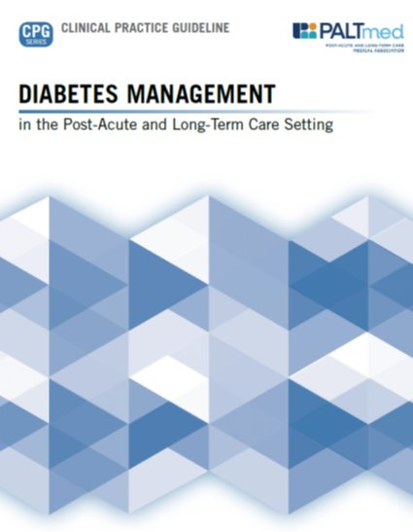
The CPG provides a new way to conceptualize the diagnosis, assessment, and management of diabetes among older adults across the long-term care continuum:
Less rigid
More focused on person-centered approaches and quality of life
Addresses long-term impact of diabetes in older adults and those closer to end of life
Considers management of diabetes across all long-term care settings, including guidance for those in assisted living communities
Available for download at: https://paltmed.org/products/diabetes-management-cpg

Slide 5
Use of Diabetes Clinical Practice Guidelines
PALTmed’s Clinical Practice Guideline (CPG) presents an updated, evidence-based approach to diabetes management among older adults across PALTC settings.
Major changes around managing medications, setting individual patient goals, and other key components of quality care require clinicians to re-evaluate how they treat patients with diabetes as well as how to most effectively collaborate with the interdisciplinary team to achieve optimal outcomes.
In conjunction with the integration of the Age-Friendly Health Systems “4 Ms” framework into our plans of care (What Matters, Medication, Mentation, and Mobility), diabetes management should also incorporate shared decision making and goal setting that includes the older adult and his or her proxy.
https://www.johnahartford.org/grants-strategy/current-strategies/age-friendly/age-friendly-health-systems-initiative

Slide 6
Using the 4Ms Framework of Age-Friendly Health Systems to Address Patient-Specific Issues That Can Affect Diabetes Management in the PALTC Setting
MENTATION Ability to use diabetes technology Anxiety Depression or dementia Coping skills and self-care | MEDICATIONS Affordability or insurance coverage End-organ disease or complications affecting medication choice History of adverse medication effects Social and family support Risk of hypoglycemia, hypoglycemia unawareness
MOBILITY Foot complications Functional ability Frailty and sarcopenia Leg weakness Neuropathy Vision status | WHAT MATTERS MOST Advanced care planning Macrovascular and microvascular complications Quality of life Remaining life expectancy Risks, burdens and benefits of treatment Treatment preferences (diet, injections, blood glucose monitoring)

