Slide 1
Improving Public Education with the
Serious Illness Messaging Toolkit
Marian Grant, DNP, Marketing Consultant

Slide 2
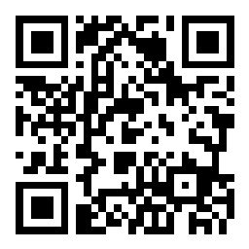
Participate in Polling
Scan the QR code or go to slido.com
Enter code #4603974
Select Session ID from the list

Slide 3
Speaker Disclosures
The speaker does not have relevant financial relationships.
All financial relationships have been identified, reviewed, and mitigated by The Society prior to this presentation.

Slide 4
Learning Objectives
By the end of the presentation, participants will be able to:
1. Describe the 5 evidence-based messaging principles for serious illness.
2. Discuss the online toolkit for serious illness messaging and how to use it.
3. Give examples of how leading organizations have used the toolkit to improve their public education and messaging

Slide 5
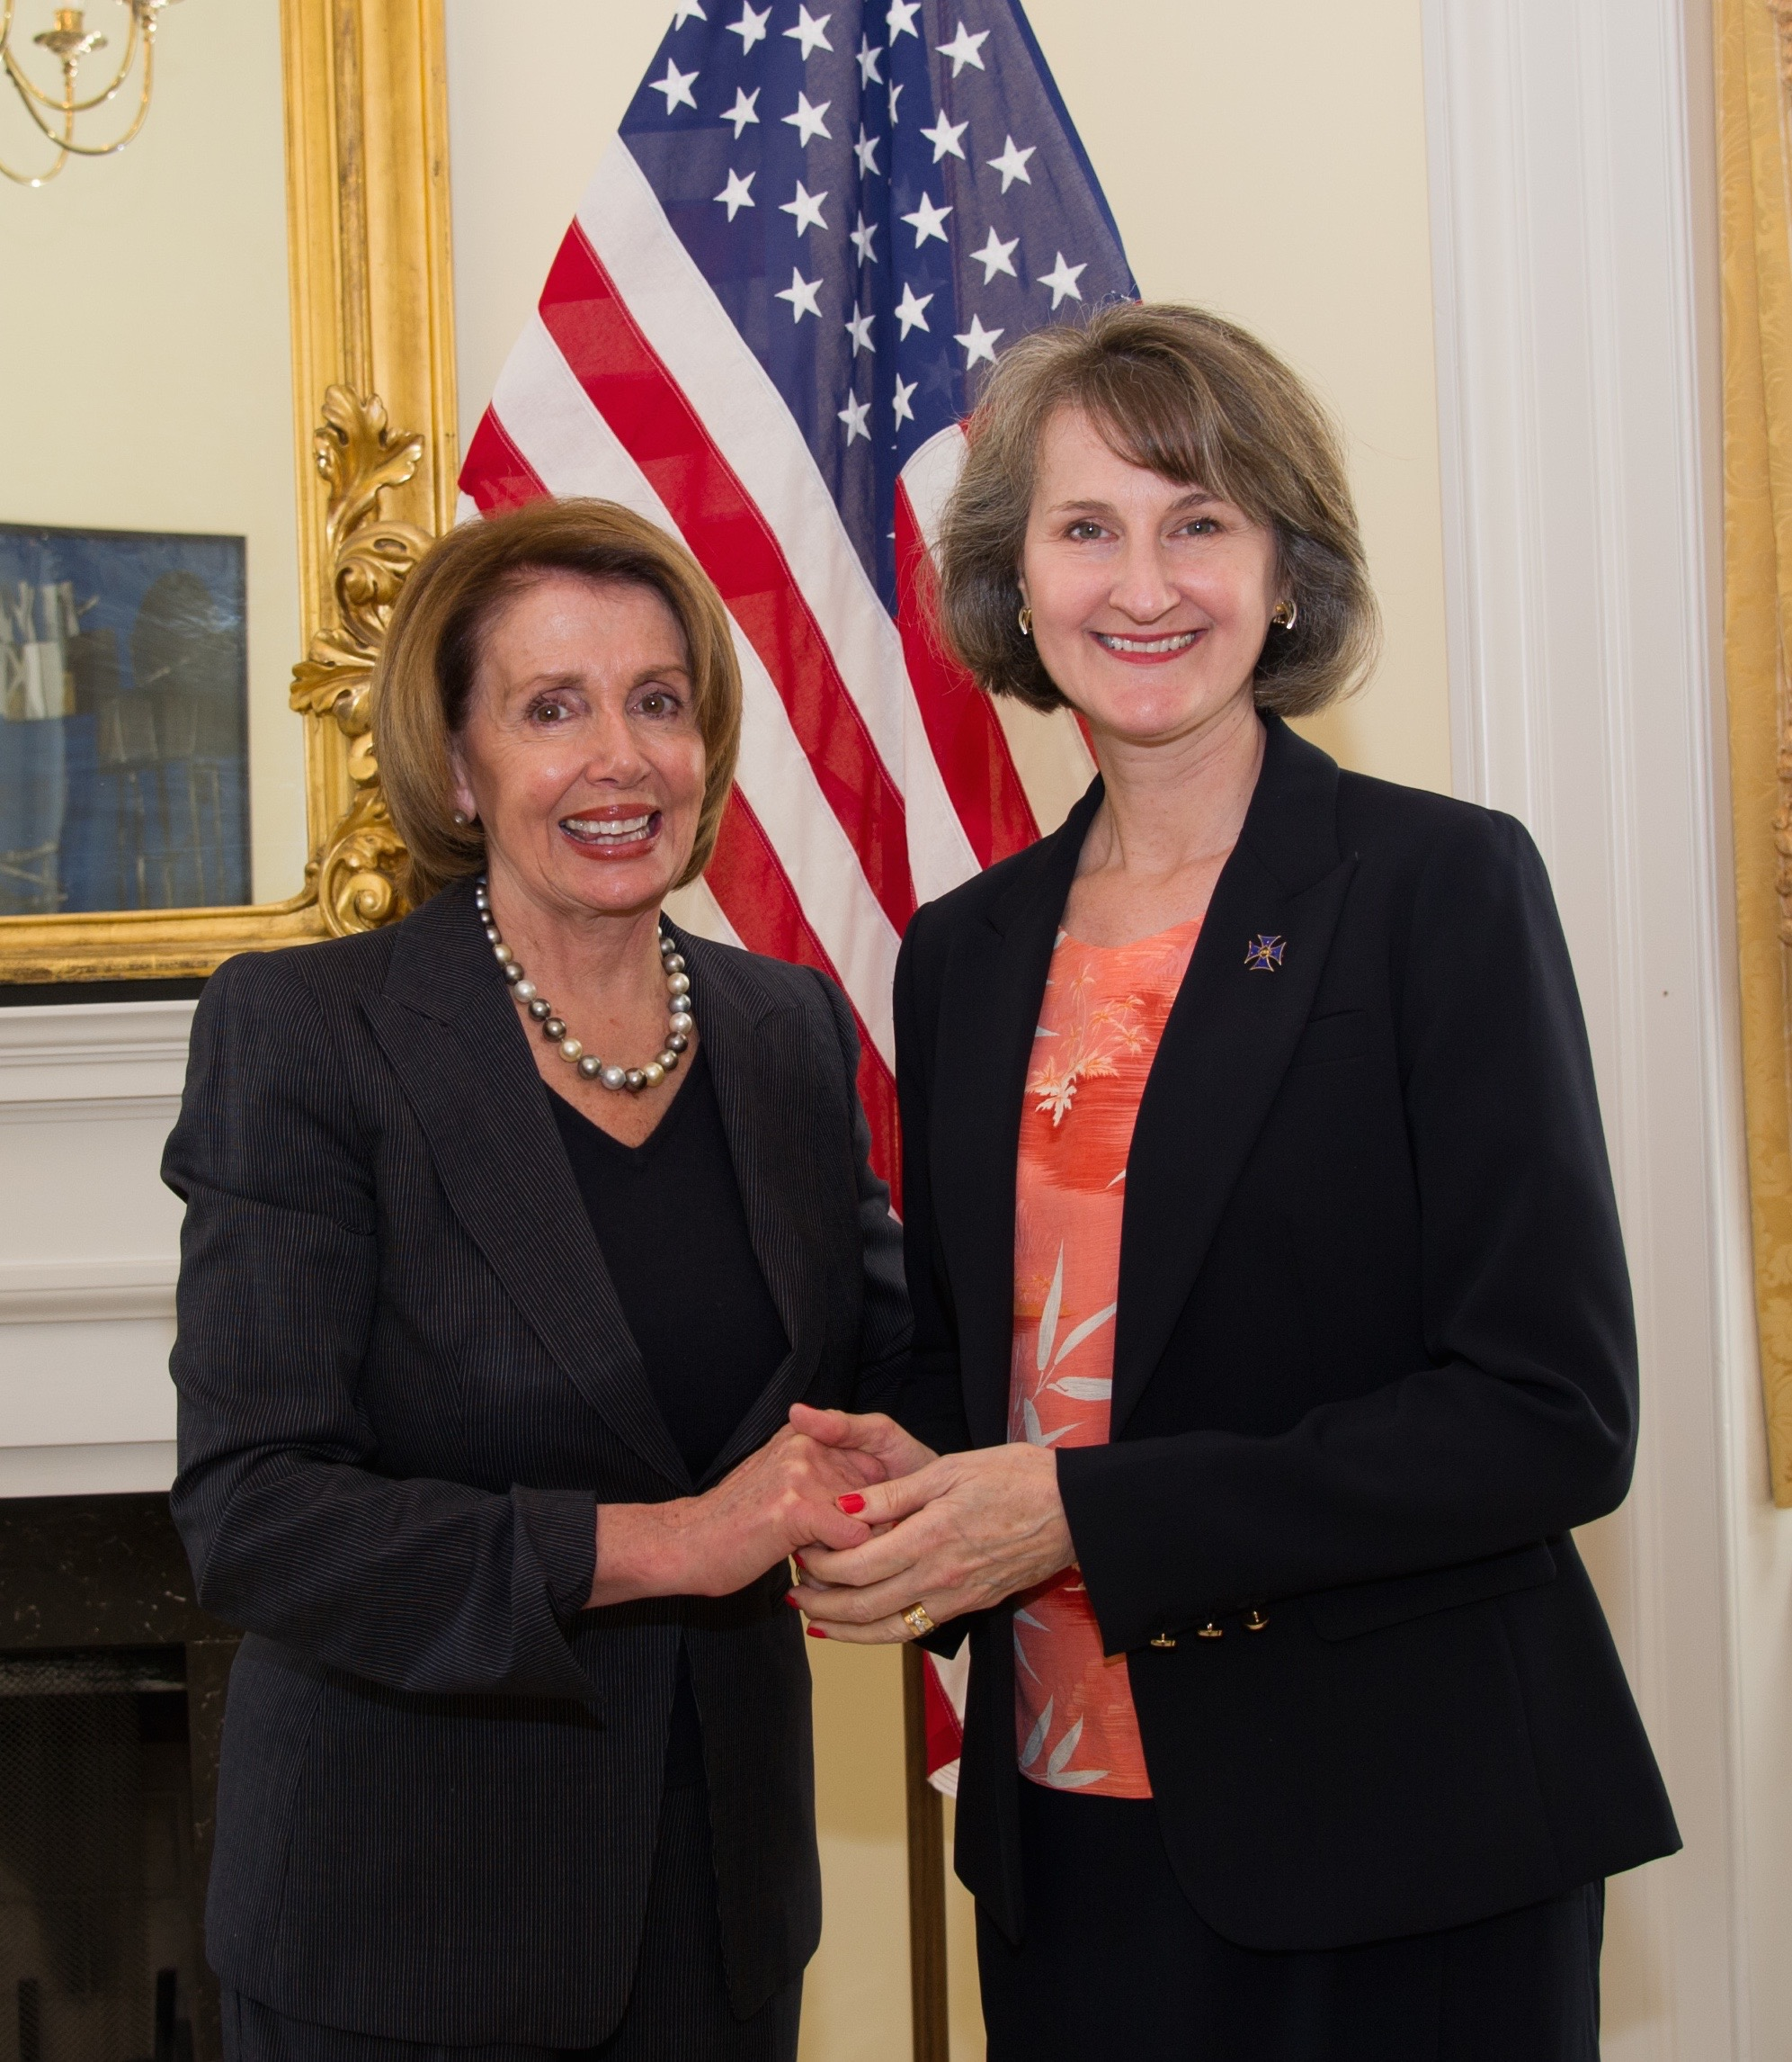
My background
Nurse practitioner, Gilchrist Hospice, UMMC
Consultant
  Center to Advance Palliative Care
  National Partnership for Hospice Innovation
  Univ of Washington
2015 RWJ Health Policy Fellow
  Nancy Pelosi staff
  Center for Medicare Medicaid Innovation
Prior Cover Girl marketing executive

Slide 6
My background
Nurse practitioner, Gilchrist Hospice, UMMC
Consultant
  Center to Advance Palliative Care
  National Partnership for Hospice Innovation
  Univ of Washington
2015 RWJ Health Policy Fellow
  Nancy Pelosi staff
  Center for Medicare Medicaid Innovation
Prior Cover Girl marketing executive

Slide 7
What this is and what it’s not
Is about introducing aspects of care for serious illness to the public (public education)
Not about clinical communication with patients
By public mean general people, potential patients but not necessarily patients or family caregivers
Education= outreach= messaging

Slide 8

Case Vignette
Laura, 72, enjoyed living in assisted living until noticed was having trouble keeping up with friends on walks.
Went to primary care doctor, then cardiologist, who found she had had silent heart attack.
Weeks later, Laura had another heart attack, and ended up in hospital with heart failure.
Nurse Nicole came to see Laura. Explained she was on palliative care team, which meant focusing on helping people live well, even with serious illness.
Nicole asked what was most important to Laura, then arranged support Laura didn’t know existed. That included medication for nausea, helping with how to talk about her illness with her grandchildren, and social worker to provide support to Laura’s husband.
A few weeks after starting palliative care, Laura starting to feel normal again and back to enjoying many of activities she used to do.

Slide 9
Poll Question:
How does this story differ from most you may have heard about palliative care?
It focuses on the benefits of palliative care and uses a positive, aspirational case
It says palliative care is the same thing as hospice.
It assumes people know what palliative care is.
It makes palliative care sound scary and unappealing.
Notes:
Correct answer is 1

Slide 10


How does this story differ from most you may have heard about palliative care?
ⓘ Start presenting to display the poll results on this slide.

Slide 11

Why This Is Needed

Slide 12
Our work depends on public interest
If you have…
Started a palliative care program
Done an advance care planning event at church
Talked to a community group about hospice
Then you have found that…
Most people—even clinicians—don’t understand about these types of care for serious illness

Slide 13
Evidence-based public education could help
Grants 2019-2025
The John A. Hartford Foundation & Cambia Health Foundation
AAHPM, CAPC, NHPCO, NCHPC, C-TAC, Conversation Project, Respecting Choices, Ariadne Lab Serious Illness Conversation project, VitalTalk, POLST
Project team
PI- Anthony Back MD, University of Washington
Marian Grant DNP, content and marketing consultant
Patrick McCabe, McCabe Messaging Partners

Slide 14
Common Public Education Pitfalls
Information vs engagement
  We educate to change behavior, not just inform
What we want them to know vs what they want to know
  What’s in it for them?
Thinking we’re the target audience
  We’re not

Slide 15

What the Research Shows

Slide 16
Tested language
“Serious” not “life-limiting” or “terminal” illness
Appealing palliative care definition
  Specialized medical care for people with serious illness.
  Goal to improve quality of life for both person and family.
  Provided by team of doctors, nurses, and other specialists who work with patient's other providers to provide extra layer of support.
  Appropriate at any age and at any stage in a serious illness
  Can be provided together with curative treatment.
Notes:
Serious illness: Health condition that carries high risk of mortality and either negatively impacts person’s daily function or quality of life, or excessively strains family caregivers

Slide 17
Public awareness and attitudes
2011-2020 published studies of consumers
Awareness/attitudes
  Advance care planning
  Palliative care
  Hospice
Findings
  Advance care planning awareness high, participation low
  Palliative care awareness low and misconceptions that it is for end of life
  Hospice awareness high, but concerns about quality & hastening death

Slide 18
Public Education Principles
₁ Talk up the benefits
These services and care improve peoples’ lives.
₂ Present choices for
every step
At every stage of an illness,
you have choices.
₃ Use stories
The stories that resonate are positive and aspirational.
₄ Invite dialogue—and not just once
The call to action is to talk with someone.
₅ Invoke a new team
Patients, families, clinicians, & community all have a role.

Slide 19



Tested Principles

Slide 20
Public & clinician focus groups
2019, Denver & Baltimore
8-9 per group; semi-structured moderation
Demographics
  Participants age 70+
  Participants age 50-70
  More than a third of the participants were ethnically diverse
  All had medical coverage of some kind
Did again in 2020 after Covid with little change

Slide 21
What they said about principles
Talk up the benefits
“It gives you a handle on the illness and it kind of broadens your mind. It takes some of the pain away, some of the anxiety away.”
Present choices for every step
“It gives you a sense of control. It’s what you want, not what they want.
Use stories
“You can relate to something like this because the alternative is to explain how 72% of the people do this and 32% of them do that. I’d rather have anecdotes about people.”
Invite dialogue
“The important thing is getting the conversation going, and this is not threatening. It’s reassuring to me.”
Invoke a new team
Participants liked the inclusivity of framing the conversation around “we” and naming all the players relevant to the conversation (patients, loved ones, care team).

Slide 22
What serious illness providers said
They’re hesitate to initiate these conversations.
“We get a lot of backlash from our patients; it’s hard to bring it up”
These providers want their expertise to be acknowledged.
“They don’t understand the extremes we can go to keep them alive”
They worry patients will choose care they don’t want to prescribe.
“My initial reaction [is] people are sugarcoating it and being ambiguous like, ‘We’re all here to do whatever you want.’”
They agreed on what hospice is, but not advance care planning or palliative care.
“I guess it depends upon what you mean by palliative care…”

Slide 23
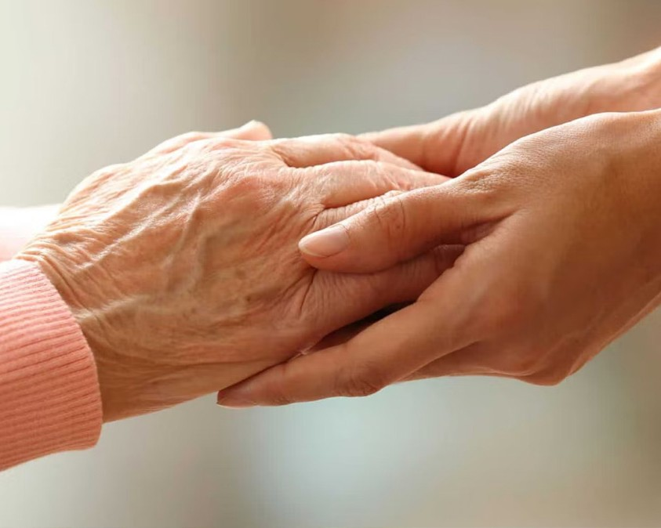
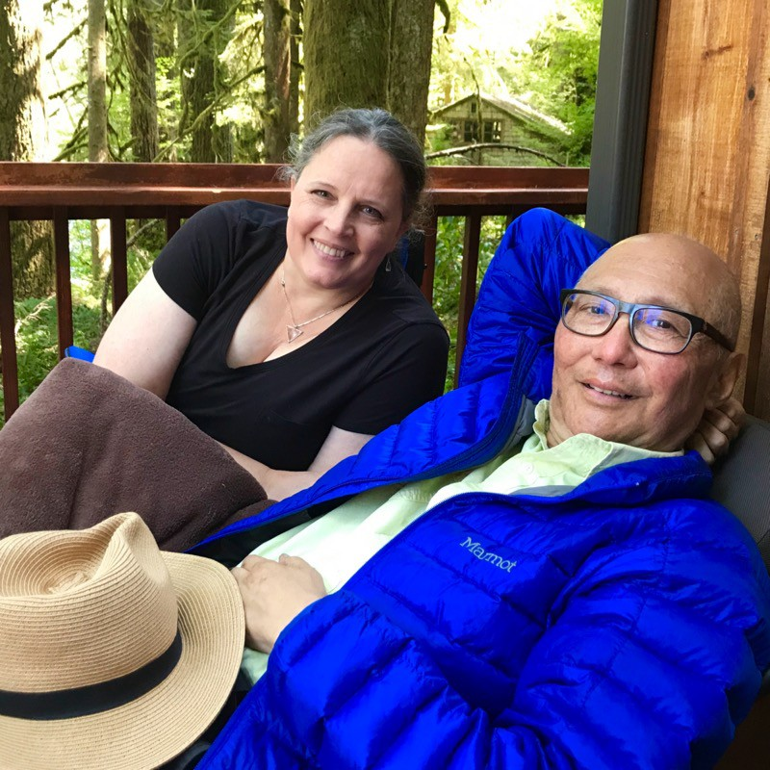
Visuals
Important to reinforce information and communicate emotion
Should be positive and aspirational
Should reinforce the benefits of serious illness care
Instead of hands, show what living well looks like

Slide 24
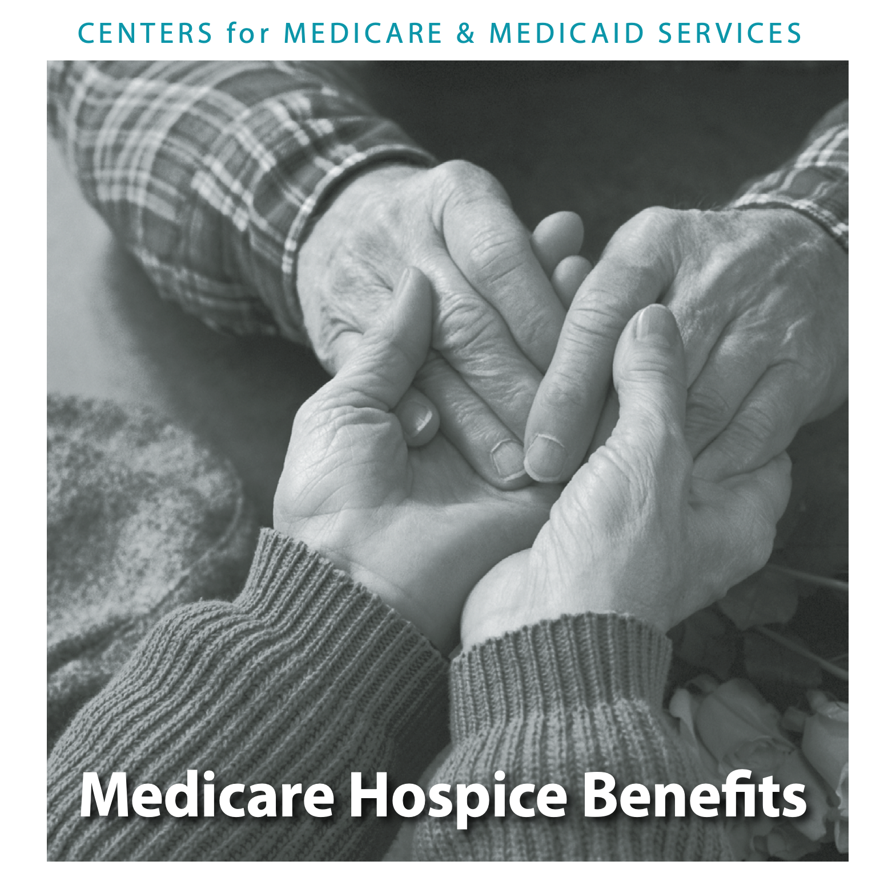
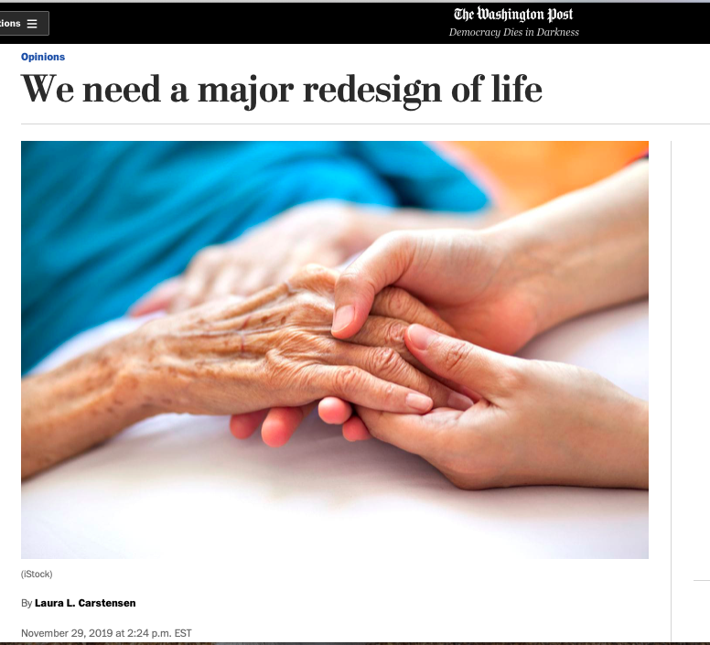
But we’ve trained CMS and the media

Slide 25

How To Use The Toolkit

Slide 26

Seriousillnessmessaging.org

Slide 27
How to use this toolkit
Whats in the toolkit
The 5 Principles
Talk Up the Benefits
Present Choices for Every Step
Use Stories — Positive Ones
Invite Dialogue — and Not Just Once
Invoke a New Team
We built this toolkit because we want to change how the public views serious illness care - so that more people experience the benefits of our work. Based on empirical research and decades of experience, we’ve developed resources that can help any health communicator effectively write content and hold positive conversations with the general public about the benefits of advance care planning, palliative care, and hospice.
Our field started with the pioneering work of hospice. The hospice public message was essentially: we’ll
give you a good death. That public message, we have learned, appeals to a small slice of the public. But the majority of laypeople don’t want to talk about dying, and their hesitation and fear have led to misconceptions about what we do.
Serious Illness
Messaging Toolkit

Slide 28



Quick Guides
Palliative Care
What you’ll learn
How best to introduce palliative care to the public.
Why *not* to message palliative care as end-of-life.
How to illustrate what palliative care does

Slide 29
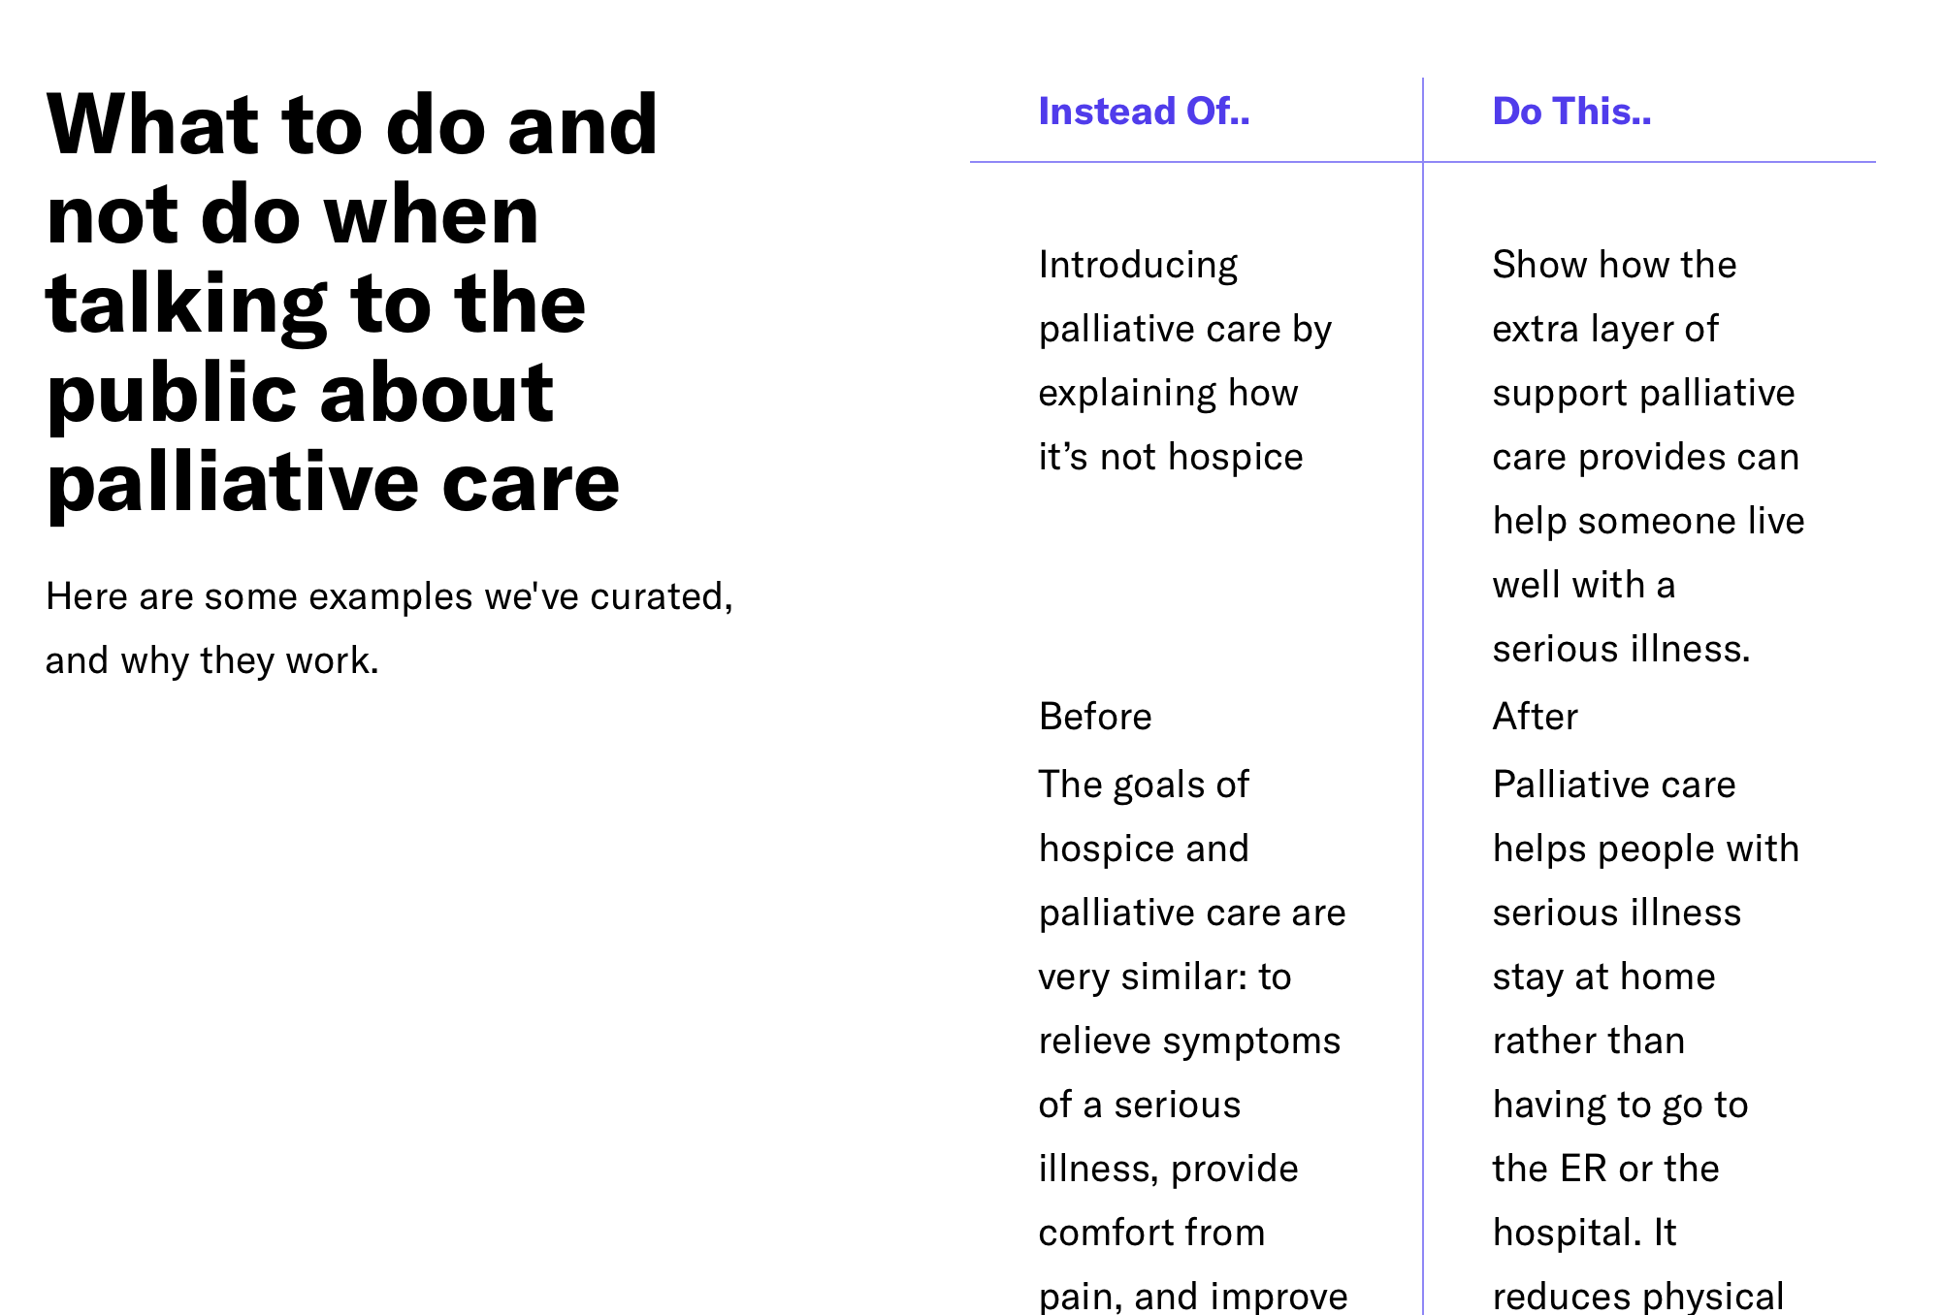

Slide 30

Quick Guides
Hospice
What You'll Learn
  The best ways to talk about hospice.
  How to talk about end of life in a positive way.
  Why we shouldn't try to message "a good death".

Slide 31
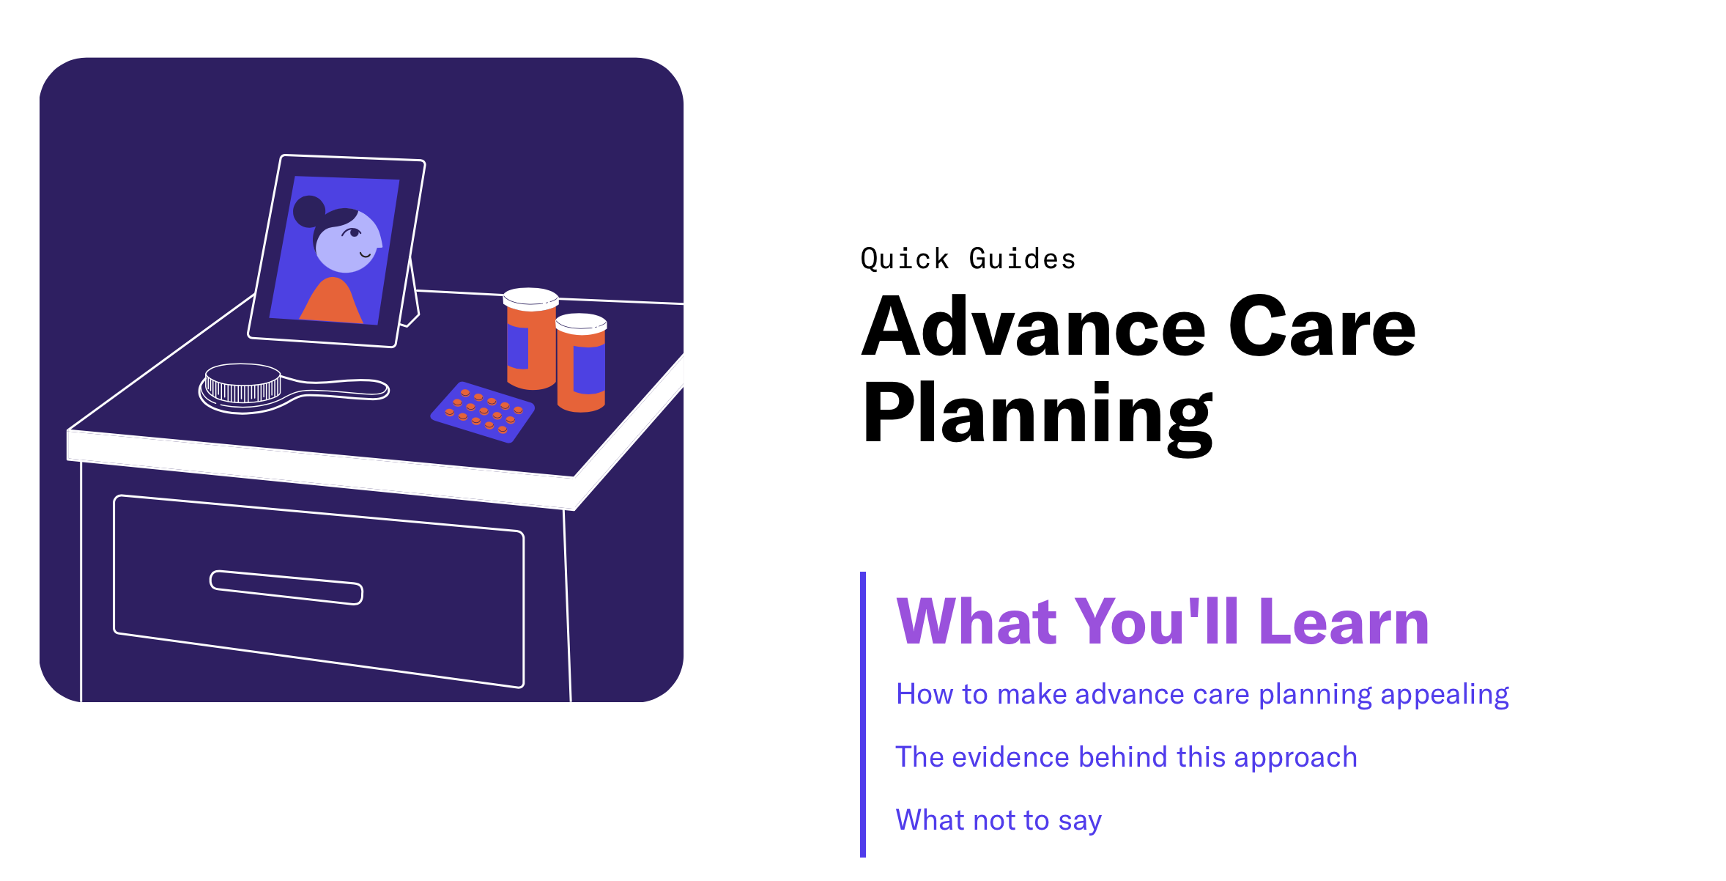

Slide 32
Bonus: Educating Clinicians

Slide 35
Palliative care clinical heart failure story
Robert, 68, is a new patient with heart failure with reduced ejection fraction you, his cardiologist, saw after his most recent heart attack. He’s not an interventional candidate because of small vessel disease.
He’s undertreated from your cardiology perspective--his regimen has not been optimized--and he's not doing well. His quality of life is poor. However, he seems unwilling to consider therapeutic options, and you’re not sure how to persuade him. A colleague suggested a palliative care consultation.
The palliative care team was able to identify depression and that Robert's resistance to further treatment stemmed from guilt that his lifestyle had caused his current problems. The consultant started him on an antidepressant, the palliative care social worker provided some counseling, and Robert was able understand the rationale for the options you wanted to offer (the consultant called you, a nice touch).
When he returned to you, Robert was able to commit to more intensive medical management and consideration of a defibrillator, and you felt good about providing him state-of-the-science care--and helping him feel better.

Slide 36

Steal These Messages

Slide 37
Steal These Messages
All of the messaging in this section is copyright-free. No royalties. No restrictions. Copy and paste as you please, and bring these to life in whatever ways you need.
are meant for you to take. Our only ask is that you take the time to really understand how the
five messaging principles come into play here in the words both present and absent. Our hope is that these messages will be brought to life through your organization’s communications and ultimately, be used to better connect with the public about advance care planning, palliative care, or hospice services.
We’ve taken the time to write evidence-based messages that you can just copy and paste.
Whether you want to steal as-is, edit slightly to fit your organization’s needs, or use as inspiration, these messages

Slide 38
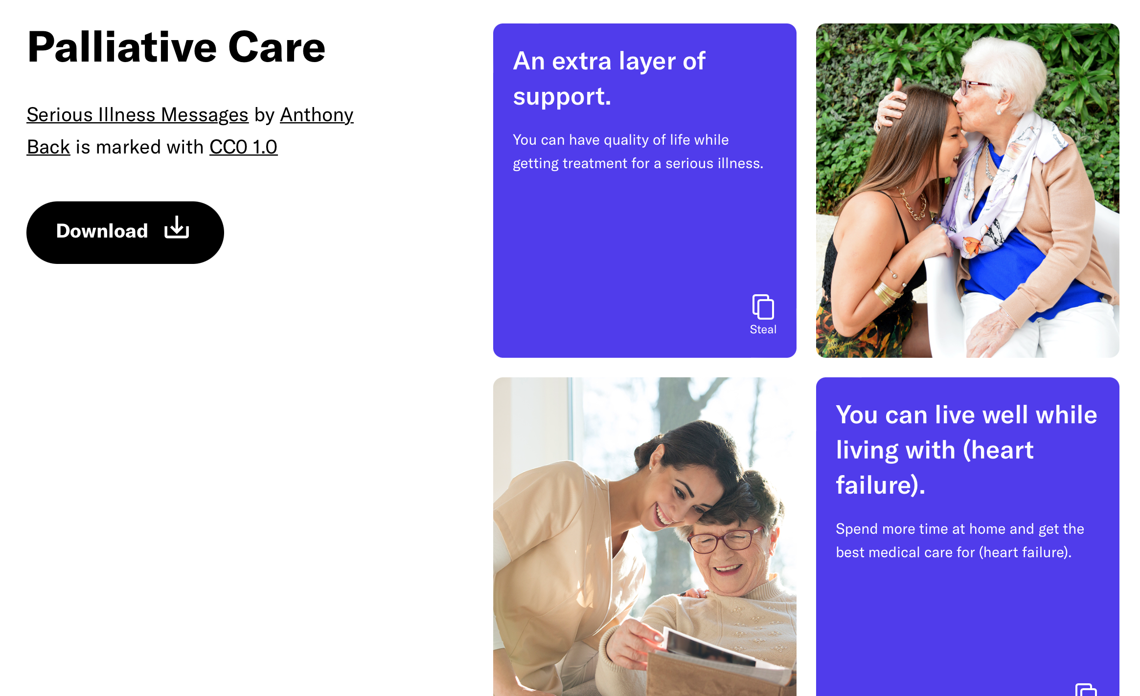

Slide 39
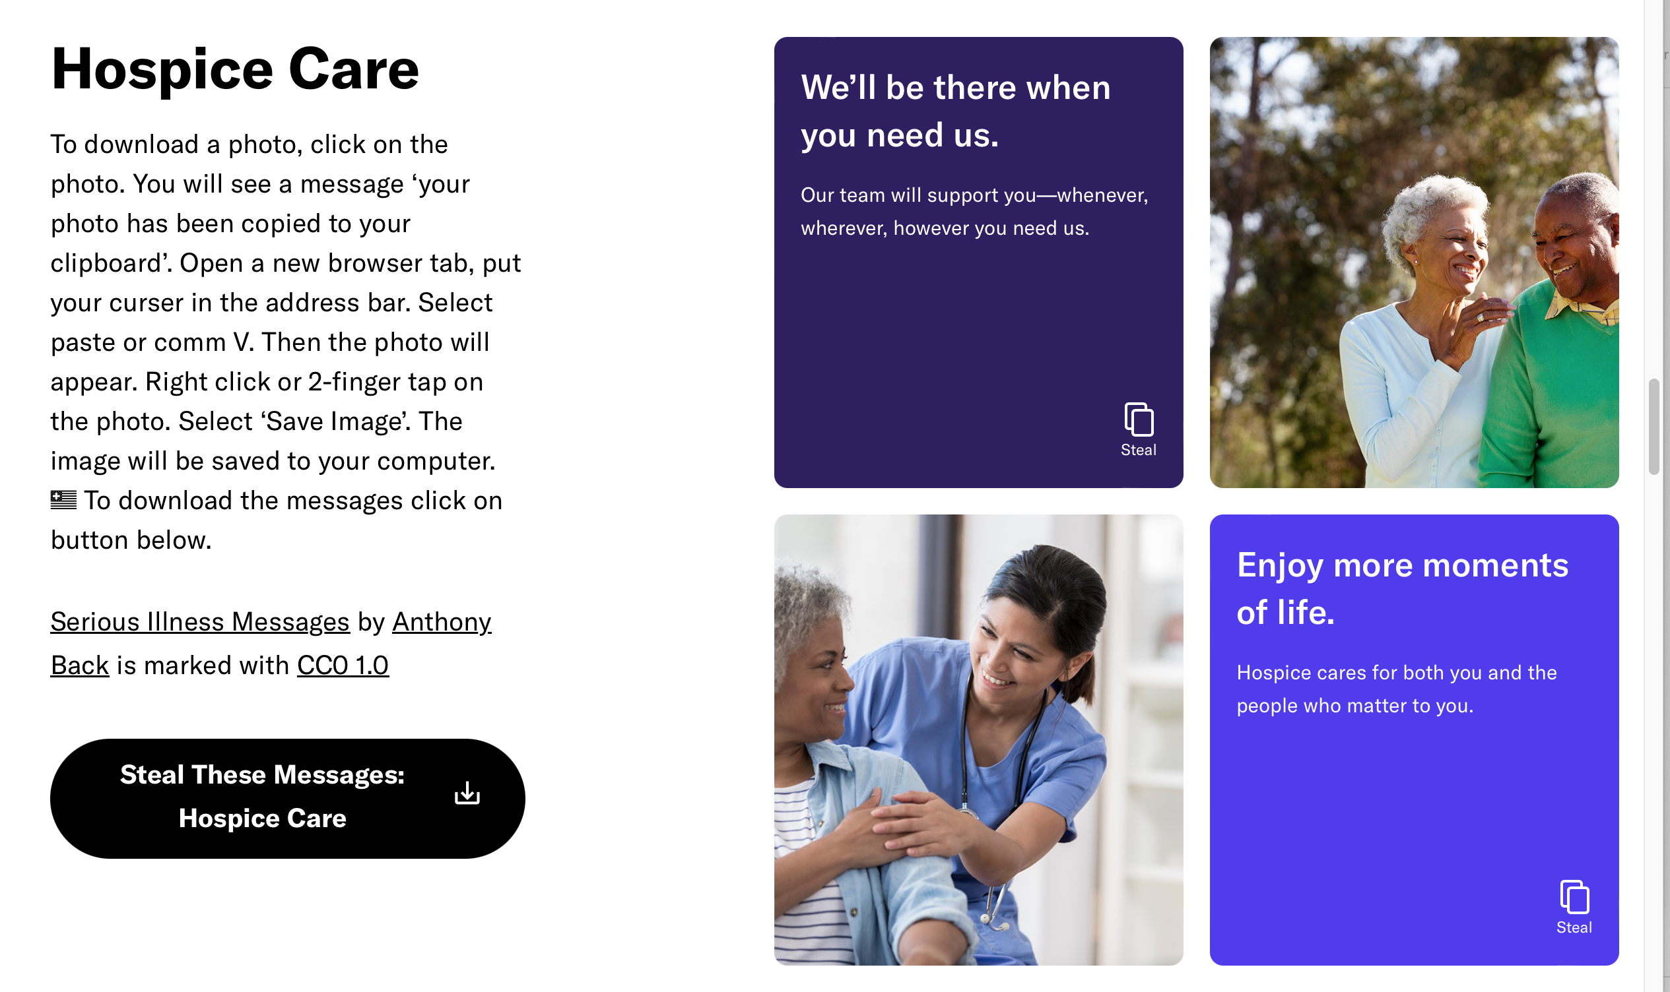

Slide 40
Leading organizations using principles
CAPC public website www.GetPalliativeCare.org
The Conversation Project website https://theconversationproject.org
National Hospice and Palliative Care Organization updated public www.CaringInfo.org website
      2022 avg monthly visitors +40%
      2023 traffic up +59%
WebMD info on palliative care

Slide 41
Take Home Messages
Educate about the benefits with positive stories

Slide 42
Take Home Messages
Don’t link palliative care with hospice
                Death

Slide 43
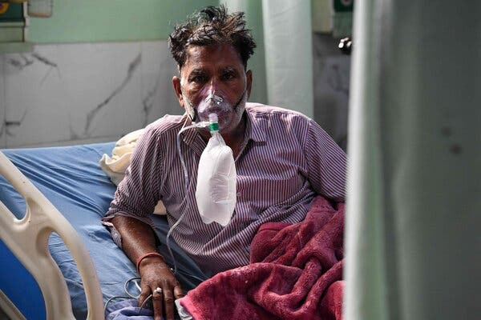
Take Home Messages
Stop with the hands or obvious patients

Slide 44
Bibliography
M. S. Grant, A. L. Back, N. S. Dettmar. Public Perceptions of Advance Care Planning, Palliative Care, and Hospice: A Scoping Review. J Pall Med. Jan 2021.46-52. http://doi.org/10.1089/jpm.2020.0111
A. L. Back, M. S. Grant, P. J. McCabe. Public Messaging for Serious Illness Care in the Age of Coronavirus Disease: Cutting through Misconceptions, Mixed Feelings, and Distrust, J Pall Med. Jun 2021.816-819. http://doi.org/10.1089/jpm.2020.0719
A. L. Back, M. R. Warner, K. M. Beard, M. H. Goodnow, L. A. Constans, P. J. McCabe. Use of Messaging Principles to Design a Facebook Ad Promoting Public Engagement in Serious Illness Care for National Healthcare Decisions Day. J Pall Med. Dec 2021.1762-1765. http://doi.org/1 0.1089/jpm.2021.0346
Finding the Right Messages for Serious Illness Care, CSU Shirly Haynes Institute for Palliative Care, https://csupalliativecare.org/finding-t he-right-messages-for-serious-illness-care/
Massachusetts Serious Illness Coalition 2021 research http://maseriouscare.org/uploads/MCSIC-2020-2021-Public-Experience-Research- Findings.pdf

Slide 45
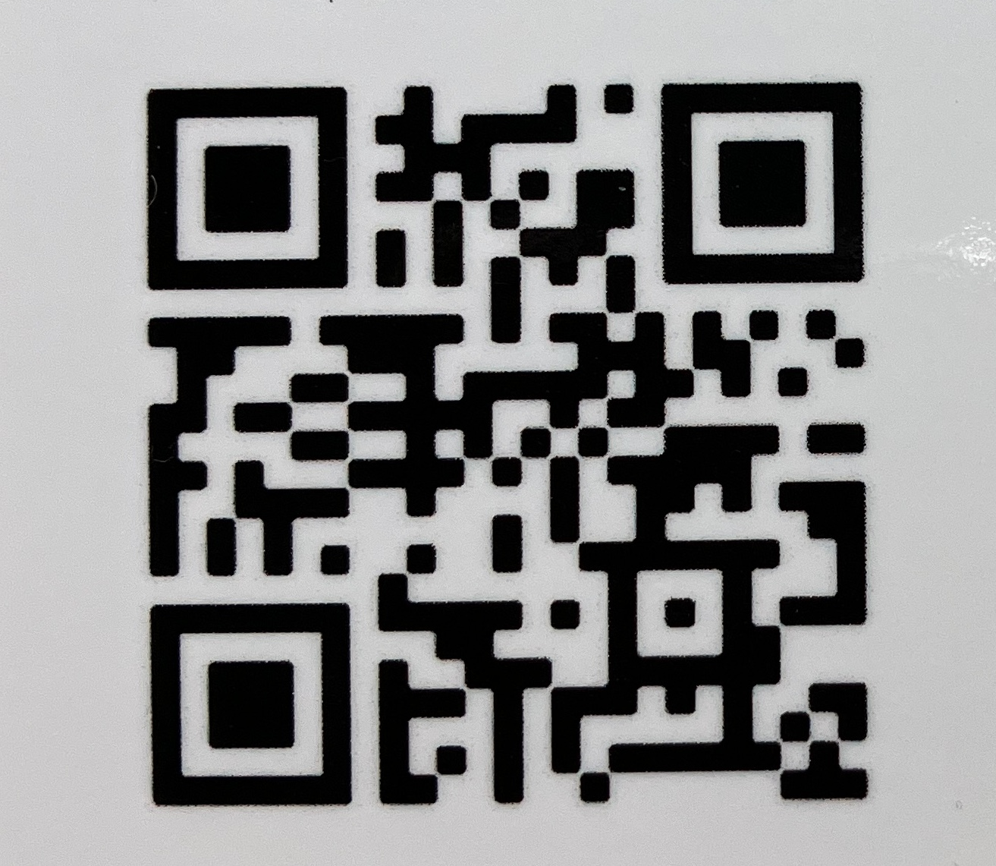
Seriousillnessmessaging.org
Marian Grant consultant@MarianGrant.com

